Slide 1
Dental lab equipment
Lecture 2, first year
Burn out furnace and Centrifugal casting machine

Slide 2
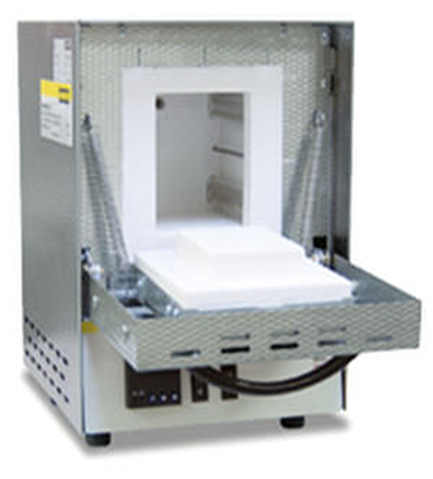
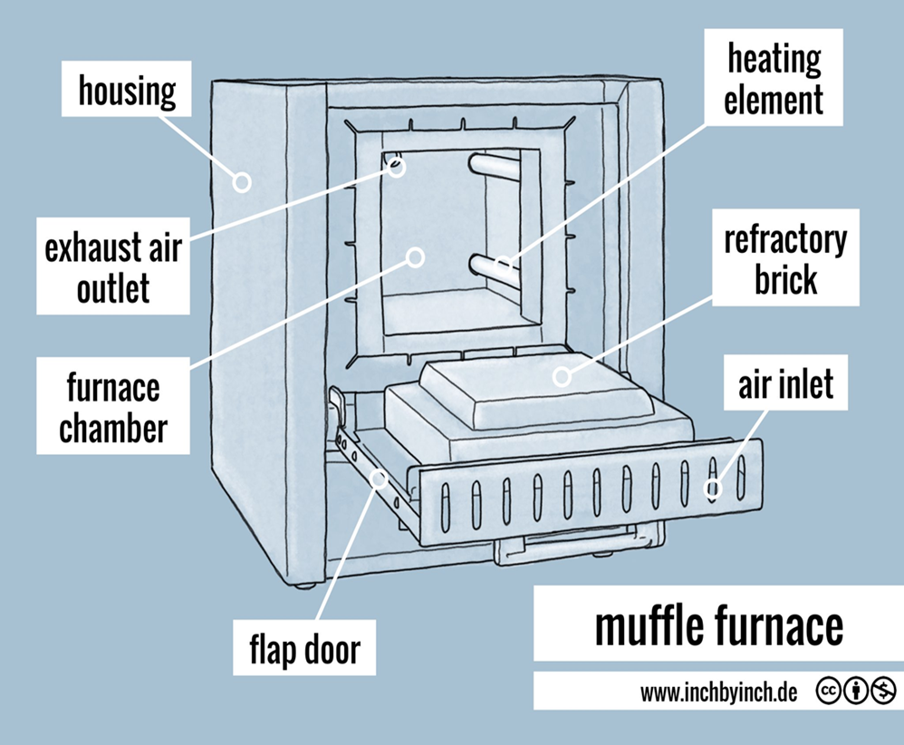
Muffle oven ( burn out furnace )
Is a furnace with external heated chamber , the walls radiantly heat the content of the chamber, so that the material being heated has no contact with the flame, and a high temperature atmosphere is created ( 1200 – more than 2000 c ) The furnace is heated by electric elements and is insulated with Ceramic fiber .

Slide 3
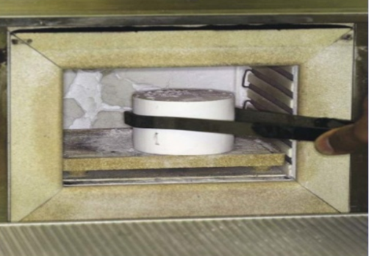
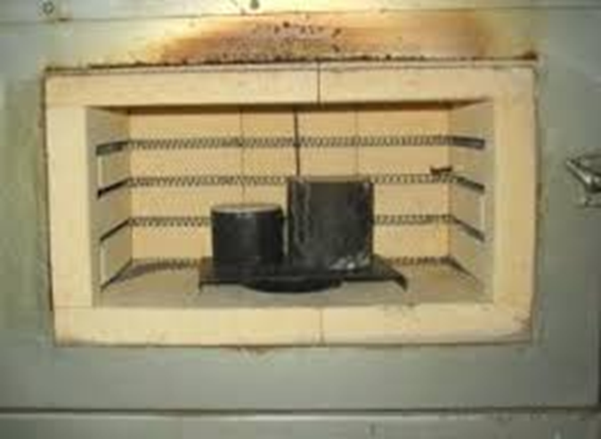
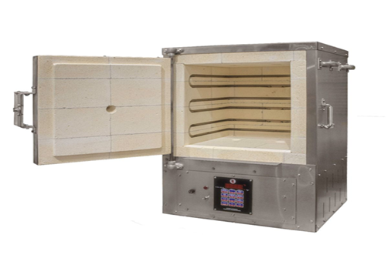
Uses : In chrome – cobalt and crown and bridge , 1- wax elimination , 2- heating investment models , There are many types and sizes

Slide 4
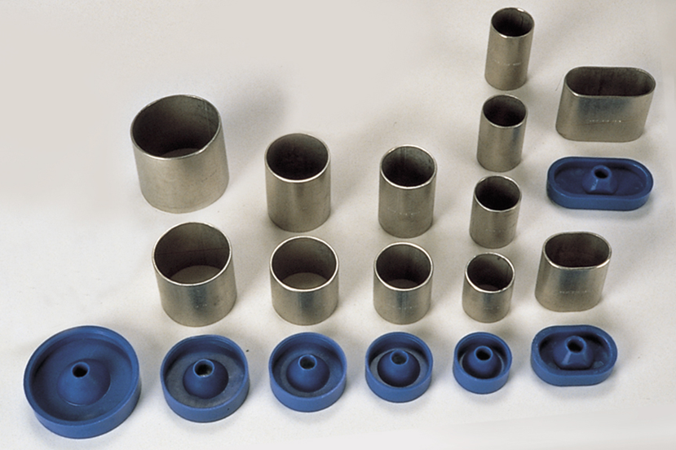
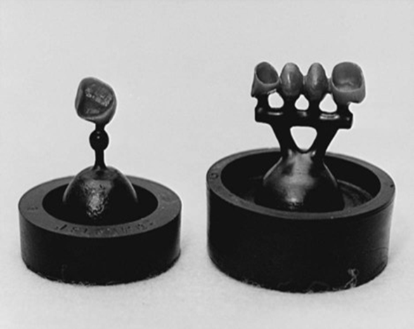
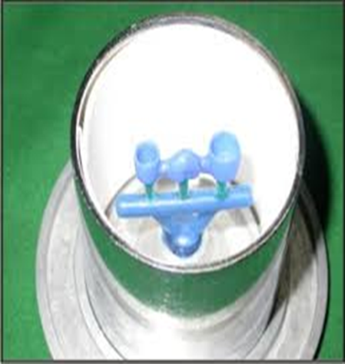
Casting ring
They are rings used to confine fluid investment material around the wax pattern while the investment sets , it comes in different sizes , made from stainless steel or plastic , with plastic ring former

Slide 5
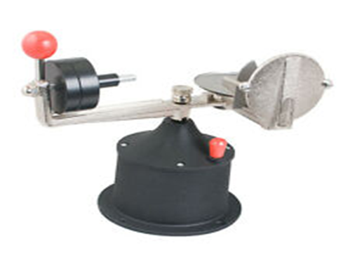
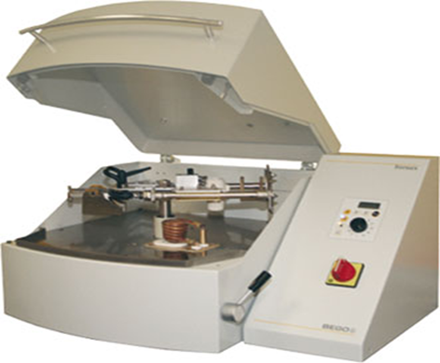
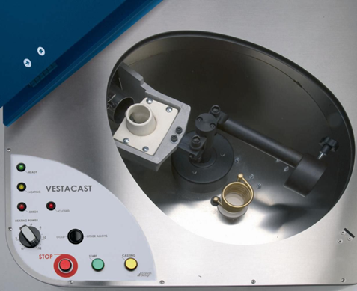
Centrifugal Casting machines are an equipment makes use of centrifugal force to thrust the liquid metal into the mold. They are used to melt and cast a variety of alloys. for casting removable partial denture frameworks and crown and bridge
Types of centrifugal casting machine:
1- conventional ( spring wound ) centrifugal casting machine
2- Electric centrifugal casting machine
3- Vestacast centrifugal casting machine
1
2
3

Slide 6
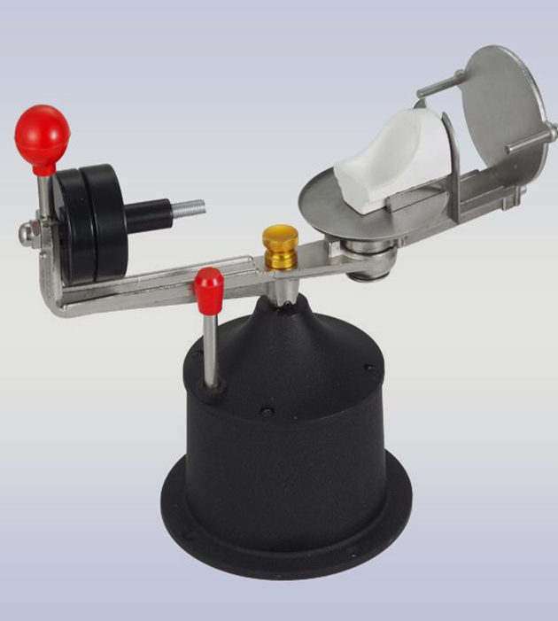
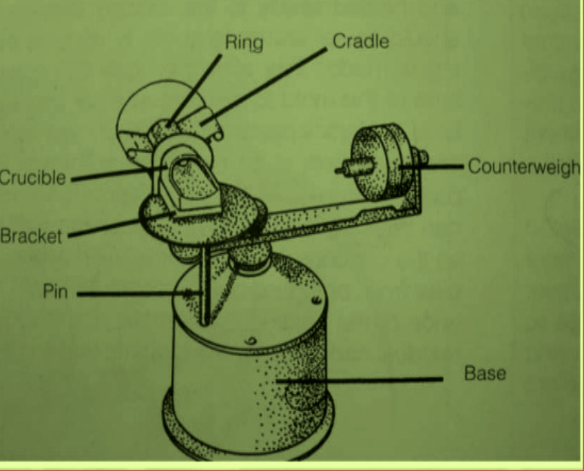
Parts of conventional centrifugal casting machine
1- base – is the support center, it must have high strength and located in non- moving surface to avoid vibration or rotation during casting it contains movement lock and the spring
2- pin – contain the spring used to rotate the arm during casting process

Slide 7
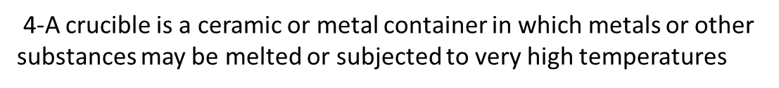
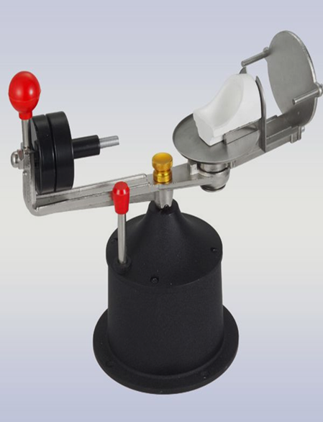
3- counterweight , a heavy metal which can be increased and decreased to balance the weight of the ring the counterweight is placed on the balancing arm which is connected to the base
4
3

Slide 8
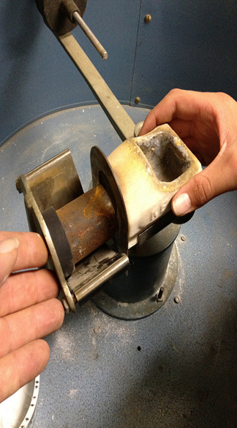

5- cradle : is metal housing to seat the casting ring
6- head plate :support the casting ring from the back to prevent its displacement
7- bracket: fix the crucible in fixed position and prevent its movement during rotation
6
5

Slide 9
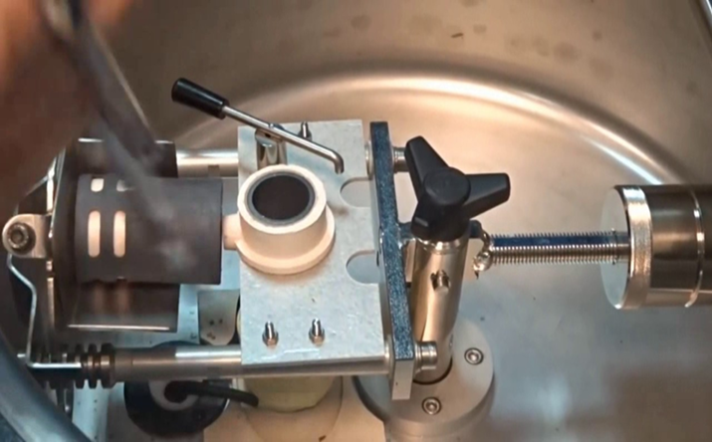
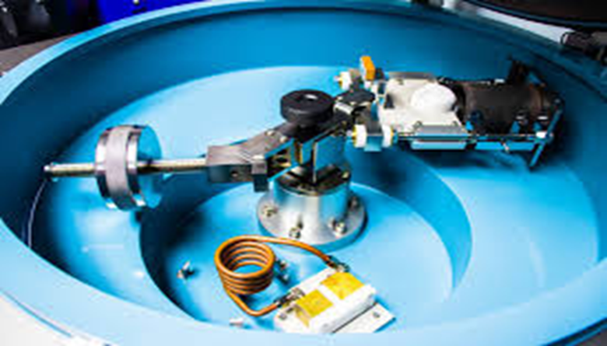
Electrical resistance heated centrifuge casting machine
1.The alloy is placed in graphite or ceramic crucible and heated with the help of a resistance based heating unit
2.The crucible of this unit is located flush with casting ring
3.This allow alloy to stay molten for slightly longer time which ensure continuous flow of molten metal and proper solidification from tip casting to the button surface

Slide 10
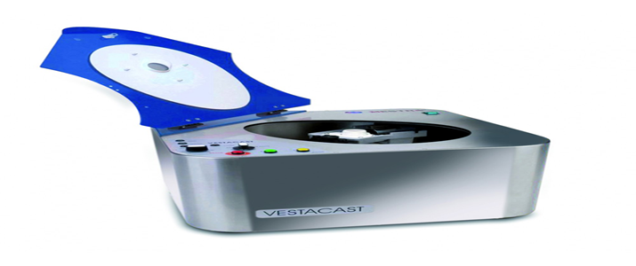
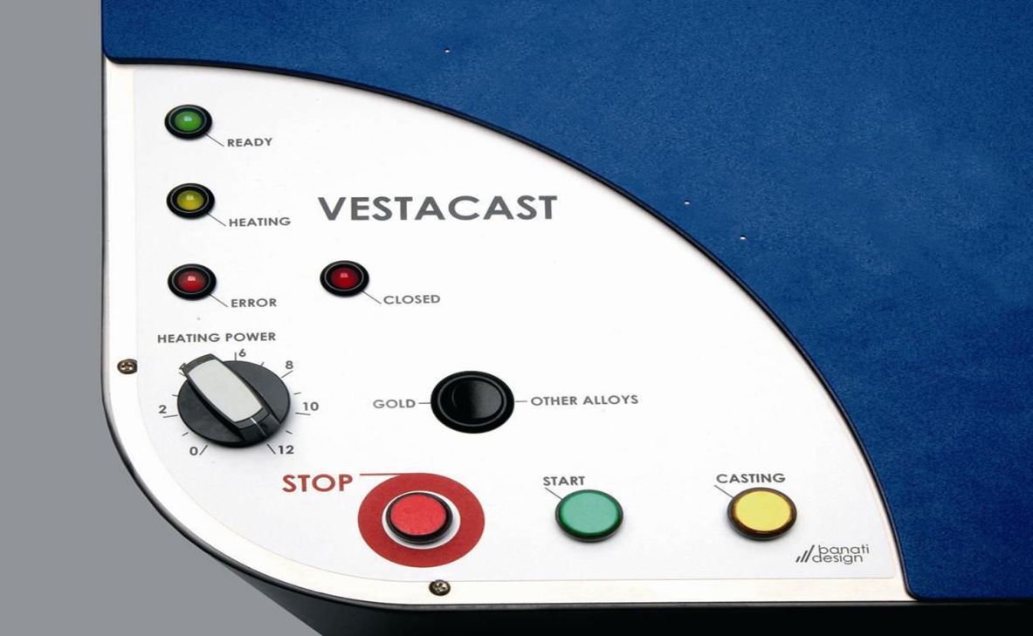
Vestacast centrifugal casting machine
Vestacast is a compact, easy to operate induction casting machine for melting and casting all dental alloys up to 1750 ºC with exception of titanium and titanium alloys

Slide 12

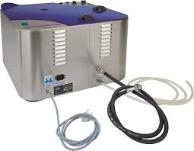
Induction coil
Water supply for cooling the induction coil
crucible
counterweight

Slide 13


