Slide 1
Dipping wax heater, Electronic spatula and bio star

Slide 2
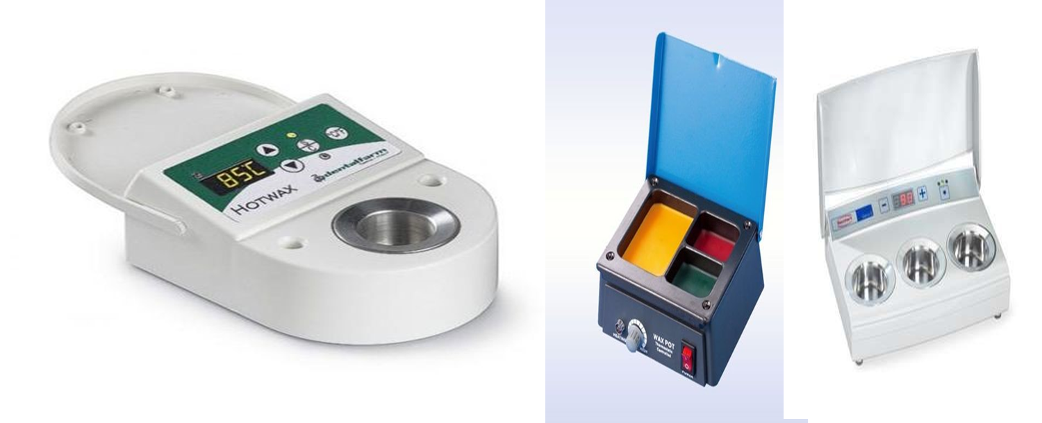
Dipping wax heater ( wax dipping pot ) :
The Digital Dipping Pot is designed to melt a variety of waxes used in the dental laboratory. The unit can heat wax quickly and maintain its liquid state.

Slide 3
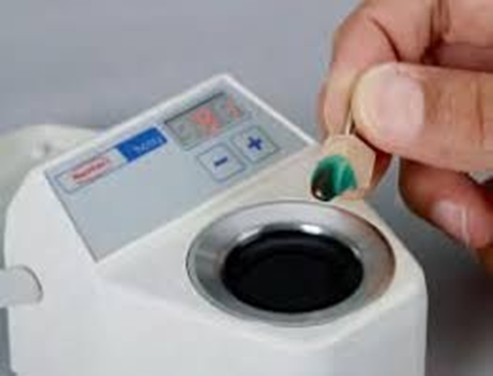
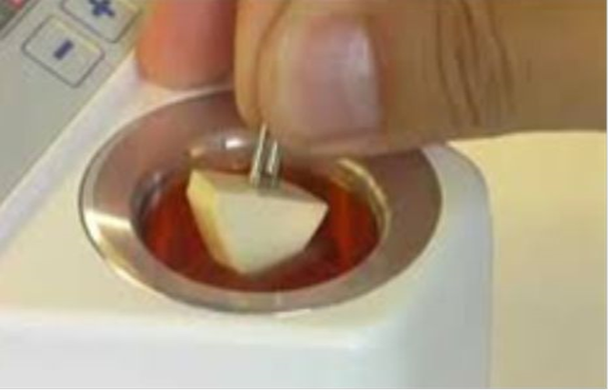
It consist an Electronic controlled heater (temperature from 30° to 120°C) for rapid and controlled melting of the most commonly used waxes in the dental laboratories.
The small-sized melting pot allows to achieve quickly the preset temperature, ideally suited for the wax dipping technique. It may be equipped with more than one pot

Slide 4
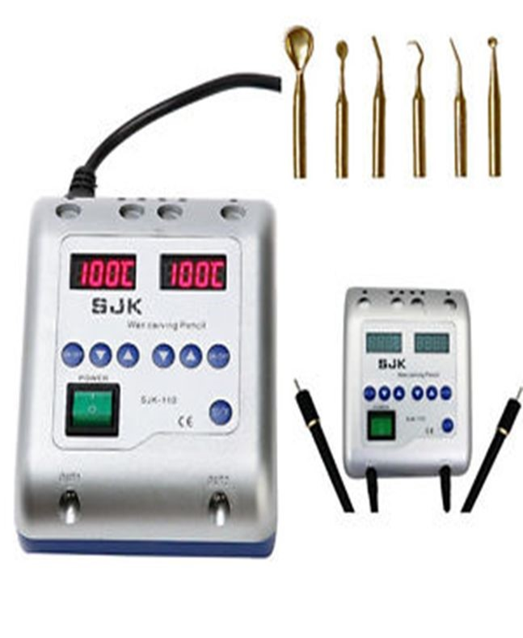
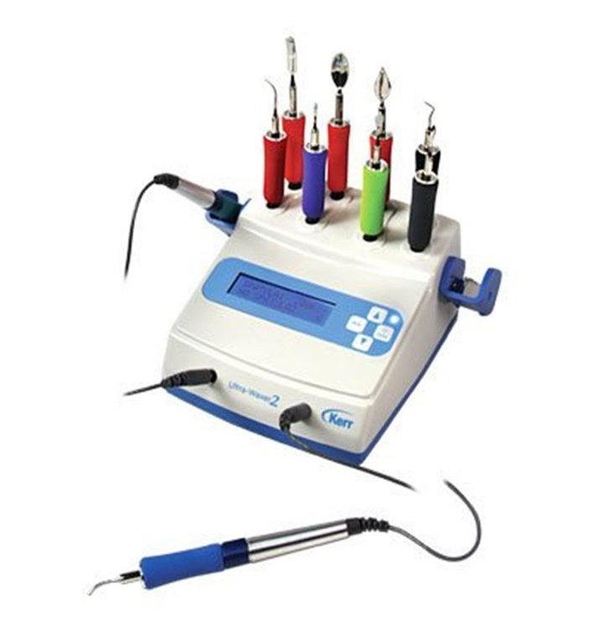
Electric Wax Spatulas. The electric spatula is a machine that in the dentistry laboratory is very useful and easy to handle for performing dental modeling .
It works by means of a heat system that receives from the motor and connects with the tip of the spatula by means of a cable.

Slide 5
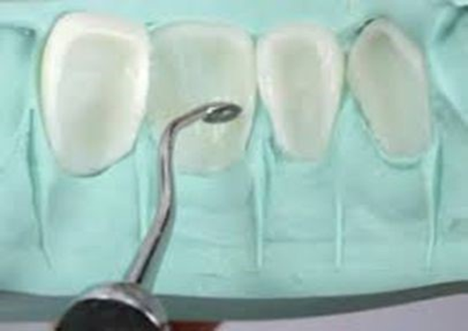
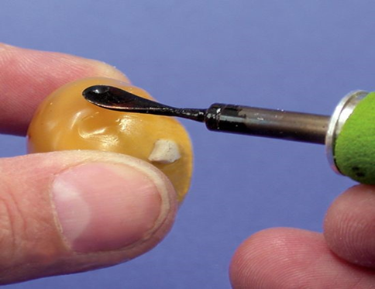
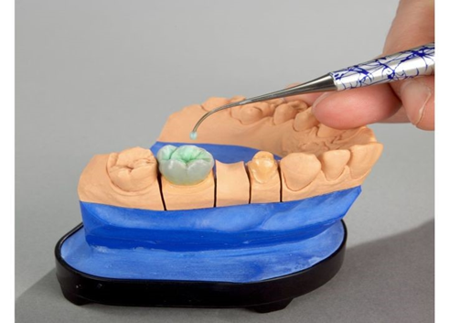
advantage of electric carver :
1-The working temperature can be kept even after power off.
2-Electric carving wax knife is more efficient than other wax metal knife
3- can work at temperatures 50 ℃ to 200 .

Slide 6
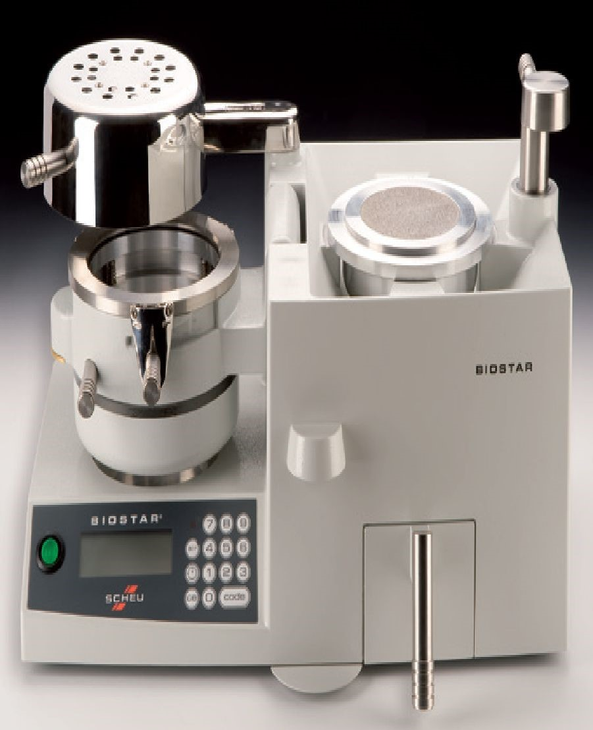
Vacuum form machine : are machine used to form dental appliance ( night guard , bite raising appliance , orthodontic appliance, and other ) , using thermoplastic materials and application of heat and pressure . There are many types of these machines , the most common commercial name is Biostar

Slide 7
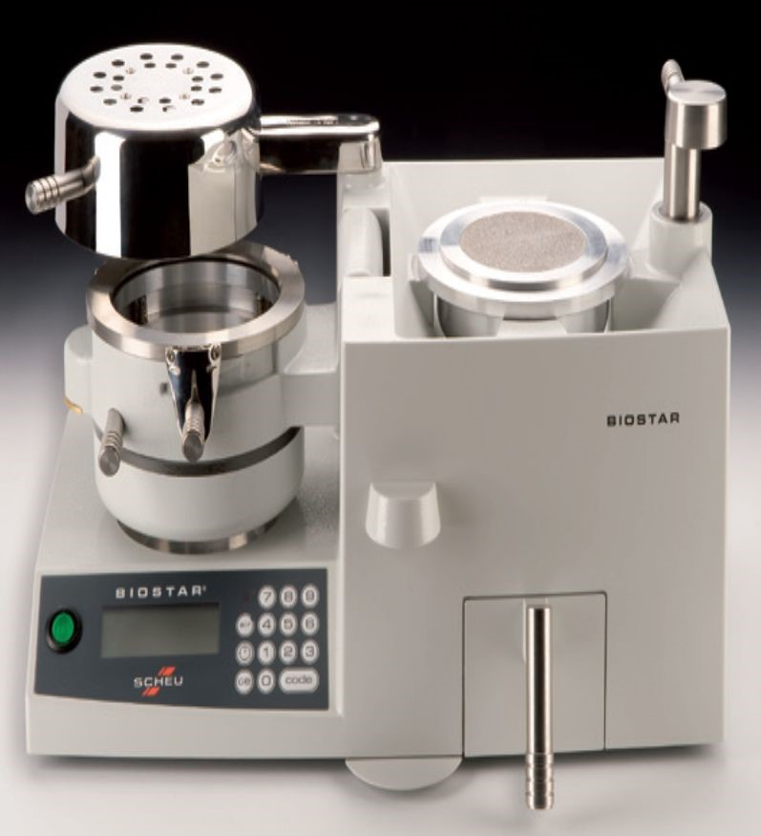

1-Heating Element: Found on left side of machine, swivels from front to back and is used to softer thermal plastic
2-Pressure Chamber: Compartment that the thermal- plastic held , hrated and formed over a dental model.
3-Locking Handle: Holds chamber in molding position and allow air pressure to enter chamber
3
7
4
2
6
4-Clamping Frame: Secures thermal-plastic to chamber
5

Slide 8
5-Pellet Drawer: Contains overflow of pellets.
6. Bar Code Scanner: Automatically enters the correct processing information for the thermal-plastic.
7.pellet cup : container that hold dental model, and pellet the holes At the base of the pellet cup For air escape in pressure
suction
7
6
5

Slide 9
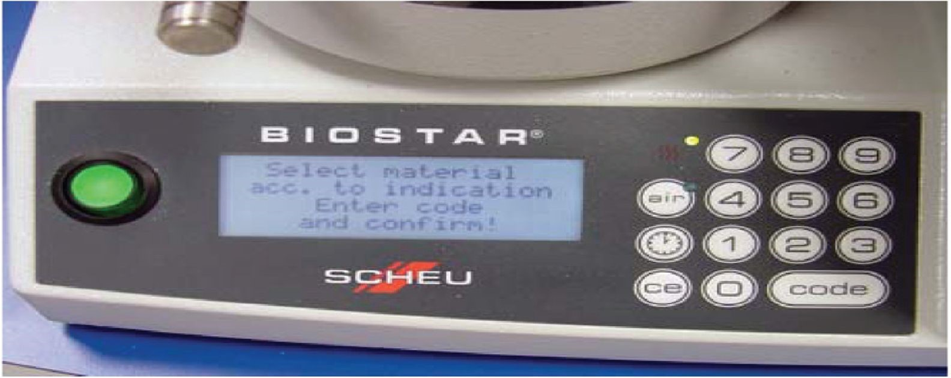
On/Off Switch: Power switch.
Code Button: Programs heating and cooling , operating times for material heating and pressure forming
Air Button: Removes air pressure from chamber
CE Button: Erases information placed in memory
Time Button: (Illustration of clock) Allows operator to manually program heating and pressure molding
times, separately.
CODE: Three-digit code to identify heating and pressure molding times.

Slide 10
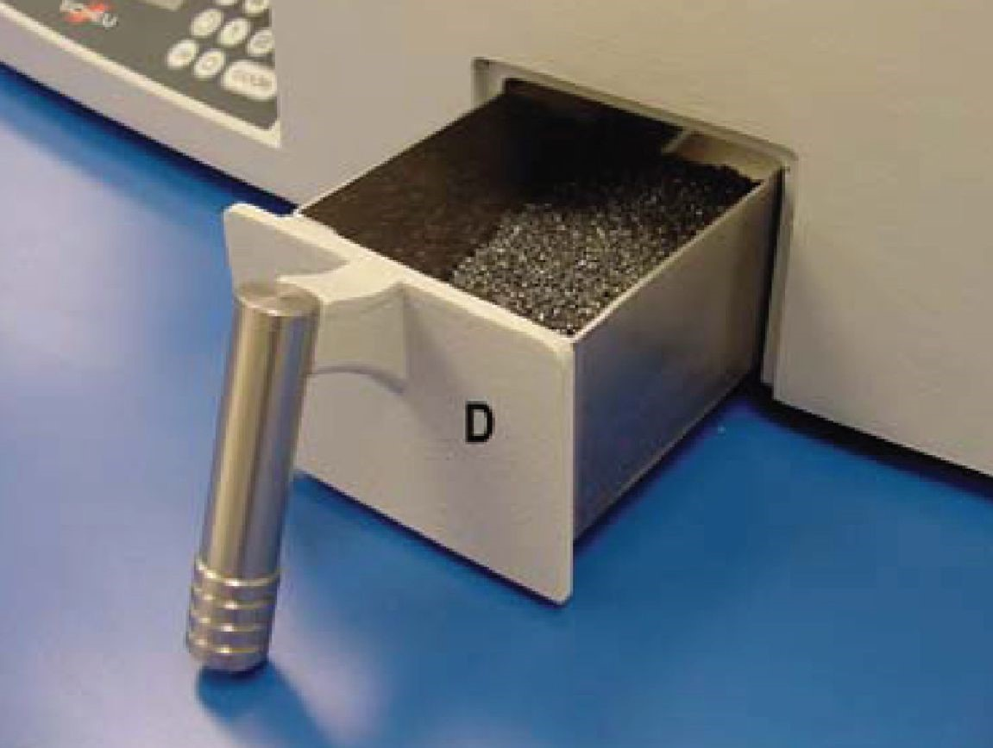
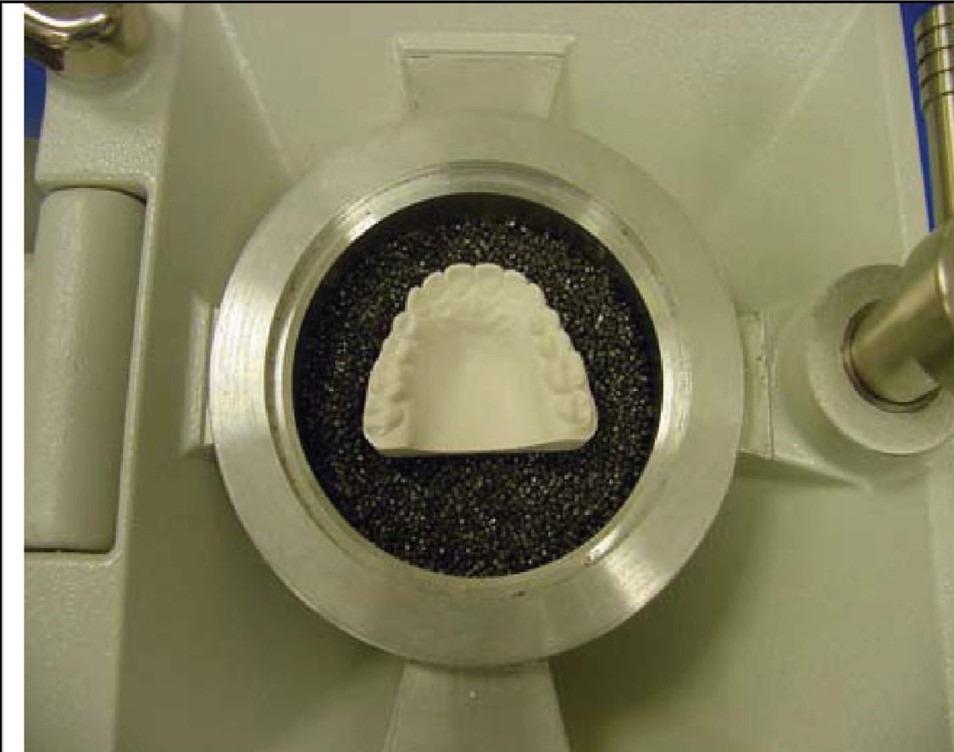
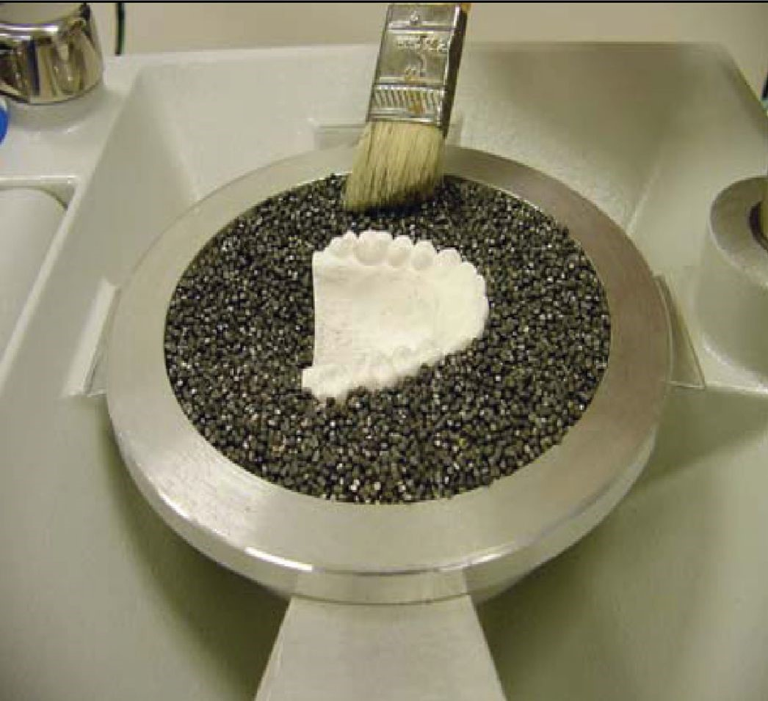
Pellet cup are used
1-To hold the model in the proper level
2- To prevent the thermal-plastic material from stretching over areas of the model that are not part of the appliance design ,The plastic sheet is placed in the frame on the pressure
chamber under the heater

Slide 11
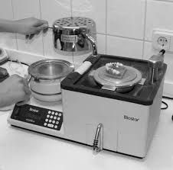
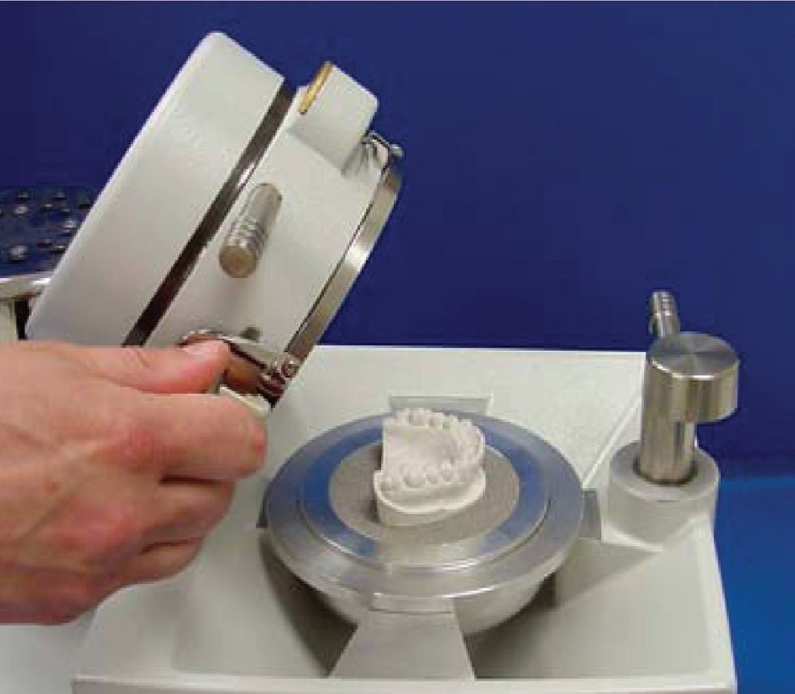
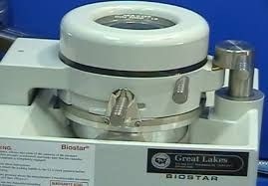
When heating of the plastic sheet is completed according to the code, the heater is pushed aside and the pressure chamber with the plastic held by the frame is turned over the cast with action of pressure suction the frame is adapted on the cast

Slide 12
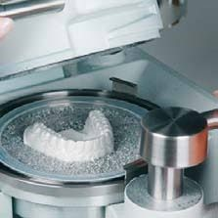
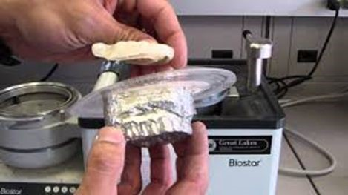
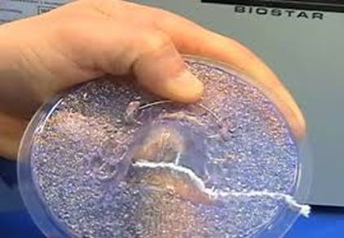
The cast with the adapted plastic sheet are removed and separated , and finished

Slide 13


