Slide 1
Dental lab equipment
CAD- CAM IN DENTISTRY

Slide 2
CAD/CAM dentistry is a field of dentistry and prosthodontics using CAD/CAM (computer-aided design and computer-aided manufacturing) to improve the design and creation of dental restorations, especially dental prostheses, including crowns, crown lays, veneers, inlays and onlays, fixed bridges, dental implant ...

Slide 3
CAD CAM was introduced in 1970s. Since then, its use in dentistry has been increasing day by day. With CAD CAM, dentists can get high quality inlays, onlays, implant abutments, cast partial dentures, crowns, bridges etc. Maxillo-facial prosthesis and orthodontic .

Slide 4
ADVANTAGES OF CAD CAM
They provide quality restorations with quick and easy fabrication. Scanning of intra oral tissues takes less time than conventional impression, and if the chair side system is available, the patients can get their restorations in one appointment.
DISADVANTAGE OF CAD-CAM , High cost due to the need of high quality computer hard wear

Slide 5
CAD CAM restorations can be produced by three different ways.
1-Chair side production
2-Laboratory production
3-Centralized production
1- Chair side production
It involves taking an impression chair side and then producing the restoration at the same time. It doesn’t require involvement of the laboratory and the patients can have their restoration at the same appointment. it saves times but it is expensive and puts extra cost on the patient.

Slide 6
Laboratory production
It is somewhat similar to the conventional method. The dentist takes the impression & sends it to the lab, where other works carried out by the lab technician.
Centralized production
In centralized production of the restoration, an impression is taken and a master cast is digitized in the lab, then it sends to outsource laboratory through internet. In that outsource lab, the final restoration is fabricated which sends back to the dentist.

Slide 7
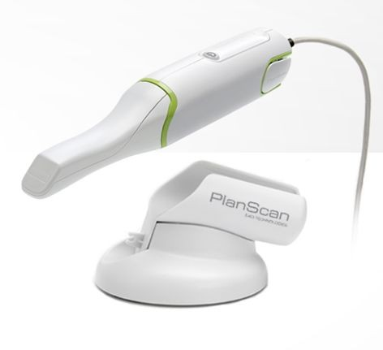
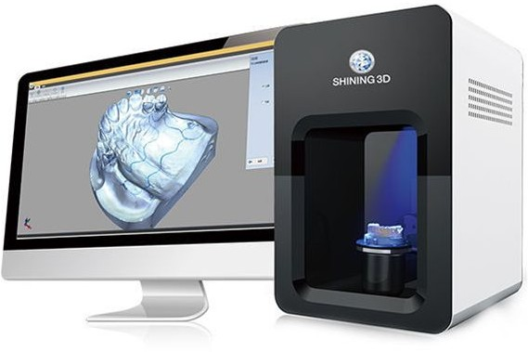
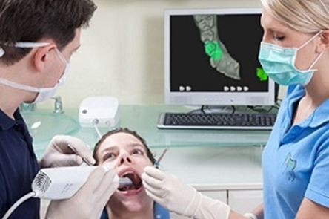
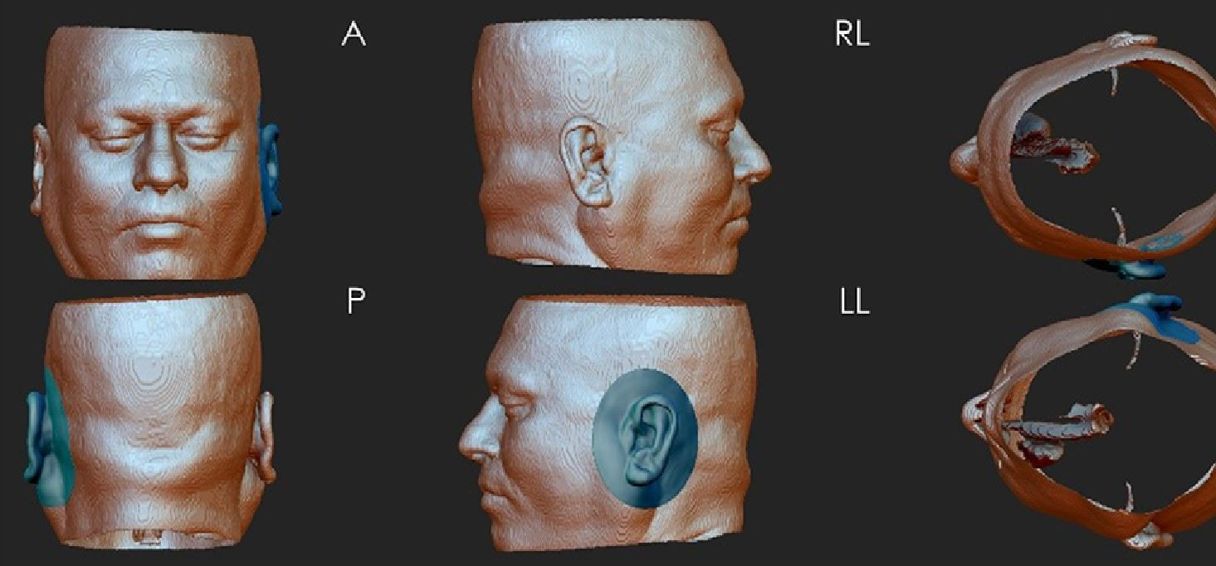
METHODS OF DATA COLLECTION IN CAD CAM
There are several methods by which data can be collected .
Intra oral scanning ( digitization )
Extra oral scanning ( digitization)
Ct scan or MRI
1
2
3

Slide 8
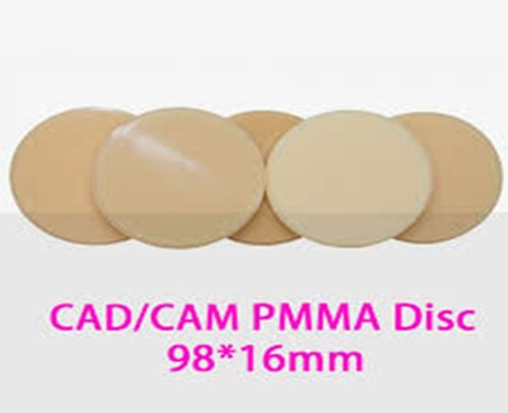
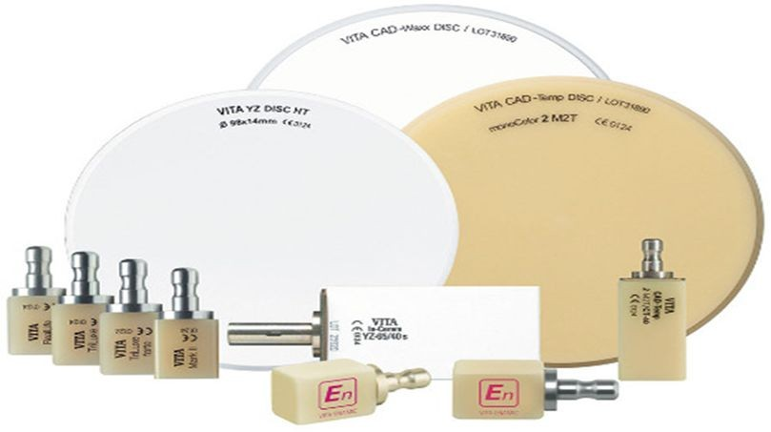
Material for CAD- CAM
There are a variety of CAD/CAM materials to choose from, all designed to provide efficient restoration design and production. materials available in block form, including
glass ceramics,
resin nano ceramics, 3- zirconia,
4- ceramic composites
,5- ceramics and resin composites.

Slide 9
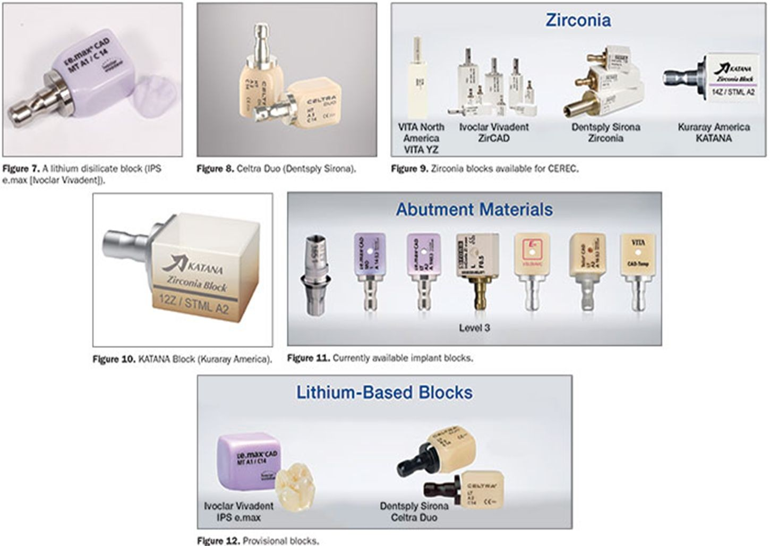
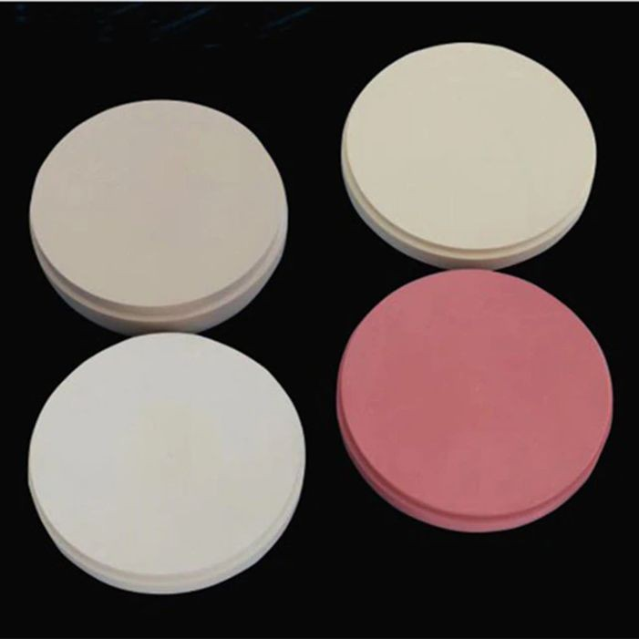
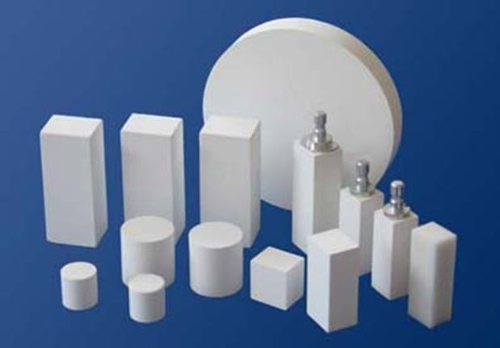

Slide 10
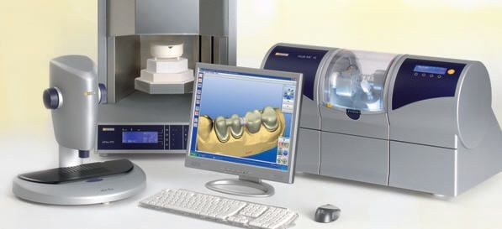
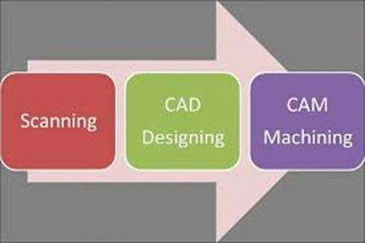
CAD- CAM PARTS
1-computer 2- scanner
3-milling machine

Slide 11
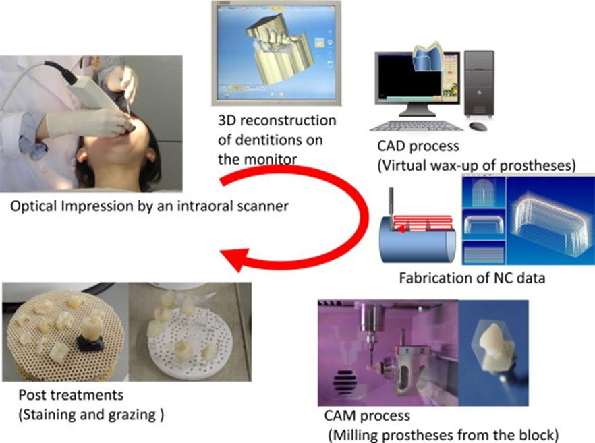

Slide 12
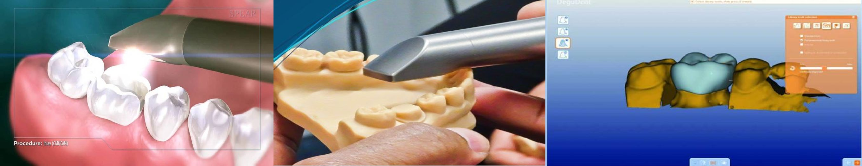
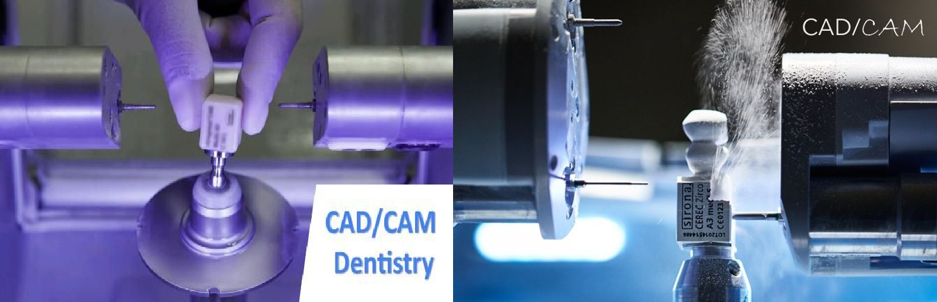

Slide 13
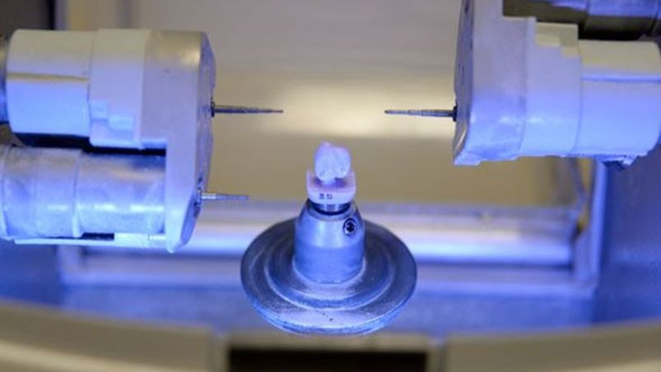
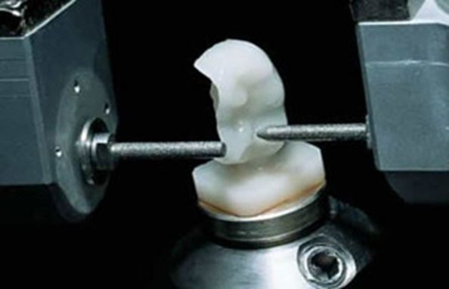
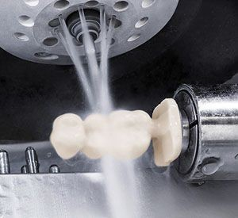
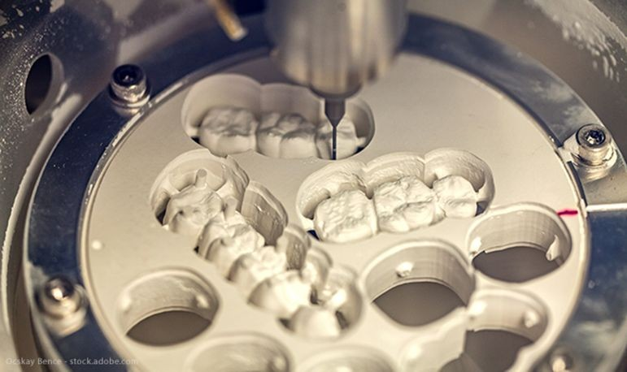

Slide 14
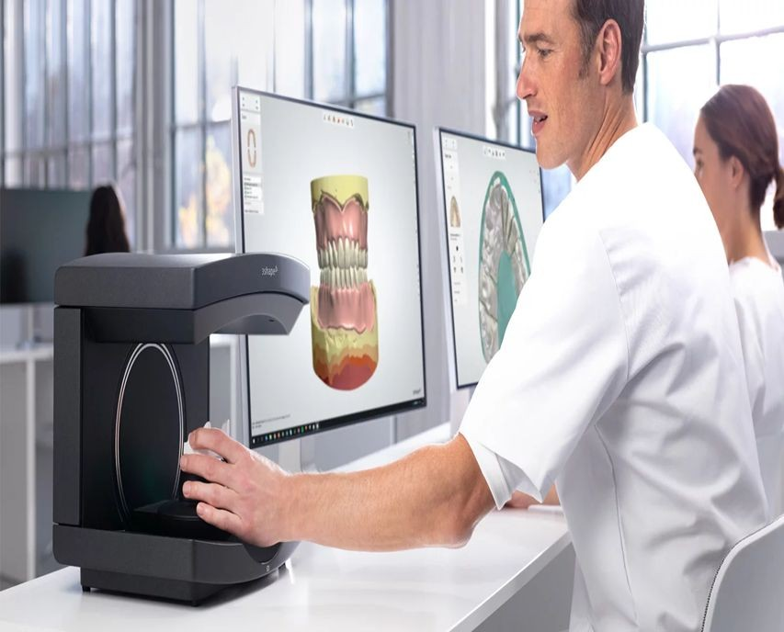
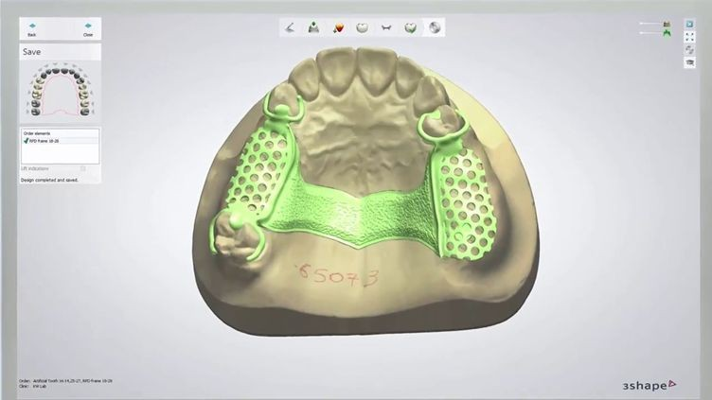
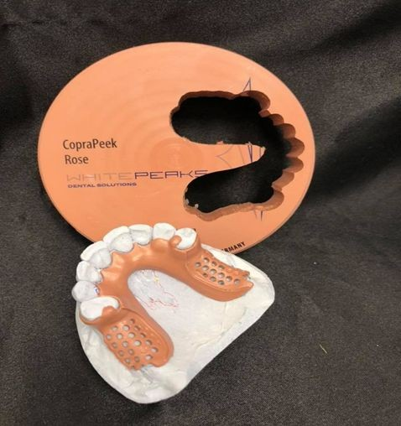
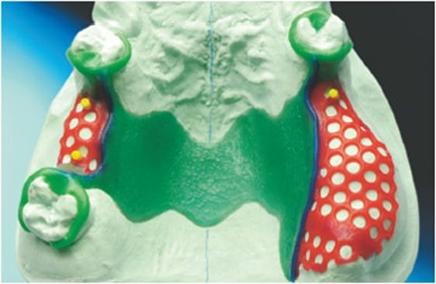
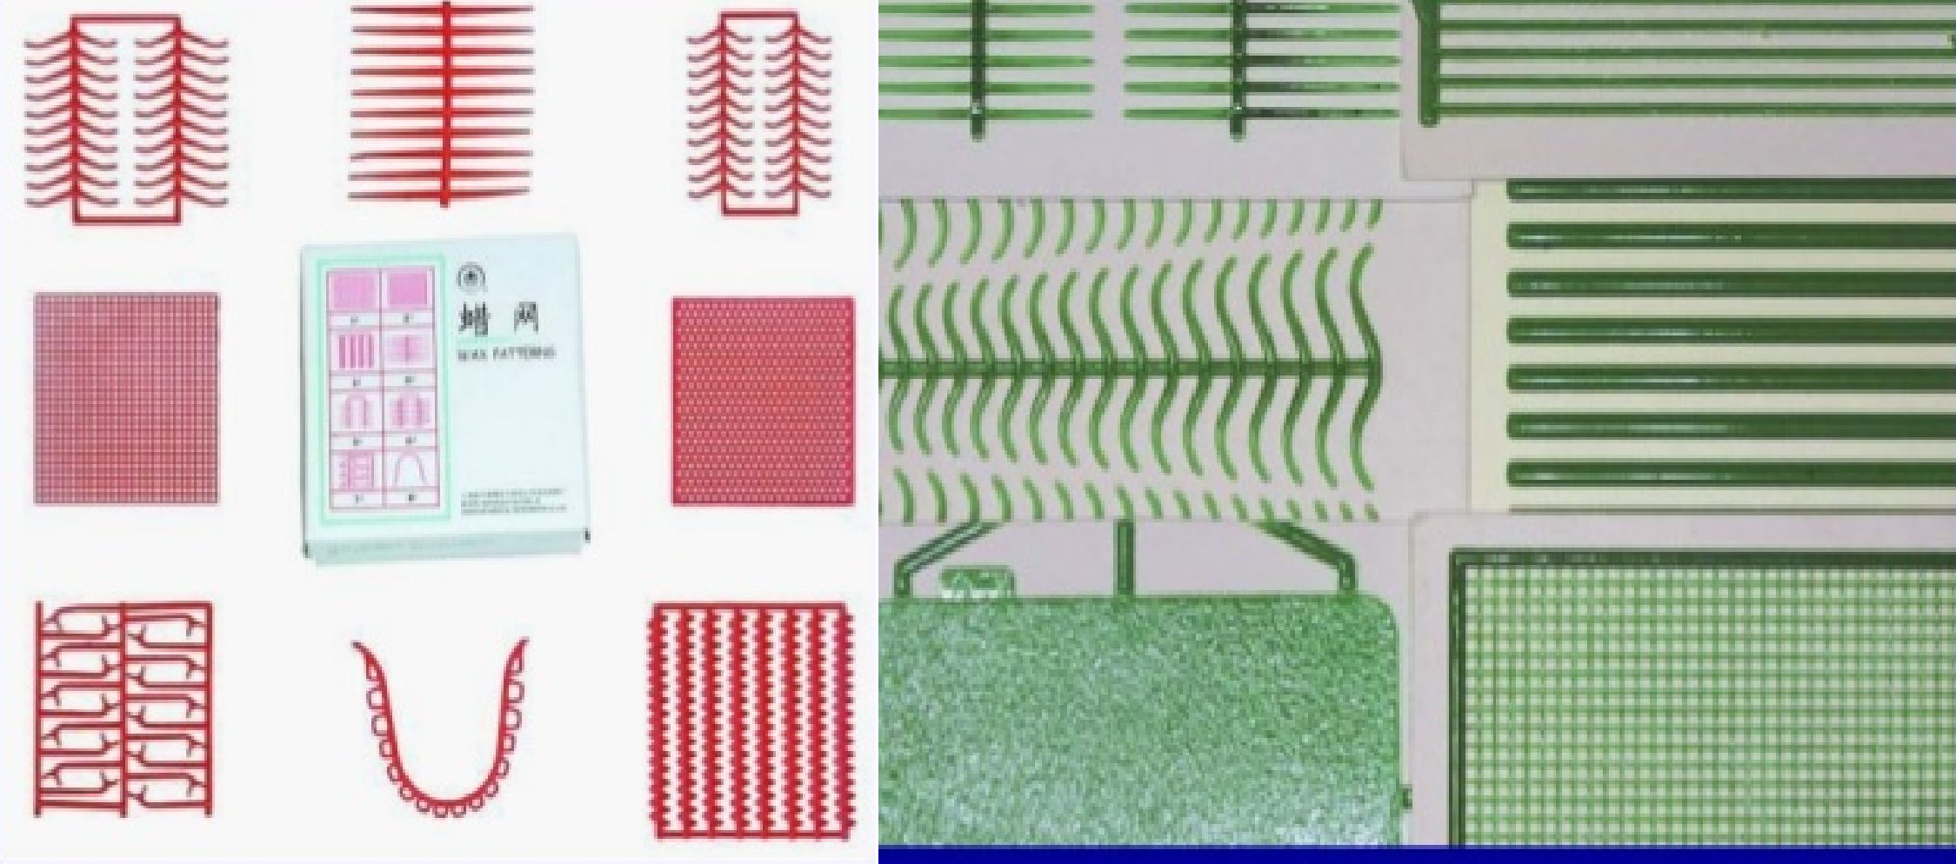
Scanning of the master cast , design , fabricating of the frame to be ready for casting
Conventional method of preparing wax pattern of partial denture using prefabricated wax pattern

Slide 15
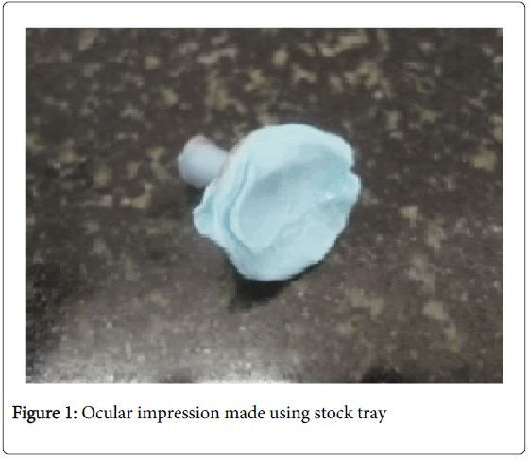
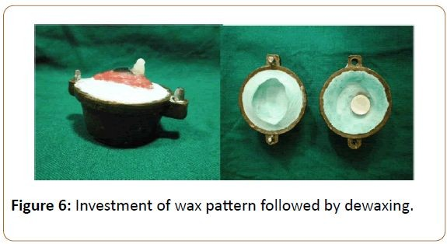
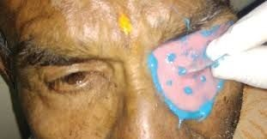
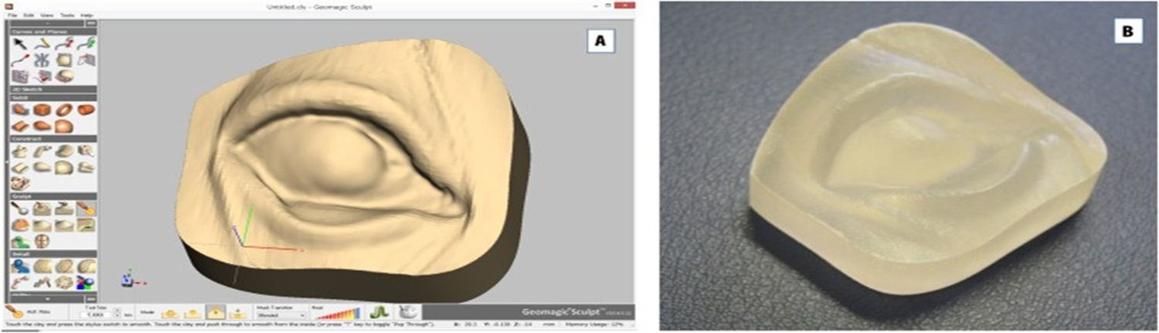
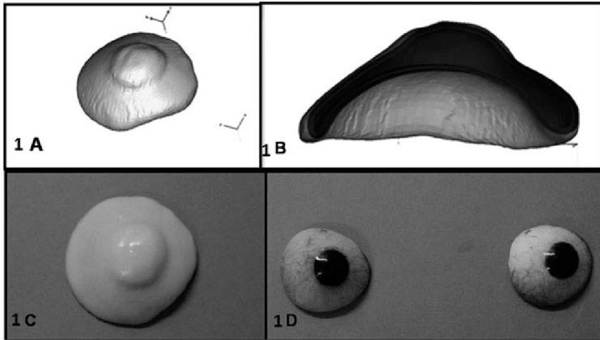
Conventional method and CAD- CAM method for ocular prosthesis

Slide 16
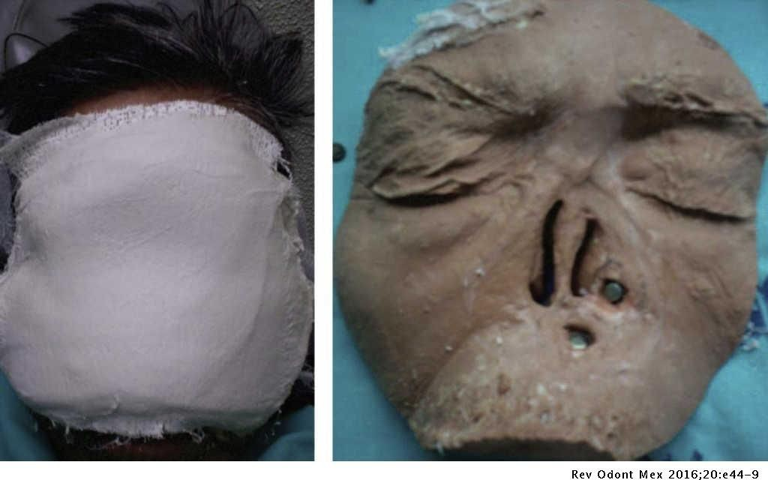
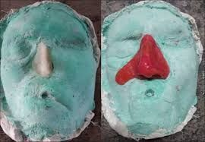
Conventional method for fabrication of nasal prosthesis

Slide 17
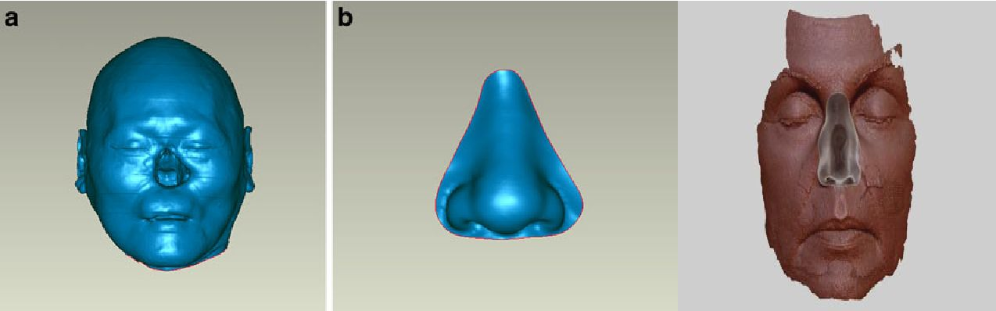
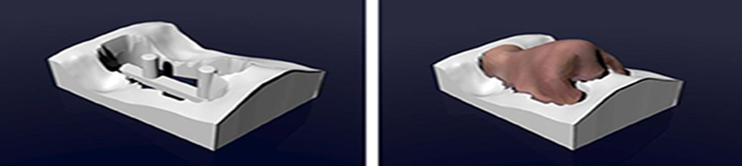
CAD- CAM FABRICATION OF NASAL PROSTHESIS

Slide 18


