Slide 1
Introduction to dental anatomy lec(1)
Presented by :M.Sc.D.P.T Samah khaleel

Slide 2
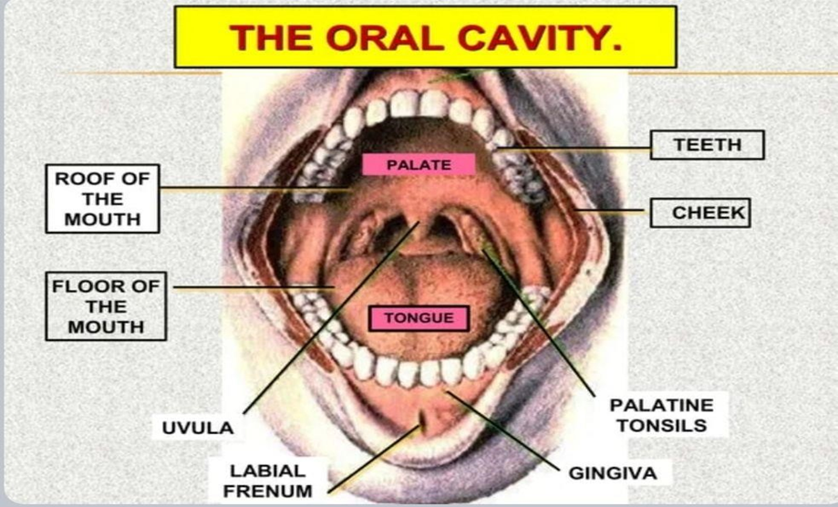

Slide 3
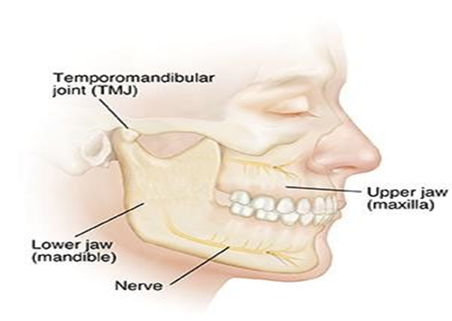
The jaw(dental arch ):- The jaw is the bone which carries the teeth .
There are two jaws: 1.The upper jaw, which is fixed , called (Maxilla) so that the teeth that arranged in upper jaw called maxillary teeth
2.The lower jaw ,which is movable ,called (mandible) and the teeth which arranged in lower jaw called mandibular teeth .

Slide 4
Dental anatomy :- it is the science that deal with studying the anatomy of the human teeth and teeth arrangement of dental arch.
Definition of the tooth :-it is a hard mass (calcified tissue ) which placed inside the oral cavity for the purpose of cutting and mastication of the food

Slide 5
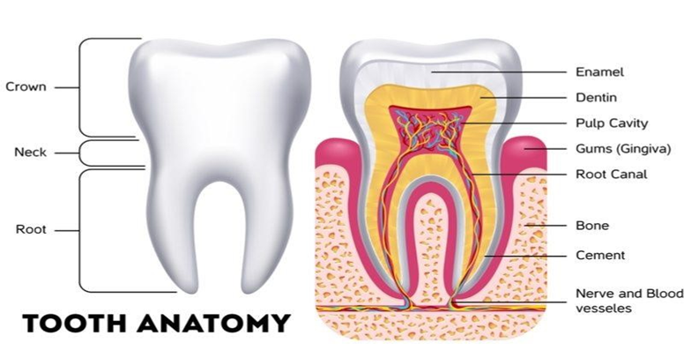
Anatomy of the tooth :- each tooth has a crown and root portion.
The crown is covered with enamel, and the root portion is covered with cementum. The crown and root join at the cementoenamel junction (CEJ) or cervical line .

Slide 6
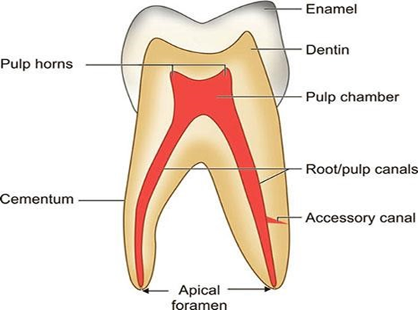
The dental pulp :-is the soft tissue of the tooth which present in the pulp chamber and pulp canal :-
Pulp chamber :- is the part of the dental pulp in the crown .
Pulp canal :-is the part of dental pulp in the root

Slide 7
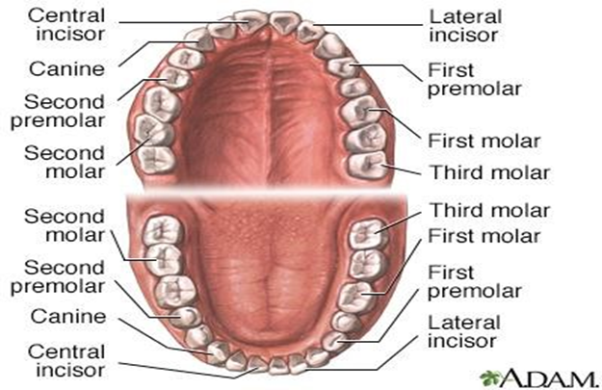
Classification of teeth :-
1.Anterior teeth which include ( incisors & the canines) , incisors act for cutting food , canines for tearing of food .
2.Posterior teeth which include the( premolars & molars ).

Slide 8
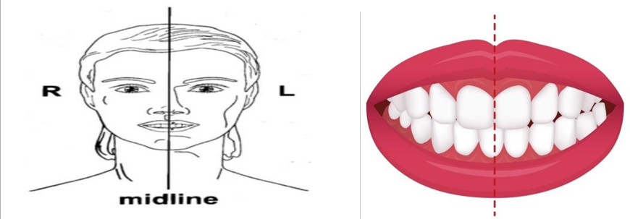
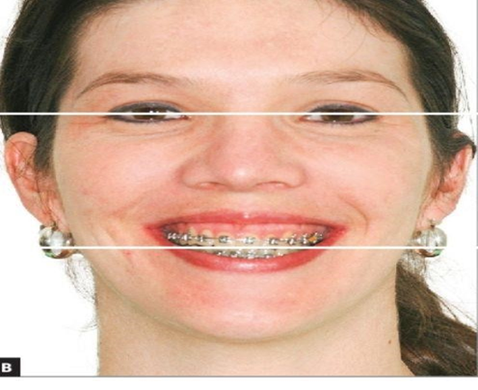
Midline :- it is an imaginary vertical plane that divide the arches into two equal right and left and segments
Occlusal plane : it is an imaginary horizontal plane that divide the arches into equal upper and lower segments .

Slide 9
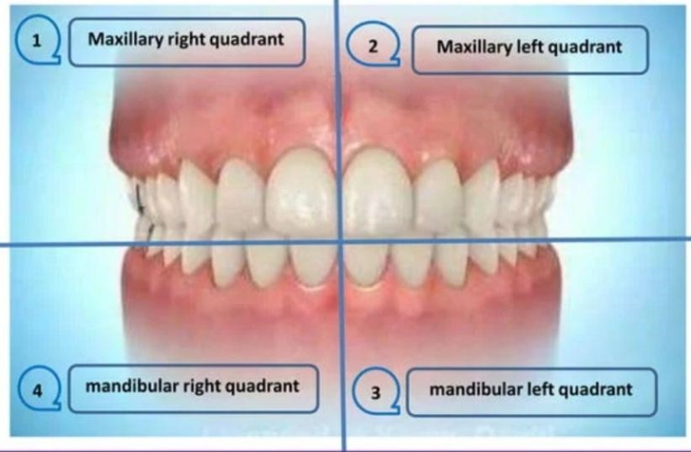
As a result this two lines the oral cavity is divided into four quadrants which are
1.Maxillary right quadrant
2.Maxillary left quadrant
3.Mandibular right quadrant
4.Mandibular left quadrant

Slide 10
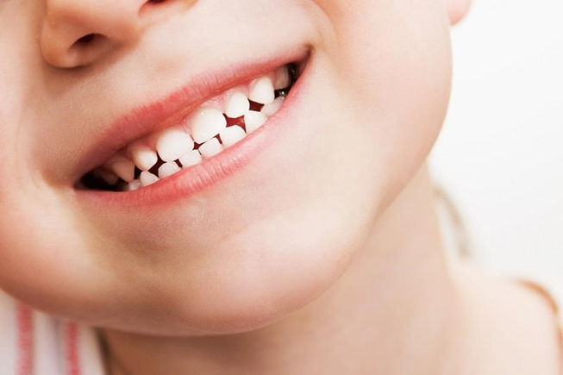
Dentition :- it is the term that used to describe all the teeth that present in upper and lower jaw bones
Classification of dentition :- the humans have two sets of teeth in their life time
A- Deciduous dentition :-began to erupt at 6month of age and completed at about 2-2.5 years of age .

Slide 11
Number of deciduous teeth :-the oral cavity of children before 6 years of age contain 20 deciduous teeth ,10 in maxilla and 10 mandible
Terminology deciduous teeth :-
1.Temporary teeth
2.Primary teeth
3.Milk teeth
4.Baby teeth

Slide 12
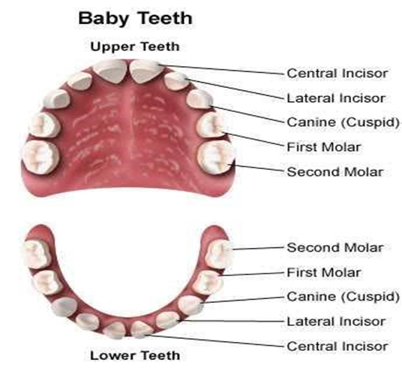
Deciduous dentition include :-
1-Deciduous incisors (I)
a. Deciduous central incisor :is close to midline
b. Deciduous lateral incisor : next to central incisor
2-Deciduous canine (c):-Next to lateral incisor which located in the corner of the mouth .
3-Deciduous molars (M) :-the last two teeth of the mouth .
1-Deciduous first molar : next to the canine 2-Deciduous second molar : last one

Slide 13
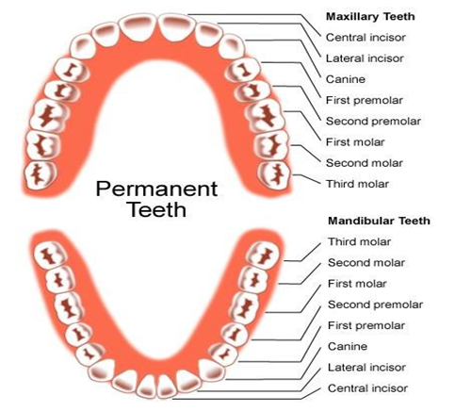
B- The permanent teeth (secondary ) or adult teeth:- the second set of teeth that begin to erupt at the age of 6 years and completed at the age of 13 years except third molars. Permanent dentition is also referred to as adult teeth. Permanent Dentition comprises 32 teeth, of which 16 are present on each jaw

Slide 14
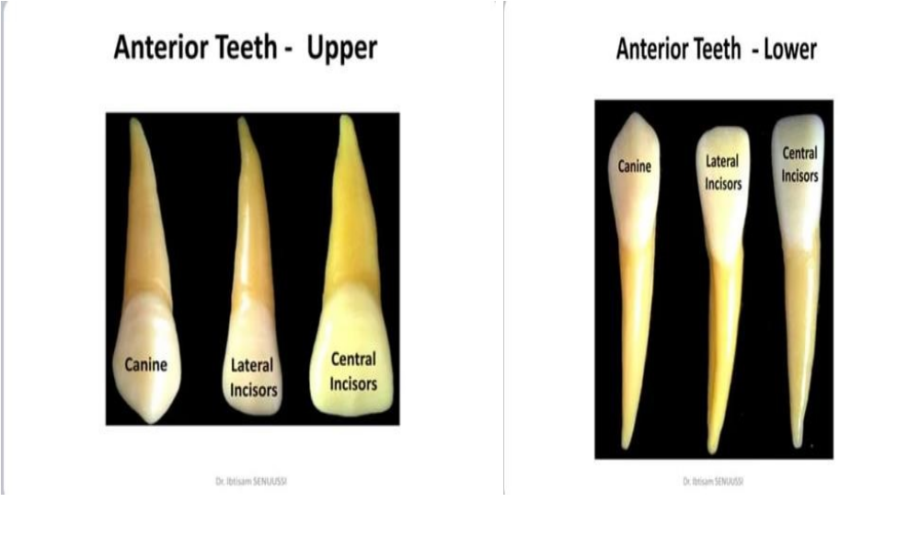
The permanent dentition include :-
Permanent anterior teeth which include
1-permanent central incisor found close to the midline.
2-permanent lateral incisors found distal to central incisor .
3-Permanent canine is found distal to lateral incisor

Slide 15
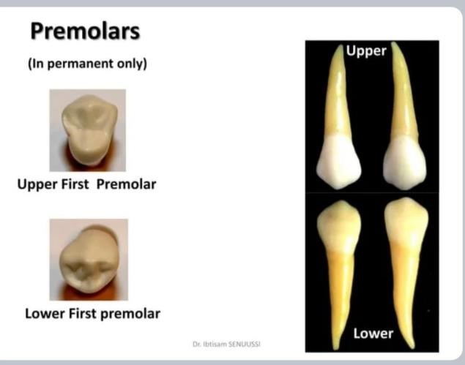
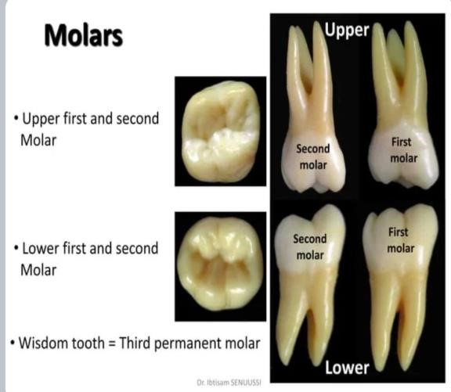
Permanent posterior teeth which include
1- Permanent premolars :- are the fourth and fifth from the midline .which termed the first and second premolar
2-Permanent molars : are the sixth , seventh and eighth teeth from the midline which termed first, second and third molar .

Slide 16


