Slide 1

Universal Safety Precautions
Dr. Ahmed Salim
Department of Prosthetic Dental Technology

Slide 2
Universal Safety Precautions
Standard Precautions are the basic level of infection control practice to reduce the transmission of pathogenic organisms from known and unknown sources.
Standard Precautions are designed to both protect healthcare workers (HCW) and prevent HCW from spreading infections among patients.
These practices are based on the principle that all body fluids pose a risk for transmission of blood borne viruses or other transmissible infectious micro-organisms, include blood and body fluids, secretions, excretions (except sweat), non-intact skin and mucus membranes

Slide 3
5 Steps of Universal Precautions
All members should follow these universal precautions at all times.
Education
Hand washing
Use of protective barriers (Personal Protective Equipment (PPE))
Cleaning of contaminated surfaces
Safe handling/disposal of contaminated material

Slide 4
1. Education
The employer must provide training to protect the health and safety of the worker and provide for the safe handling and disposal of biological agents.
Hygienic (washroom) facilities with water, soap and disposable towels or a hot air hand dryer must be provided at all our worksites.

Slide 5

2. Hand Washing
Wash hands frequently and thoroughly, especially after contact with any body fluid or a contaminated surface.
Wet, soap and lather hands for at least 20 seconds.
Wash and scrub under fingernails and cuticles with a small brush.
Rinse hands thoroughly and dry.

Slide 6
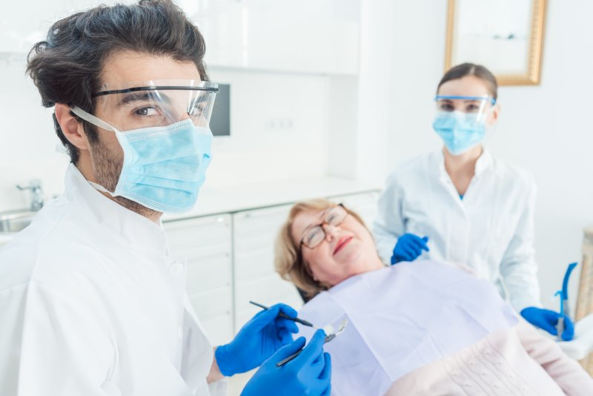
3. Protective Barriers
protective barriers reduce your risk of exposure to potentially infectious material through contact with broken skin or mucous membranes.

Slide 7
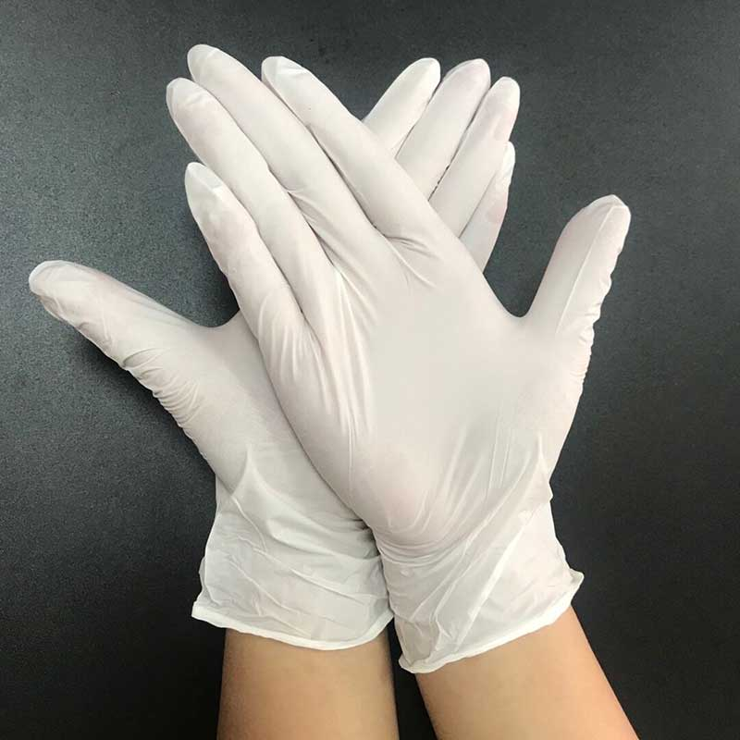
3.1 Gloves
Surgical quality latex or vinyl gloves must be provided by the employer for all contact with blood, body fluids and feces.
Wash hands thoroughly with warm water and soap after removing gloves.
Change gloves after each task or exposure and dispose as contaminated waste.

Slide 8
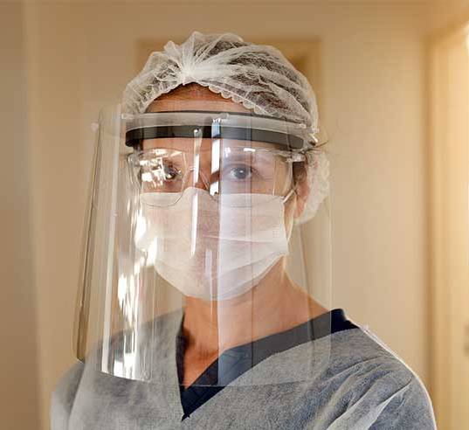
3.2 Eye glasses and Mask
Protective eye glasses and a mask must be provided and used where blood, body fluids or feces are likely to splash on the mucous membranes of the eyes, nose or mouth.

Slide 9
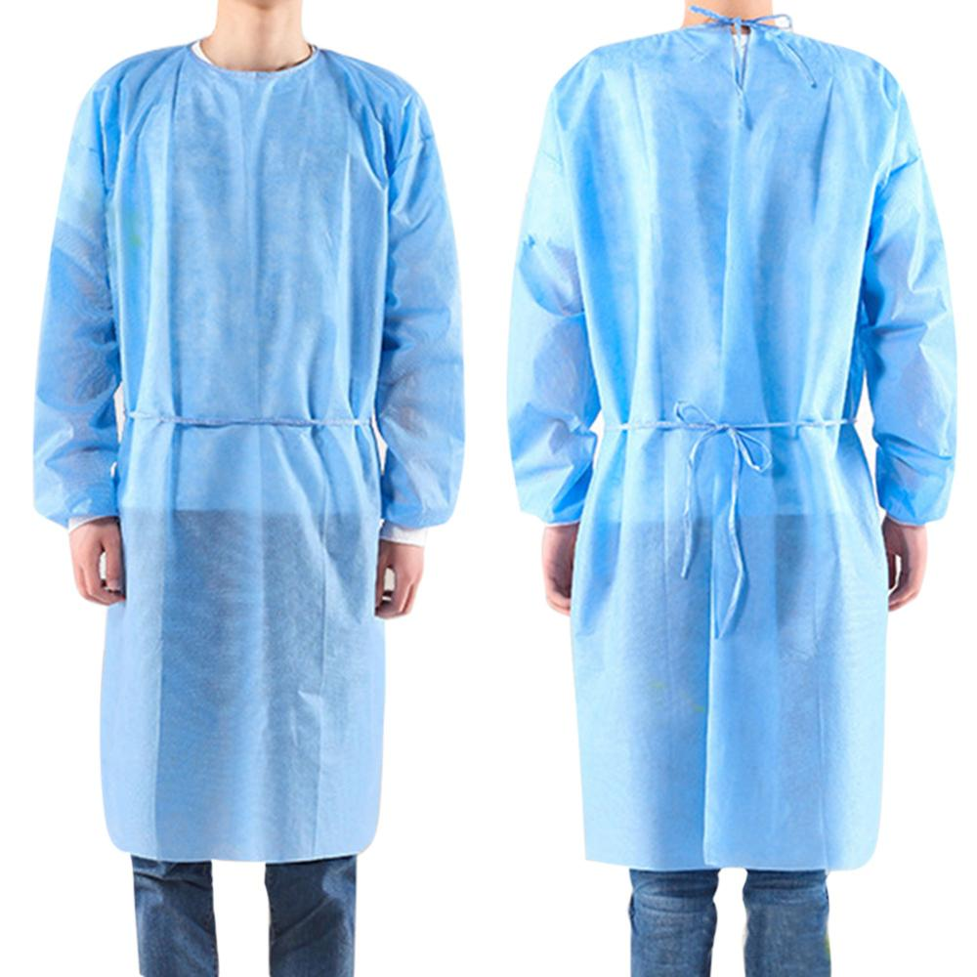
3.3 Gowns and Lab coats
Gowns, lab coats or aprons must be provided and worn where clothing is likely to be soiled.

Slide 10
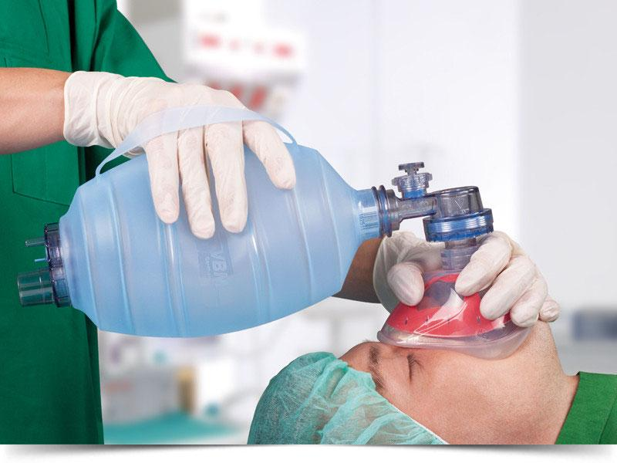
3.4 Resuscitation Devices
To minimize your exposure during emergency mouth-to-mouth resuscitation, mouthpieces or other resuscitation devices should be provided.
Resuscitation devices should be a disposable type and available in every first aid kit.

Slide 11
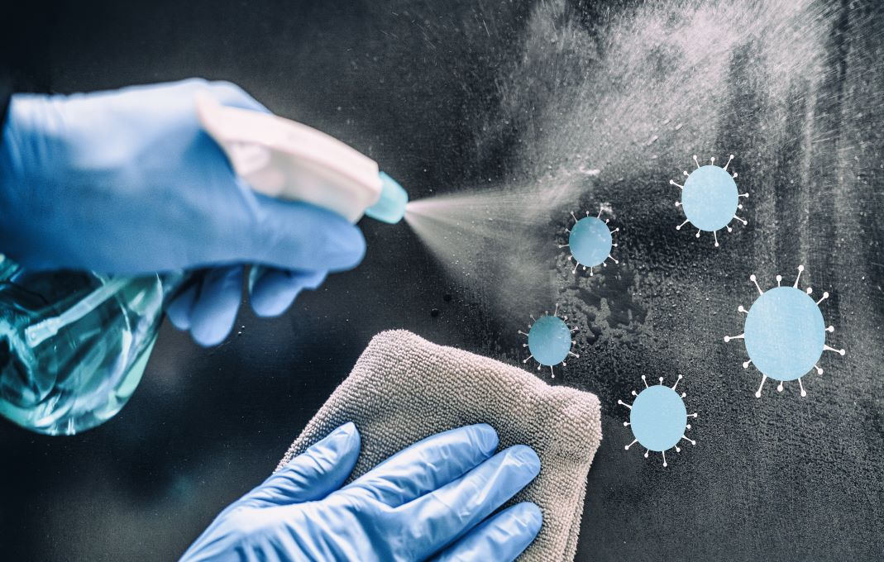
4. Cleaning and disinfecting of contaminated areas
Decontaminate the area with an approved germicide or 1:100 solution of household bleach.
All used equipment must be thoroughly washed and disinfected.

Slide 12

5. Management biological waste and contaminated materials:
Dispose of biological waste in a puncture-resistant container lined with a leak-proof plastic bag.
Consider all biological waste as infectious.
Wear puncture-resistant gloves and handle all contaminated wastes carefully to prevent body contact.
Post a biological waste symbol on the container and never mix biological waste with regular trash

Slide 13

Thanks &
be Safe

