Slide 1
Anatomical land mark of mandibular arch (3rd lec )
Submitted by :Assist lecturer samah khaleel

Slide 2
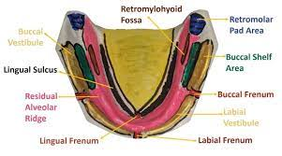
It comprises of:
1. Limiting structure
2. supporting structures.
3. Relief areas.

Slide 3
1.Labial frenum.
2. Labial vestibule.
3. Buccal frenum.
4. Buccal vestibule.
5. Lingual frenum.
6. Alveololingual sulcus.
7. Retromolar pad.
8. Pterygomandibular raphe

Slide 4
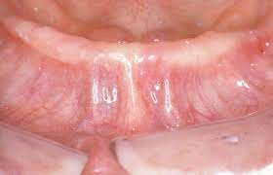
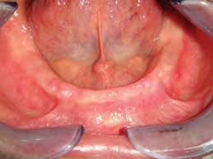
1. Labial frenum:
it is a fibrous band of mucous membrane that extends from the labial aspect of residual ridge to the lip
2.Labial vestibule
the space between the residual alveolar ridge and the lips. The length and thickness of the labial flange of the denture occupying this space is crucial in influencing lip support and retention

Slide 5
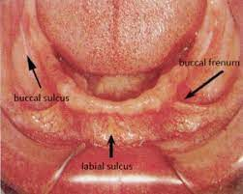
3.Buccal frenum:
The fibers of the buccinator are attached to the frenum. It should be relieved to prevent displacement of the denture during function.
4. buccal vestibule
It extends posteriorly from the buccal frenum till the retromolar region. It is bound by the residual alveolar ridge on one side and buccinator on the other side.

Slide 6
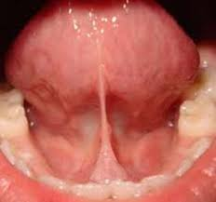
5. Lingual Frenum
It is a fold of mucous membrane can be observed when the tongue is elevated, extending along the floor of the mouth to the under surface of the tongue.
It will produce the lingual notch in the denture. Relief should be provided in the anterior portion of the lingual flange.

Slide 7
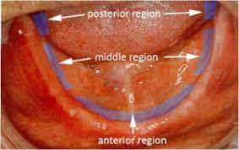
6.Aleveo lingual sulcus :
It extends from the lingual frenum to the retro-mylohyoid curtain.
2. It is considered in three regions namely:-
a) Anterior region: it extend from the lingual frenum to the premylohyoid fossa ,where the mylohyoid curves below the sulcus .
b) Middle region:-it extends from the premylohyoid fossa to distal end of the mylohyoid ridge.
c) Posterior region:-the retro-mylohyoid fossa is present here.

Slide 8
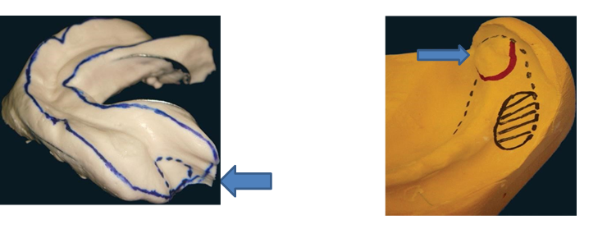
7.Retromolar Pad (Pear-Shaped Pad):
It is an important structure , which forms the posterior seal of the mandibular denture.
2. The pear-shaped pad is a triangular keratinized soft pad of tissue at the distal end of the ridge.
3. The denture base should extend only one half to 2\3rd over the retromolar pad.

Slide 9
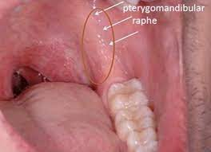
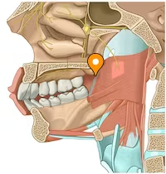
8.Pterygomandibular raphe: arises from the hamular process of the medial pterygoid plate and gets attached to the mylohyoid ridge.

Slide 10
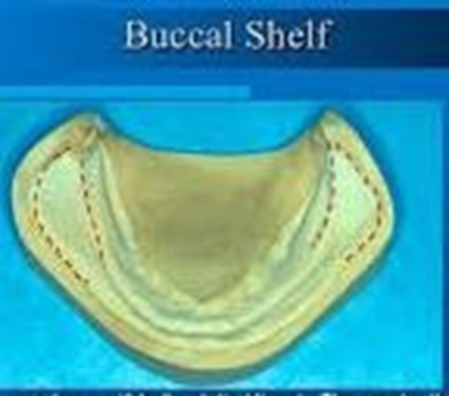
Supporting structure
1.Buccal Shelf Area:
It is the area between the buccal frenum and anterior border of the masseter. Its boundaries are:
Medially the crest of the ridge
Distally the retro-molar pad
Laterally the external oblique ridge.

Slide 11
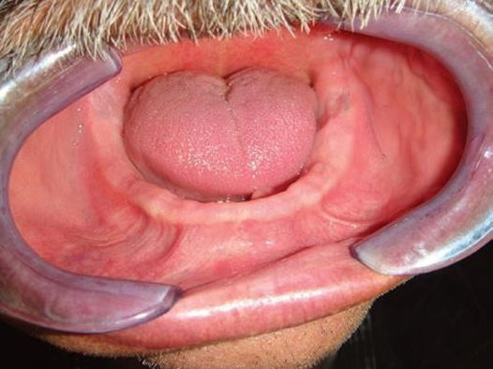
2.Residual Alveolar Ridge:
It is the portion of alveolar ridge and the soft tissue covering which remains following the removal of teeth.
The bone of crest of lower residual ridge being made of spongy bone therefore may not be favorable as a primary stress bearing area for the lower denture

Slide 12
Relief area
1.Torus mandibularis
2.Genial tubercle
3.Mental Foramen

Slide 13
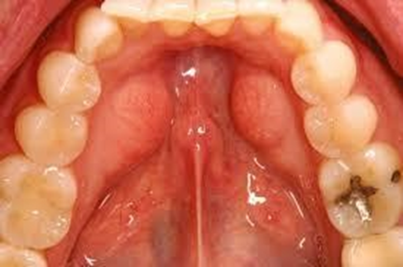
1.Torus mandibularis
It is an abnormal bony prominence found bilaterally on the lingual side, near the premolar region. It is covered by a thin mucosa. It has to be relieved or surgically removed.

Slide 14
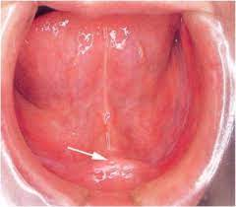
2.Genial tubercle
These are a pair of bony tubercles found anteriorly on the lingual side of the body of the mandible. Due to resorption, it may become increasingly prominent making denture usage difficult.

Slide 15
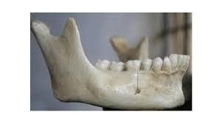
3.Mental Foramen
It is located on the external surface of the mandible between the 1st molar and 2nd premolar area. In case of sever resorption of residual ridge, the denture should be relieved over the foramen to prevent pressure being applied on the mental nerves and blood vessels.

Slide 16


