Slide 1
By Layth Kareem
Ms.c in MRI applications
Special procedures of GI tract (9)
methods of imaging the hepatobiliary system (MRI of the liver)

Slide 2
methods of imaging the hepatobiliary system
1. Plain film
2. Ultrasound (US)
3. Computed tomography (CT), including:
(a) Routine ‘staging’ (portal venous phase) CT
(b) Triple phase ‘characterization’ CT
(c) CT cholangiography
4. Magnetic resonance imaging (MRI)
5. Endoscopic retrograde cholangiopancreatography (ERCP)
6. Percutaneous transhepatic cholangiography (PTC)
7. Operative cholangiography
8. Postoperative (T-tube) cholangiography
9. Angiography—diagnostic and interventional
10. Radionuclide imaging:

Slide 3
What is MRI?
(MRI)is a non-invasive imaging technology that produces three dimensional detailed anatomical images. It is often used for disease detection, diagnosis, and treatment monitoring. It is based on sophisticated technology that excites and detects the change in the direction of the rotational axis of protons found in the water that makes up living tissues.

Slide 4
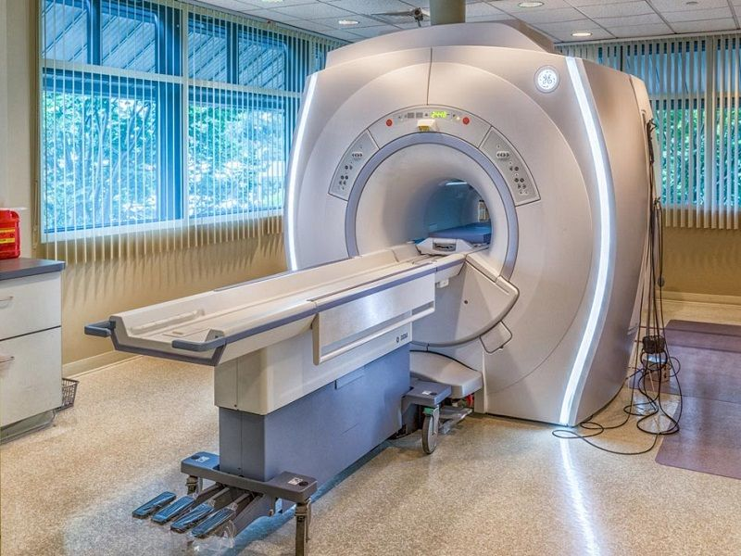
CLOSED MRI

Slide 5
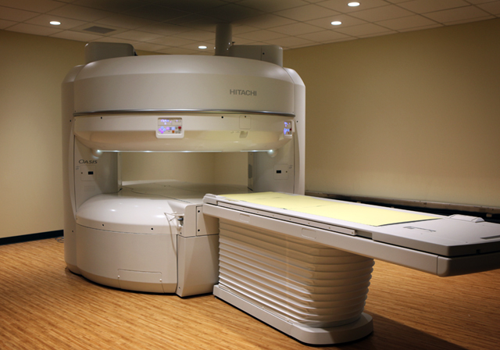
OPEN MRI

Slide 6
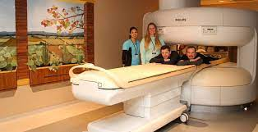
OPEN MRI

Slide 7
Magnetic Resonance Imaging Of The Liver
Indications
1.Lesion characterization following detection by CT or US.
2. Lesion detection, particularly prior to hepatic resection for hepatic metastatic disease.

Slide 8
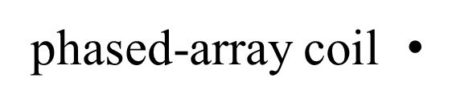
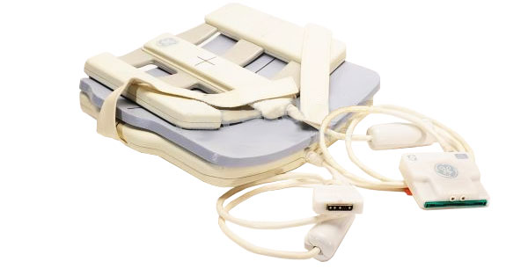
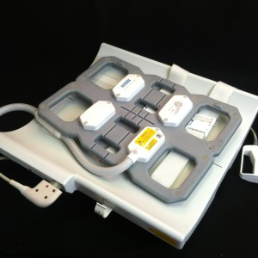
Magnetic Resonance Imaging Pulse Sequences
A minimum field strength of 1.5T is required using a multichannel phased-array coil. Common pulse sequences are:

Slide 9
MRI pulse sequences of the liver
1. Localizer
2.T1-weighted spoiled gradient echo (GRE). This has replaced the
conventional spin-echo sequence. In and out of phase scans are
used to investigate patients with suspected fatty liver
3. T2-weighted spin echo (SE). T2-weighted fast spin-echo (FSE;
General Electric) or turbo spin-echo (TSE; Siemens).
Compared with conventional T2-weighted SE images, FSE/TSE
images show:.
4. Magnetization-prepared T1-weighted GRE. A further breath-hold
technique with very short sequential image acquisition.
5. T1-W GRE fat-suppressed volume acquisition. This sequence can be
obtained rapidly following i.v. gadolinium.

Slide 10
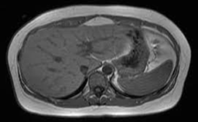
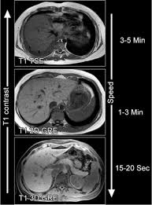
Magnetic Resonance Imaging Pulse Sequences
Fat suppression:
1. Decreases the motion artifact from subcutaneous and
intraabdominal fat
2. Increases the dynamic range of the image
3. Improves signal-to-noise and contrast-to-noise ratios of focal liver lesions
T1 (SE)

Slide 11
Very heavily T2-weighted sequences can be used to show water content in bile ducts, cysts and some focal lesions. These may be obtained as:
1. Gradient echo breath-hold sequences (e.g. fast imaging with steady-state precession (FISP), fast imaging employing steady state acquisition [FIESTA])
2. Breath-hold very fast spin echo (e.g. half Fourier acquisition single shot turbo spin echo [HASTE])
3. Non-breath-hold respiratory-gated sequences used for
magnetic resonance cholangiopancreatography (MRCP).

Slide 12
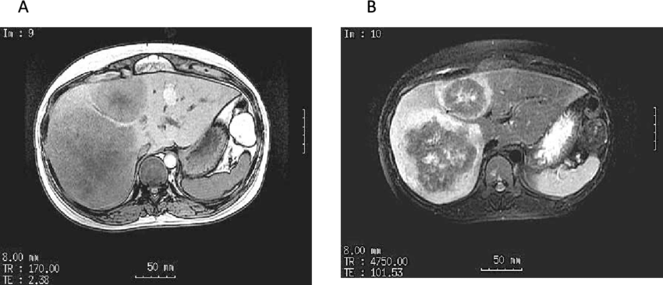
MRI of the liver T1and T2 wheighted

Slide 13
STIR
Fat suppression is also used to allow better delineation of fluid containing structures. Short T1 inversion recovery (STIR) also suppresses fat, which has.
And is typically used to null the signal from fat
a short T1 relaxation time. Other tissues with short T1 relaxation (hemorrhage, metastases and melanoma) are also suppressed.

Slide 14
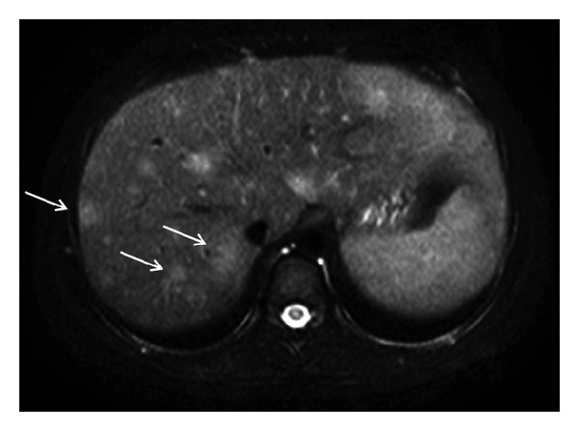
STIR

