Slide 1
By Layth Kareem
Ms.c in MRI applications
Special procedures of GI tract (7)
methods of imaging the hepatobiliary system

Slide 2
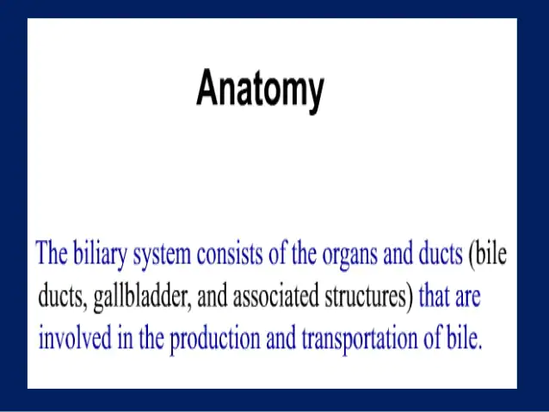
Biliary system

Slide 3
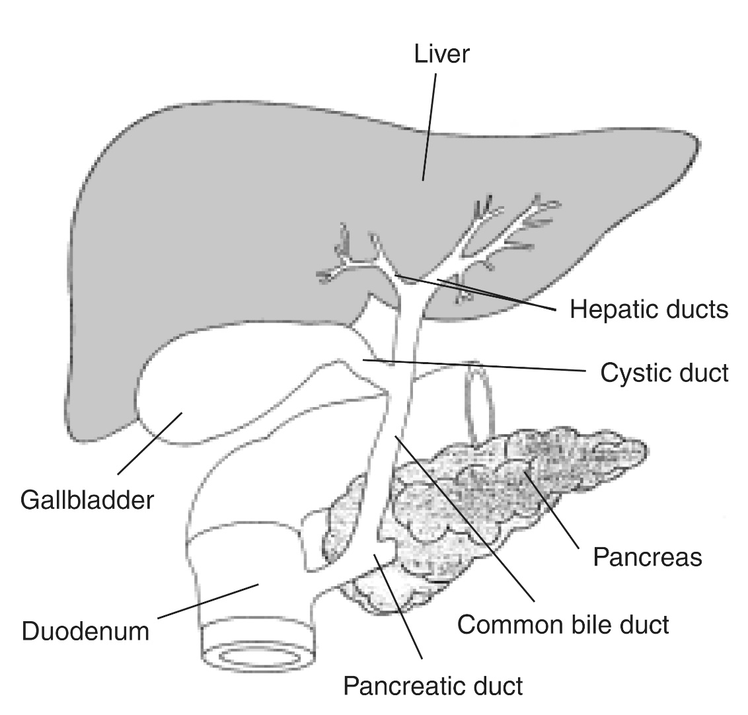
Anatomy biliary system

Slide 4


Slide 5
methods of imaging the hepatobiliary system
1. Plain film
2. Ultrasound (US)
3. Computed tomography (CT), including:
(a) Routine ‘staging’ (portal venous phase) CT
(b) Triple phase ‘characterization’ CT
(c) CT cholangiography
4. Magnetic resonance imaging (MRI)
5. Endoscopic retrograde cholangiopancreatography (ERCP)
6. Percutaneous transhepatic cholangiography (PTC)
7. Operative cholangiography
8. Postoperative (T-tube) cholangiography
9. Angiography—diagnostic and interventional
10. Radionuclide imaging:
.

Slide 6
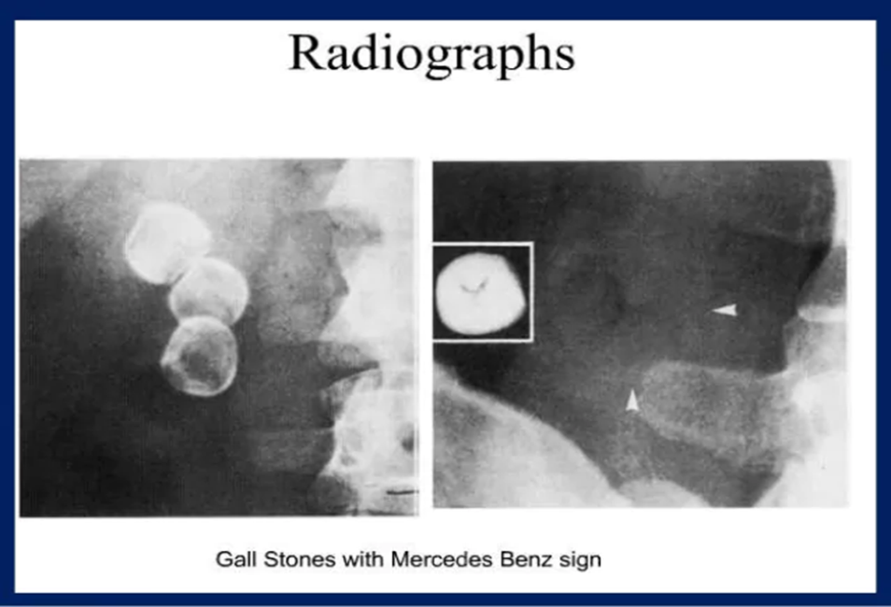
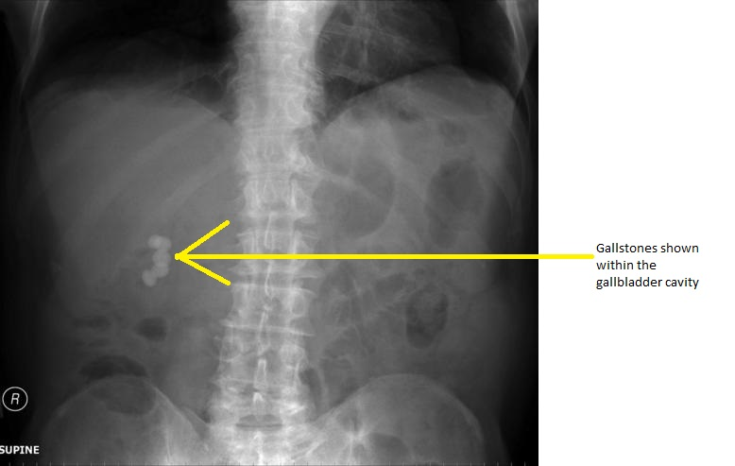
plain films
PLAIN FILMS:
Not a routine indication.
1. May incidentally demonstrate air within the biliary tree or portal venous system, opaque calculi or pancreatic calcification.

Slide 7
ULTRASOUND OF THE LIVER
Indications
1.Suspected focal or diffuse liver lesion
2. Jaundice
3. Abnormal liver function tests
4. Right upper-quadrant pain or mass
5. Hepatomegaly
6. Suspected portal hypertension
7. Staging known extra hepatic malignancy, superseded by CT

Slide 8
8. Pyrexia of unknown origin,
9. To provide real-time image guidance for the safe placement of needles for biopsy
10. Assessment of portal vein, hepatic artery or hepatic veins
11. Assessment of patients with surgical shunts intrahepatic portosystemic shunt (TIPS) procedures
12. Follow-up after surgical resection or liver transplant

Slide 9
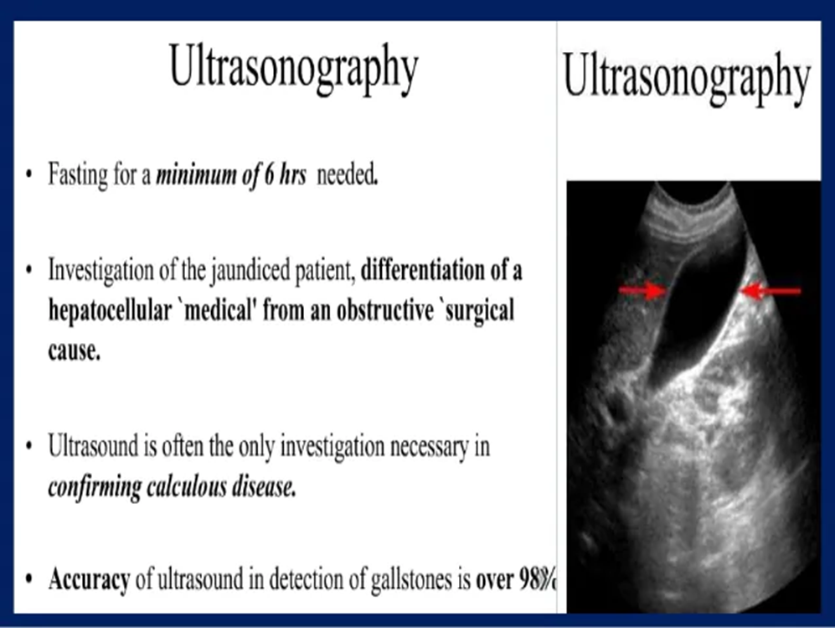
Ultrasonography

Slide 10
ULTRASOUND OF THE LIVER
Contraindications
None.
Patient Preparation
Fasting or restriction to clear fluids only required if the gallbladder is also to be studied
Equipment
3–5-MHz transducer and contact gel. Selection of the appropriate preset protocol and positioning of focal zone will depend upon the type of machine, manufacturer

Slide 11
US \Technique
Technique
1. Patient supine
2. Time-gain compensation set to give uniform reflectivity through out
the right lobe of the liver
3. Suspended inspiration
4. Longitudinal scans from epigastrium or left subcostal region
across to right subcostal region. The transducer should be angled
cephalad to include the whole of the left and right lobes.
5. Transverse scans, subcostally, to visualize the whole liver
6. If visualization is incomplete, due to a small or high-positioned
liver, then additional right intercostal, longitudinal, transverse

