Slide 1

Vital Signs
م.م. احمد ابراهيم الياسري

Slide 2
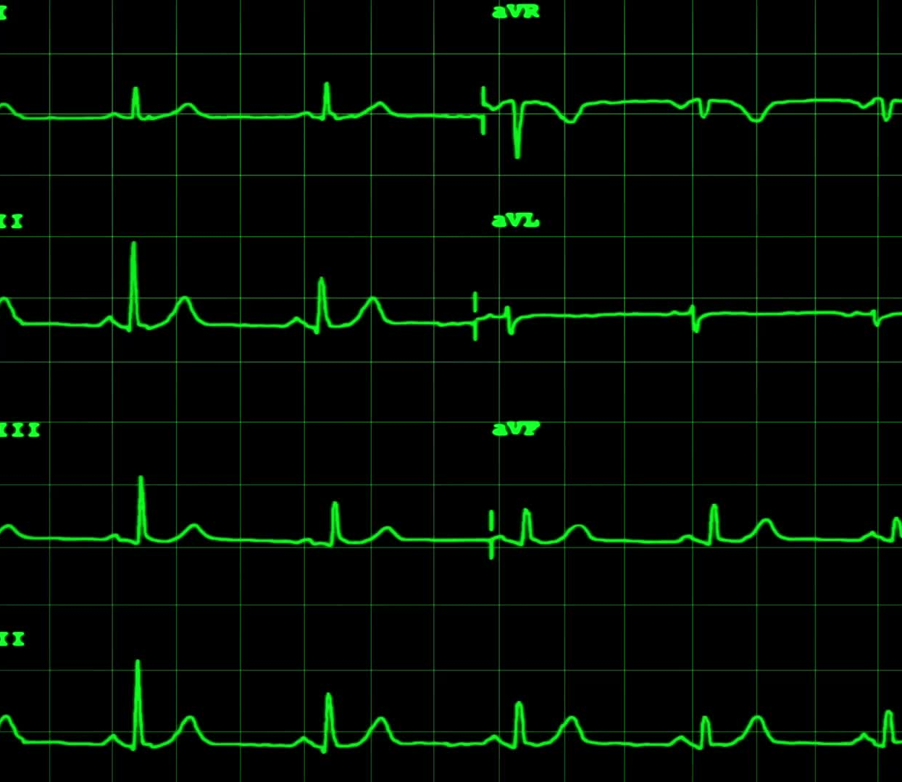
Vital signs
Vital signs :are measurements of the body's most basic functions.
The vital signs routinely monitored by medical professionals and health care providers

Slide 3
What are the Vital signs
includes:
1. Body temperature
2.Pulse
3.Respiration
4. Blood pressure
5. Pain

Slide 4

When to Assess Vital Signs
• On admission
• Change in client’s health status
• Client reports symptoms such as chest pain, feeling hot, or faint
• Pre and post surgery/invasive procedure
• Pre and post doctor intervention that could affect vital signs

Slide 5
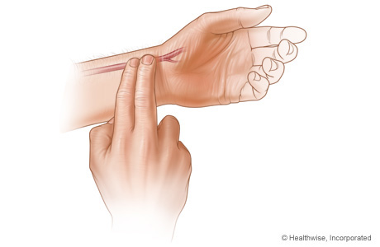
Pulse
• Is a wave of blood created by contraction of the left ventricle of the heart.
• Pulse represents the stroke volume output and the amount of blood that enters arteries with each ventricular contraction

Slide 6
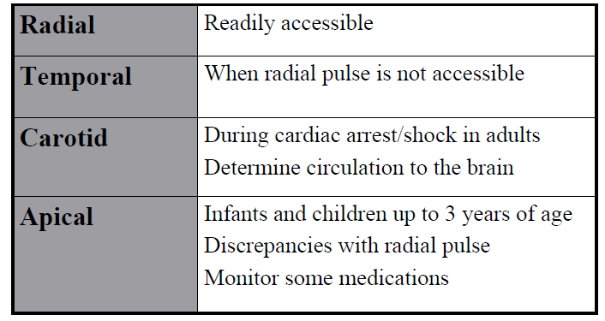
Pulse Sites

Slide 7
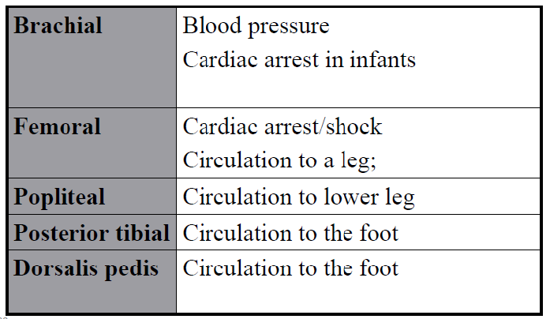
Pulse Sites

Slide 9
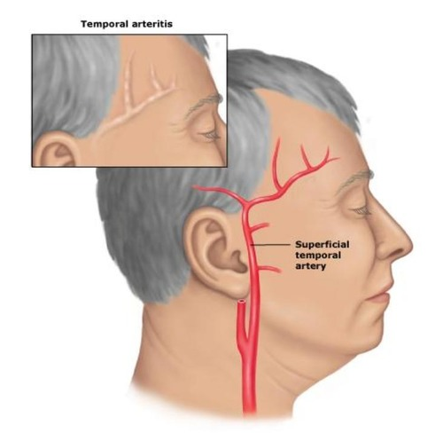

Slide 10
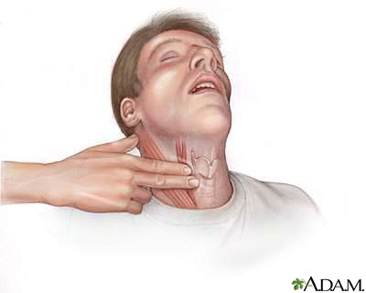

Slide 11
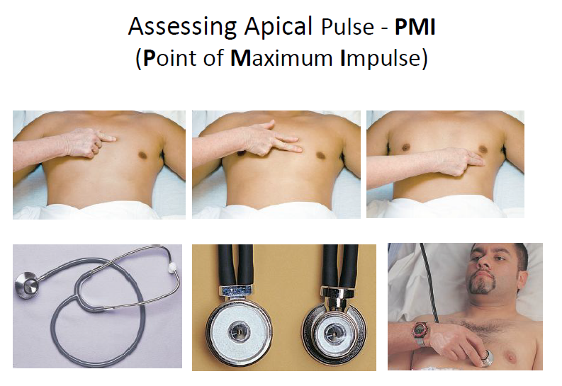

Slide 12
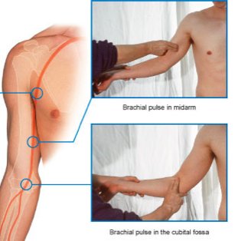

Slide 13
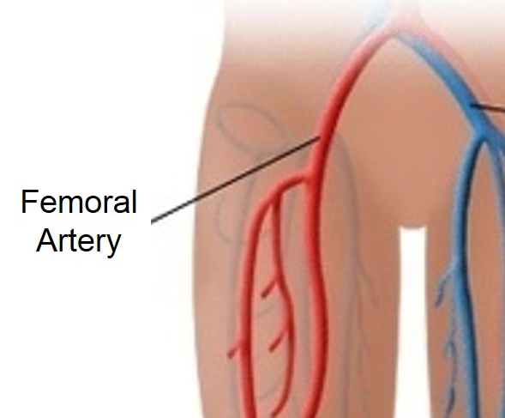

Slide 14
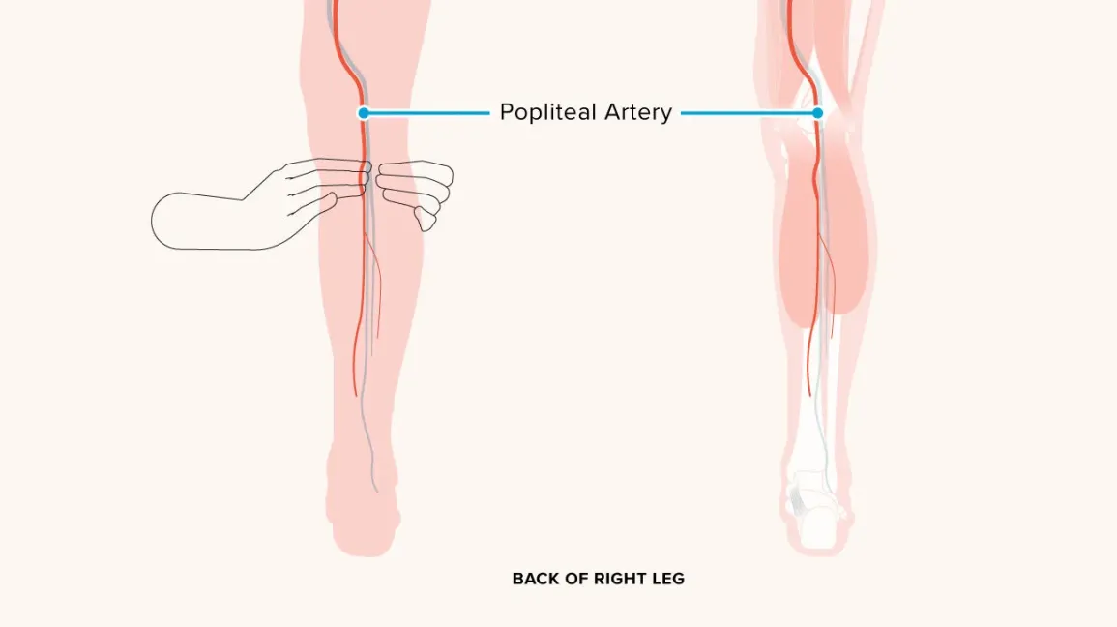

Slide 15
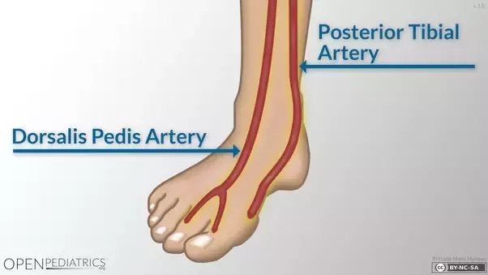

Slide 16
Factors Affecting Pulse
• Age
– Age increase, pulse
decrease
• Gender
– After puperty male pulse
slower than female
• Body temperature, fever
– Increase pulse

Slide 17
Factors Affecting Pulse
• Exercise
– Increase pulse
• Anxiety, Stress
– Increase pulse
• Emotions
– Increase pulse
• Medications
– Varies effect
• Hemorrhage (bleeding)
– Increase pulse

Slide 18
Variances in Pulse Rate
• Bradycardia: rate < 60 bpm
• Tachycardia: rate > 100 bpm
• Dysrhythmia (arrhythmia): irregular rhythm
• Pulse deficit: Difference between radial and
apical

Slide 19
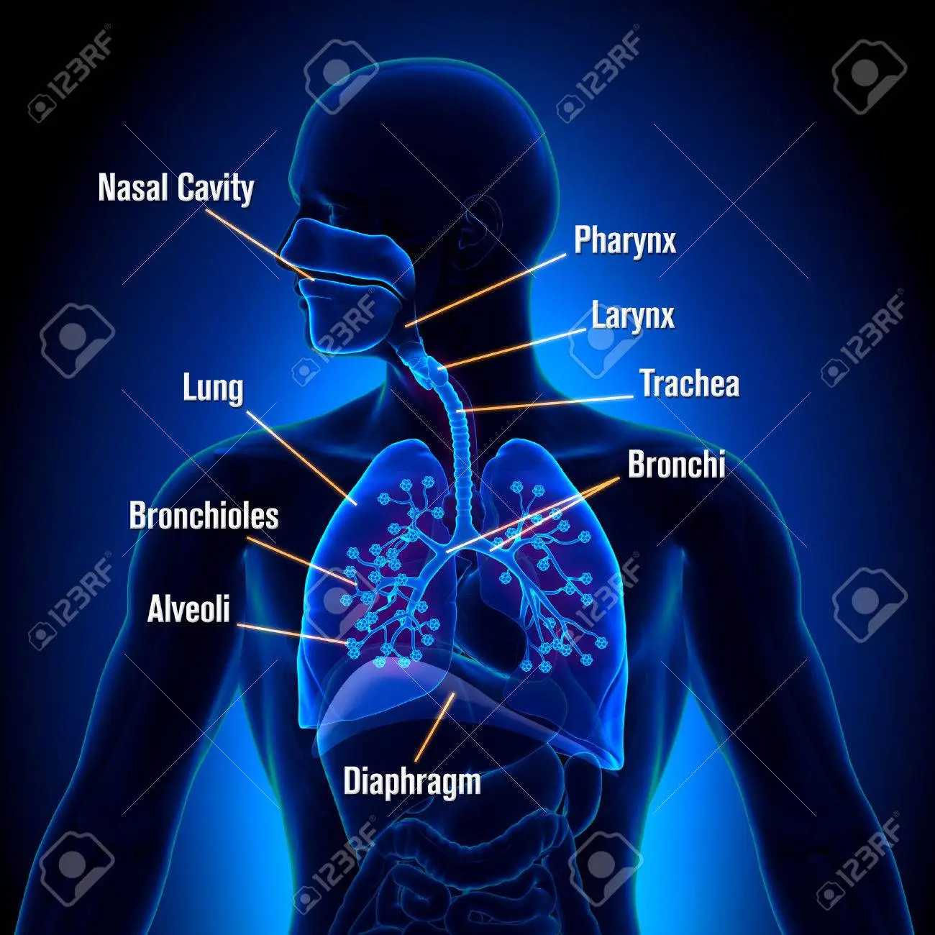
Respiration

Slide 20

Respiration
• Respiration is the act of breathing
• The exchange of oxygen and carbon dioxide in the
body
• Respiration
– External (gas exchange between alveoli of the lung and
pulmonary blood)
– Internal: gas exchange between blood and body tissues)
• Two separate process
– Mechanical
– Chemical

Slide 21
Respiration
• Mechanical
– Pulmonary ventilation; breathing
– Ventilation:
• Active movement of air in and out of the respiratory system
– Conduction
• Movement through the airways of the lung

Slide 22


Respiration
• Chemical
– Exchange of oxygen and carbon dioxide
– Diffusion
• Movement of oxygen and CO2 between alveoli and RBC
– Perfusion
• Distribution of blood through the pulmonary capillaries

Slide 23
Mechanics of Ventilation
• Inspiration (inhalation)
– Drawing air into the lung
– Involves the ribs, diaphragm
– Creates negative pressure-allows air into lung
• Expiration (exhalation)
– Relaxation of the thoracic muscles and diaphragm
causing air to be expelled

Slide 24

Variations in Assessment of Breath Sounds
• Wheeze
– High pitched continuous musical sound; heard on expiration
• Rhonchi
– Low pitched continuous sounds caused by secretions in large airways
• Crackles
– Discontinuous sounds heard on inspiration; high pitched popping or low-pitched-bubbling
• Stridor
– Piercing, high pitched sound heard during inspiration
• Stertor
– Labored breathing that produces a snoring sound

Slide 25
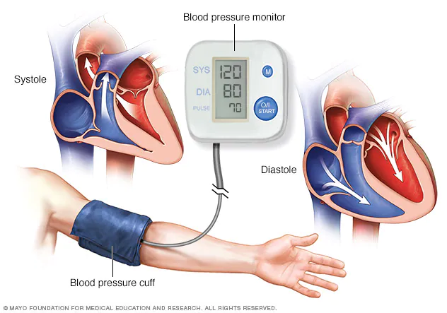
Blood Pressure

Slide 26

Blood pressure
Force exerted by blood against arterial walls
• Work of the heart reflected in periphery via BP
• Systolic
– Peak pressure exerted against arterial walls as the ventricles contract and eject blood
• Diastolic
– Minimum pressure exerted against arterial walls between contraction when the heart is at rest
• Pulse pressure
– Difference between systolic and diastolic

Slide 27
Blood pressure
• Measured in millimeters of mercury (mm Hg)
• Recorded as systolic over diastolic
– Recorded as a fraction, كسر e.g., 120/80mmHg
• Systolic = 120 mmHg
• Diastolic = 80 mmHg

Slide 28
Factors Affecting Blood Pressure
• Age
Elasticity of arteries decrease, BP increase
• Exercise
• Stress
• Race
• Nutrition

Slide 29
Factors Affecting Blood Pressure
• Gender
– After puberty, female have lower BP than male
– After menopause, women have higher BP than pre-menopause
• Medications
• Disease process
• Obesity

Slide 30
Measurement of BP
1. Direct way (Invasive):
– In patient setting only
– Catheter is threaded into an artery under sterile
conditions
– Attached to tubing that is connected to monitoring system
– Displayed as waveform on monitoring screen

Slide 31
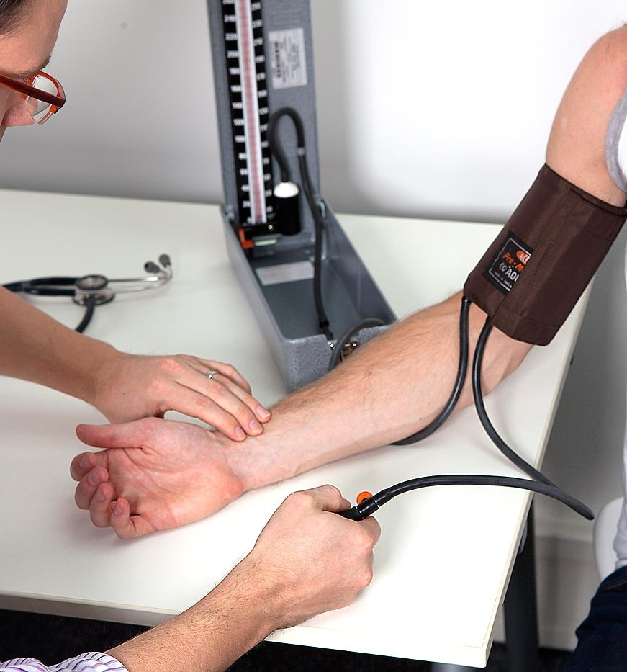
Measurement of BP
2. Indirect way
– Most common, accurate estimate
• Equipment:
Sphygmomanometer and
stethoscope
• Sites
– Upper arm (brachial
artery)
– Thigh (popliteal artery)

Slide 32
Common Errors in Taking BP
• Nurse may be influenced by patient's previous blood pressure reading or diagnosis
• Cuff too narrow or too wide
• Arm unsupported
• Insufficient rest before taking BP
• Repeating assessment too quickly
• Assessing after a meal or while patient is smoking or has pain
• Wrapping cuff too loosely
• Deflating cuff too quickly or too slowly
• Not using same arm
• Arms above level the heart

