Slide 1
Radiobiology
λ Radiobiology is a branch of science concerned with the action of ionizing radiation on biological tissues and living organisms
λ Objective
- To understand why ionising radiation can be used
to treat malignant cells
-To know the type of radiation that does this best
-To identify factors of significance to the success of
this process

Slide 2
The interaction of radiation with a cell is a matter of chance
[probability]. If an interaction occurs, the damage may not be
expressed, in fact damage is more frequently repaired
The initial deposition of energy occurs very quickly
The radiation is deposited in the cell randomly
Expression of damage occurs after a latent period, ranging from hours to years or even generations
λ The DNA is the sensitive target in the cell

Slide 3
Cell Cycle
The cell proliferation cycle is defined by two well
defined time periods: Mitosis (M), where division takes
place & the period of DNA synthesis (S).
The S and M portions of the cell cycle are separated by two periods (gaps) G1 and G2 when, respectively, DNA has not yet been synthesized or has been synthesized but other metabolic processes are taking place.
The time between successive divisions (mitoses) is called the cell cycle time.

Slide 4
Cell Death
Cell death of non-proliferating (static) cells is defined as the loss of specific function, while for stem cells and other cells capable of many divisions it is defined as the loss of reproductive integrity (reproductive death).
A surviving cell that maintains its reproductive integrity and proliferates almost indefinitely is said to be clonogenic.
When cells are exposed to ionizing radiation the standard physical effects between radiation and the atoms or molecules of the cells occur first and the possible biological damage to cell functions follows later.

Slide 5
Classification of Radiations
For use in radiobiology and radiation protection the physical quantity that is useful for defining the quality of an ionizing radiation beam is the linear energy transfer (LET).
The ICRU defines the LET as follows: “LET of charged particles in a medium is the quotient dE/ dl, where dE is the average energy locally imparted to the medium by a charged particle of specified energy in traversing a distance of dl.”
Unit usually used for the LET is keV/µm.

Slide 6
Cell Damage by Radiation
The biological effects of radiation result mainly from damage to the DNA, which is the most critical target within the cell
When directly ionizing radiation is absorbed in biological material, the damage to the cell may occur in one of two ways: Direct and Indirect.

Slide 7
Direct Action
In direct action the radiation interacts directly with the critical target in the cell. The atoms of the target itself may be ionized or excited through Coulomb interactions, leading to the chain of physical and chemical events that eventually produce the biological damage.
Direct action is the dominant process in the interaction of high LET particles with biological material.

Slide 8
Indirect Action
In indirect action the radiation interacts with other molecules and atoms (mainly water, since about 80% of a cell is composed of water) within the cell to produce free radicals, which can, through diffusion in the cell, damage the critical target within the cell.
In interactions of radiation with water, short lived yet extremely reactive free radicals such as H2O+ (water ion) and OH• (hydroxyl radical) are produced.
The free radicals in turn can cause damage to the target within the cell.

Slide 9
A free radical is a molecule or atom, which is not combined to anything (free) and carries an unpaired electron in its outer shell. It is in a state associated with a high degree of chemical reactivity.
If the water molecule is ionised H2O = H2O+ + e- (H2O is the water molecule ; H2O+ is an ion radical )
Ion meaning it is electrically charged, because it has lost an electron and a radical because it has an unpaired electron in the outer shell, making it very reactive.
Ion radicals have a short life, usually no more than 10-10 s, before they decay to form free radicals

Slide 10
Free radicals are not charged, but do have an unpaired electron in the outer shell. λ The water ion radical can, for example, do the following: H2O+ + H2O = H3O+ + OH* (H2O+, H3O+ are the ion radicals H2O is a water molecule)
OH* is a highly reactive hydroxyl radical, with 9 electrons, therefore one is unpaired.
Hydroxyl radicals (OH*), are highly reactive and can go on to react with DNA. It is estimated that 2/3 of the x-ray damage to mammalian DNA is by hydroxyl radicals

Slide 11
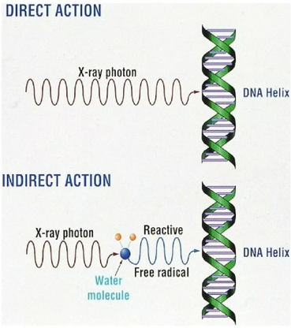

Slide 12
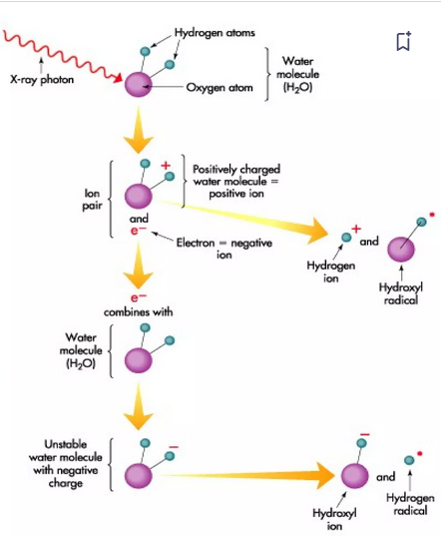

Slide 13
Types of DNA Damage
DNA damage to the cell can come in several forms:
1. Base damage/single-strand breaks (SSBs) – repaired via base
excision repair, not a major contributor to radiosensitivity.
2. Double-strand breaks (DSBs) – repaired via homologous
recombination repair (in late S/G2, a DNA template is available)
which is accurate, or non homologous end-joining which is error-
prone.
DSBs are a major contributor to radiosensitivity; ~40 DSBs are
required to kill cell.

Slide 14
3.Chromosome aberrations – result from unrepaired or misrepaired DSBs. Symmetric chromosome damage (e.g., translocations) tends to be nonlethal, whereas asymmetric damage (e.g., rings) tends to be lethal due to the loss of large amounts of DNA.

Slide 15
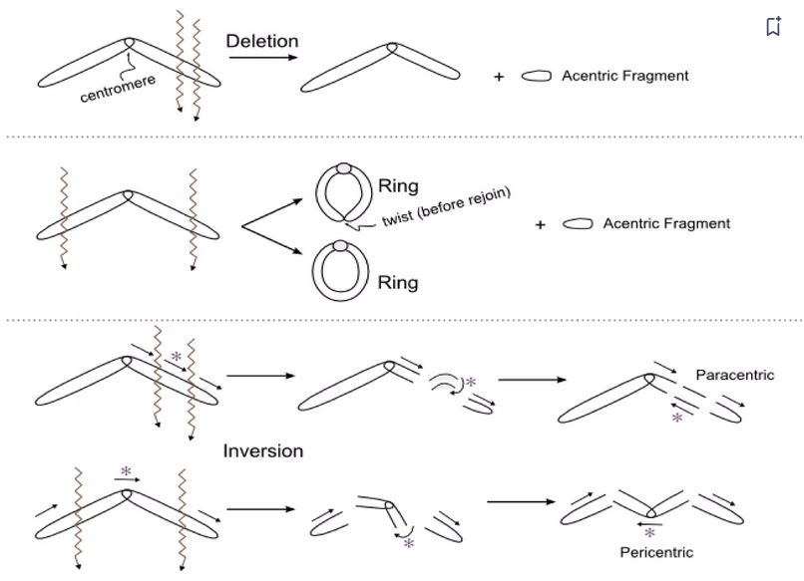

Slide 16
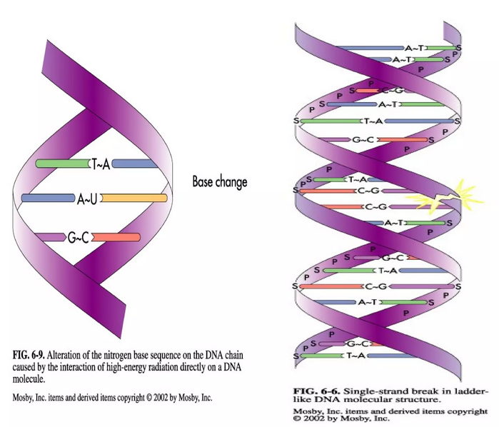

Slide 17
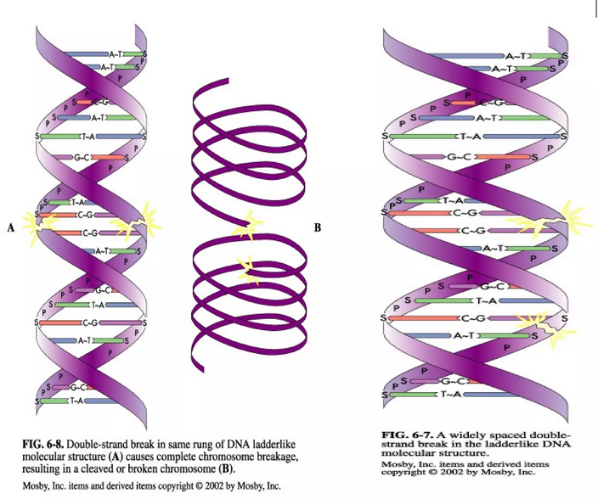

Slide 18
