Slide 1

Human Digestive System
2ed Lecture
1st Class
Dr. Hawraa kareem

Slide 2
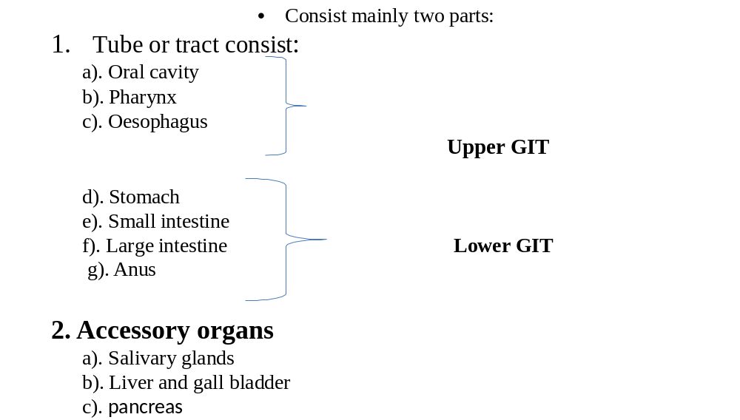

Slide 3
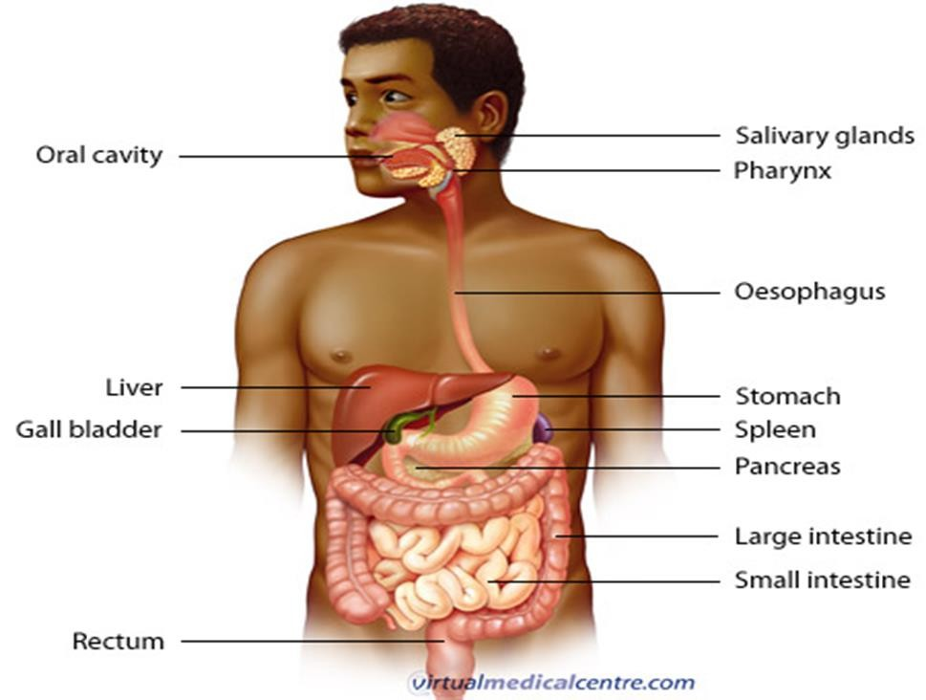

Slide 4
General Structure of the Digestive Tract
The wall of GIT is made up 4 principal layers:
1. Mucosa
2. Submucosa
3. Muscularis
4. Serosa or Advetitia

Slide 5
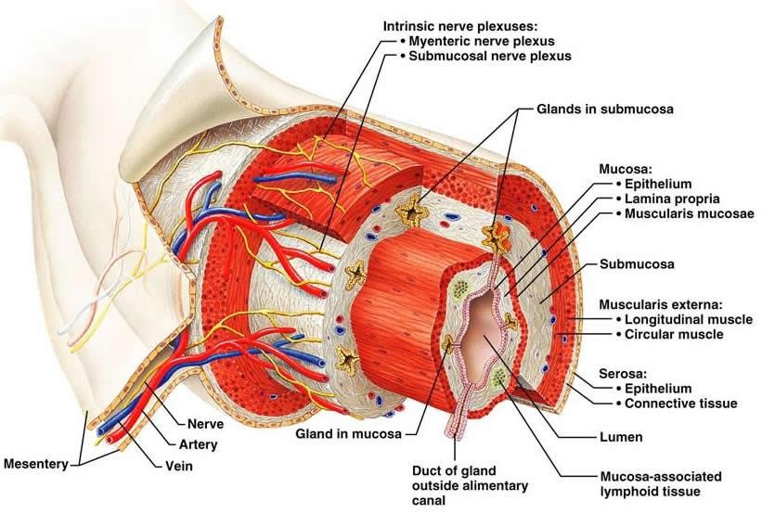

Slide 6
1.Mucosa (Mucous Membrane)
It consists of:
1. Epithelial lining
2. Lamina properia (loose connective tissue rich in blood and lymph
vessels, and sometimes containing glands smooth muscles).
3. Mascularis mucosae thin muscular layers separate
the mucosa from submucosa.

Slide 7
2.Submucosa
• It is composed of dense connective tissue with many blood and lymph vessels and also nerve plexus which called “Meissner’s plexus”.
3. Muscularis
• It is composed
• Inner circular smooth muscular layer
• Myenteric nerve plexus (Auerbach’s nerve plexus).
• Outer longitudinal smooth muscular layer.

Slide 8
4. Serosa
It is composed
• A thin layer of loose connective, rich in blood and lymph vessels
and adipose tissue
• Layer of simple squamous epithelium.

Slide 9
Anatomy of oral cavity
• Oral cavity is divided into two parts:
1. Vestibule
a). Lateral: cheeks and lips
b). Medial: upper and lower row of teeth.
c). Posterior: retomolar area.
2. Buccal cavity:
Roof: Hard palate (palatine) and Soft palate
which ended with uvula.
Floor: tongue.

Slide 10
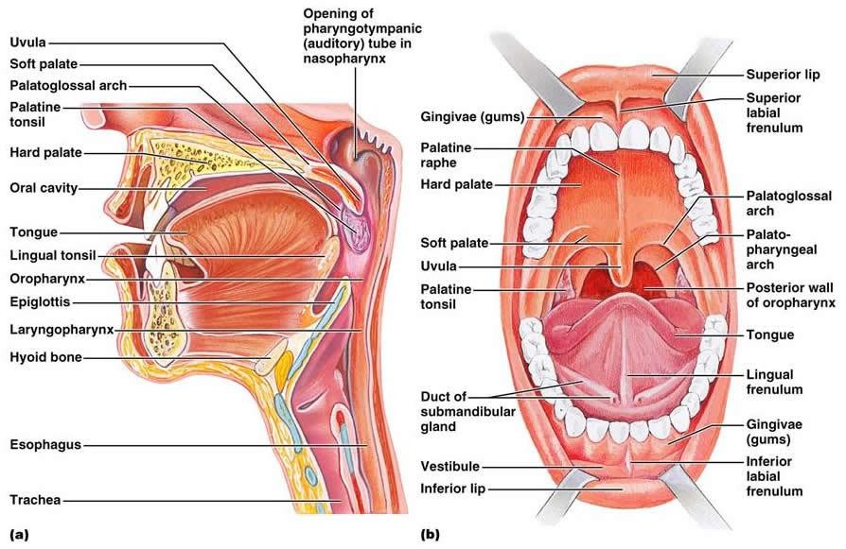

Slide 11
Structures of the oral cavity
Tongue: Muscular organ has different types of papillae. These papillae are important for taste.
lingual frenulum attaches the tongue to the floor of the mouth and prevents posterior movement of the tongue.
2. Gum and teeth
3. Salivary glands consist three major glands
a). Parotid glands (pairs)
b). Sub-mandibular glands (pair)
c). Sublingual gland.
4. Lymphoid tissues: Tonsils ( lingual tonsils, Palatine tonsils).

Slide 12
superficial to part of the masseter and anterior to the ear is the large parotid gland. this gland produces salivary amylase (ptyalin), a digestive enzyme.
the parotid gland is granular, it is attached by fascia. it is also the largest of the salivary glands.
the parotid empties into the parotid duct which empties between the last two molars at the angle of the jaw.
the parotid gland is an exocrine gland.
exocrine glands empty via a duct to a specific location.
the other type of gland is an endocrine gland
that empties directly into the bloodstream.

Slide 13
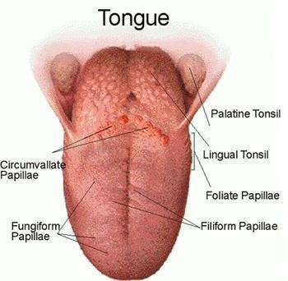

Slide 14
• Glands are organized arrangement of secretary cells.
• Exocrine glands are organized as acini or tubule, exocrine gland
has ducts therefore its secretion reaches by ducts to the affected part.
• All salivary glands are exocrine glands.
• Secretion of salivary glands may be serous, or mucous or mixed.
• Saliva in the mouth has digestive , lubricating and
protective functions.

Slide 15
Each salivary gland receives parasympathatic and sympathatic
innervation.
• Parasympathatic increases the secretion of saliva by all salivary
glands.
• Sympathatic innervation remains uncertain.

Slide 16
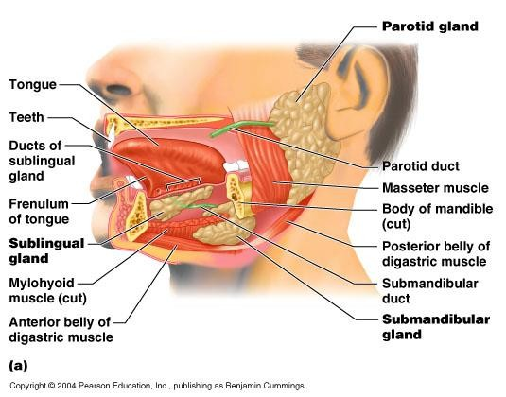

Slide 17
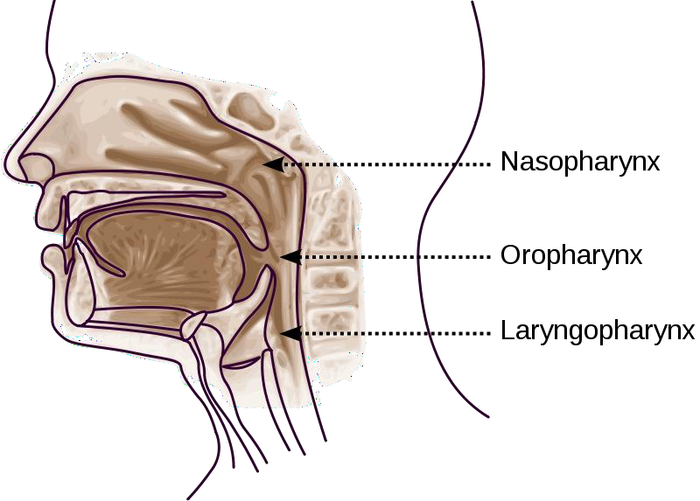
Pharynx and esophagus
• The pharynx is divided into three parts:
1. Nasopharynx
2. Oropharynx
3. Laryngopharynx

Slide 18
Oropharynx
-soft palate to epiglottis
-two sets of TONSILS
a. Palatine b. Lingual
2. Nasopharynx
-located superior and posterior to the soft palate.
-contains the pharyngeal tonsils and tubal tonsils
3. Laryngopharynx
- inferior to the epiglottis and posterior to the larynx.
- this division opens into the esophagus and larynx.

Slide 19
Superior to the oral cavity is the hard palate composed of the maxillary and palatine bones.
Superior and posterior to the oral cavity are the internal nares.
from the internal nares, if we go anteriorly we will find the external nares or nostrils.
posterior to the hard palate is the soft palate. This is muscular tissue that is moved during swallowing.
hanging from the soft palate is a conical structure
called the uvula.

Slide 20
caudal and ventral to the parotid gland is the submandibular gland (submaxillary).
the submaxillary duct empties this gland. it runs on the lateral aspect of the digastric muscle.
this gland carries saliva into the angle of the lower jaw.
the sublingual gland is on the submaxillary duct. it is wedge shaped and it is lateral to the digastric muscle.
the dorsal and ventral facial nerves run around
the outline of the masseter muscle.
these nerves come out in front of the ear from
the stylomastoid foramen and branch across the face.

Slide 21
Esophagus
• It is a muscular tube whose function to transport foodstuff from the mouth to the stomach.
• It descends toward thoracic cavity , posterior to the trachea, and enters the abdominal cavity through the oesophageal hiatus (an opening in the diaphram, to empty to the stomach.

Slide 22
Histological Structure of Esophagus
• Mucosa and submucosa project into large folds
• Submucosa contains small mucous secreting glands (esophageal
glands) their secretion facilitates the transport the foodstuff and
protects mucosa).
• Superior third of esophagus muscular layers contains skeletal
muscle fiber.
• Middel third of esophagus muscular layers
compose from mixture of both skeletal and
smooth muscle fiber

Slide 23
Inferior third of esophageal muscular layers composes only from smooth muscle fibers.
• Serosa covers only the end part of oesophagal wall
Sphincters of esophagus
Upper esophageal sphincter composed from skeletal muscle
and located in the upper part of esophagus just below pharynx.
Prevent air to inter esophagus.
2. Lower esophageal sphincter (cardiac sphincter)
composed of smooth muscle, which normally
remain in state of active contraction
to prevent backflow of materials from the stomach into esophagus.

Slide 24
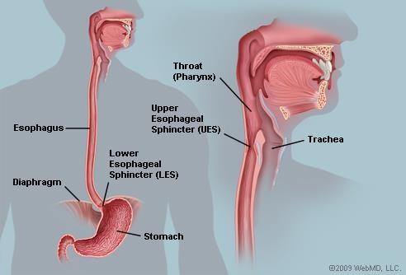

Slide 25
Stomach
• It is a muscular organ has ability to digest foods and convert them
to chyme.
• The major regions of the stomach include: cardia, fundus, body,
and pyelorus regions.
• There are two curvature in the stomach: greater curvature (lateral
surface) and lesser curvature (medial surface).
• Extending from curvatures are the lesser
omentum and greater omentum which help
to tie the stomach to other digestive organs.

Slide 26
the lesser curvature of the stomach is anchored to the liver with the lesser omentum. it cannot move.
the esophagus and duodenal ends are anchored. as food fills the stomach, it can sag on the left side.
the stomach also has longitudinal folds within the lumen. these folds, called rugae, increase the surface area of the stomach

Slide 27
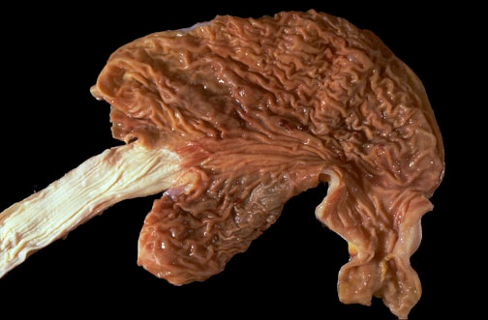

Slide 28
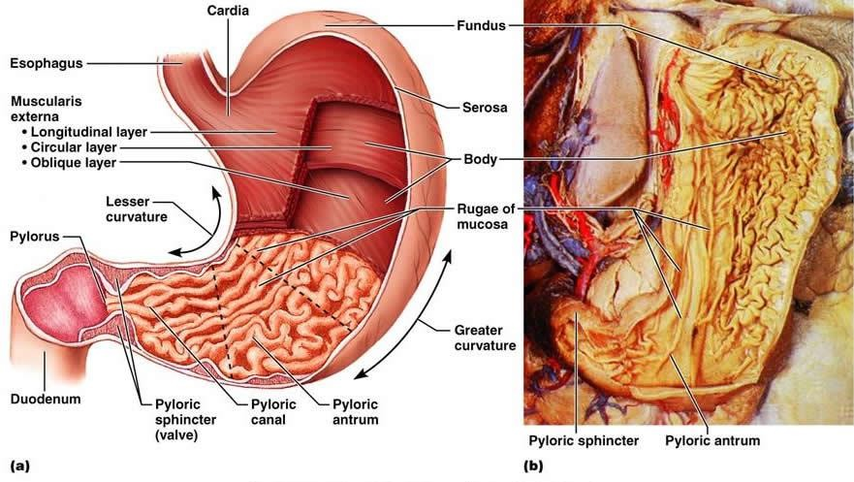

Slide 29
• The mucosa and submucosa of empty stomach make longitudinal
folds known as (rugae).
• Invagination of epithelial lining formed gastric pits.
• Lining epithelia and gastric pit cells secrete an alkaline mucus to
protect them from stomach acidity.
• The muscular layer contains an extra layer in addition to the circular
and longitudinal layers.

Slide 30
• Stomach has exocrine and endocrine secretions.
• The main secretary cells in the stomach are:
1. parietal cells (oxyntic): secret
- HCL (actually H+ and CL-)
-potassium chloride
-traces of electrolytes
-intrinsic factor is essential for absorption of vitamin B12
2. Chief cells (zymogenic cells) secret Pepsinogen
(inactive form of pepsin enzyme).
Pepsin is an enzyme digests proteins.

Slide 31
3. Mucous cells secret mucus
4. Enteroendocrine cells like :
G- cells secret gastrin.(enhance of acid by parietal cells)
D- cells secret somatostatin (acts by inhibit release other hormones
like gastrin).

Slide 32
Innervations of the stomach
By sympathatic and parasympathatic The Blood Supply to the Stomch
The greater curvature is supplied by the right gastroepiploic artery inferiorly and the left gastroepiploic artery superiorly.
The fundus of the stomach, and also the upper portion of the greater curvature, is supplied by the short gastric artery which arises from the splenic artery

Slide 33
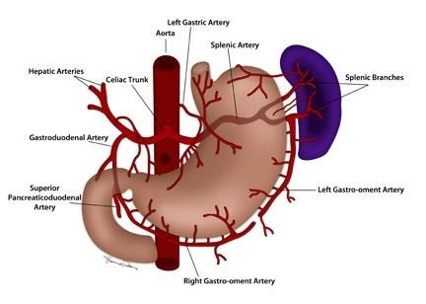

Slide 34
Small Intestine
• The small intestine is the site of the terminal food digestion, nutrient
absorption, and endocrine secretion.
• The small intestine consists of three segments:
- Duodenum
-Jejunum
- illium

Slide 35
Histology of small intestine
• Lieberkuhn glands or Intestinal glands (Crypts)
- simple tubular glands
- extend into lamina properia
- empty to the base of villi
- contain Stem cells goblet cells, absorptive cells, and Panth’s cells
(a protective cells secret an enzyme that digest cell wall of bacteria).
• Villi
- extensions of mucosa into lumen of small intestine.

Slide 36
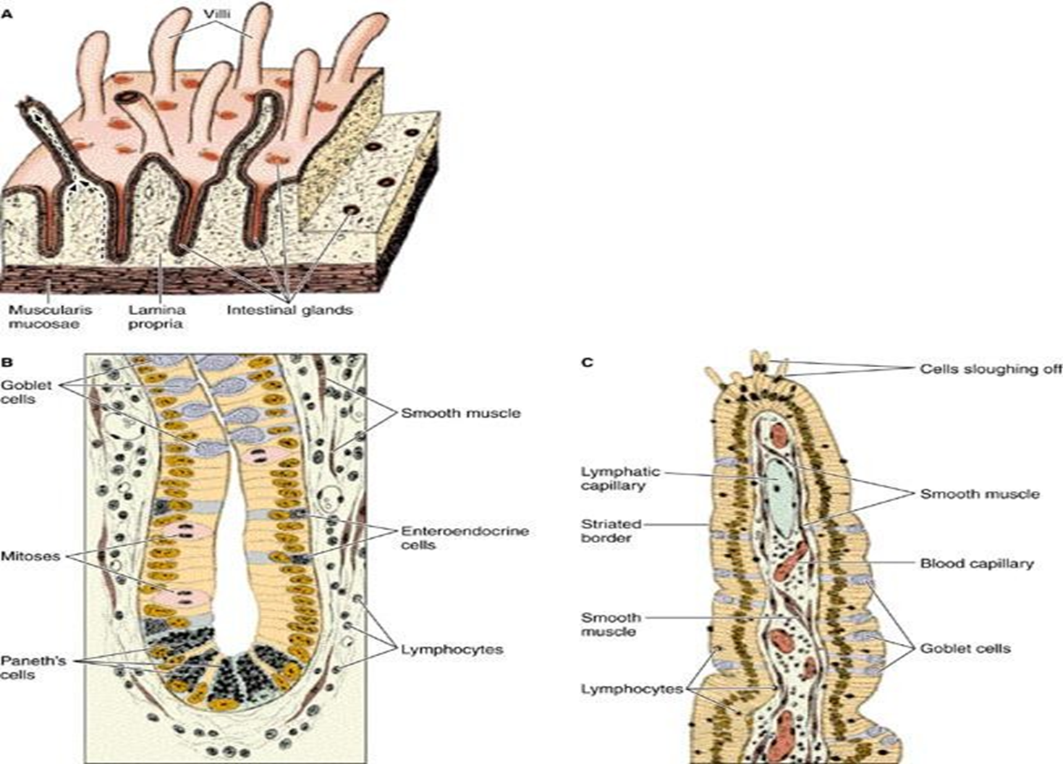
Plica
The lining of the small intestine shows a series of permanent folds called plicae circulares, consisting of mucosa and submucosa.

Slide 37
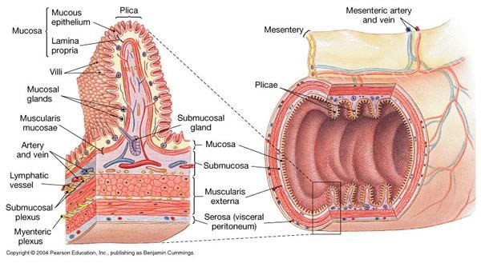
Photomicrograph of the small intestine

Slide 38
Histology of the small Intestine
• The lining of the small intestine shows a series of permanent folds
called plicae circulares, consisting of mucosa and submucosa.
• Plicae well developed in the jejunum, but do not constitute a significant
feature of the duodenum and ileum.
• Intestinal villi are mucosa projecting into the lumen
of the small intestine.
• Between the villi are small openings of
simple tubular glands called intestinal glands(glands of lieberkuhn).

Slide 39
• Therefore the small intestine is modified for dramatically increased
surface area.
• The Doudenum has Brunner’s glands (submucosal doudenal glands
secret neutral alkaline mucus). There secretions protect doudenum
from erosion by acid entering from stomach.
• The jejunum has many long leaf like villi (plicae circularis).
And intermediate number of goblet cells (produce mucus).
• The ileum has numerous goblet cells
Peyer’s patchs (aggregation of lymphocytes).

Slide 40
Innervation of intestinal glands:
- Sympathatic stimulation leads to decrease intestinal secretions
- Parasympathatic stimulation leads to increase intestinal secretions

Slide 41
Vessels of the small intestine
• The blood vessels that nourish the intestine and remove absorbed
products of digestion penetrate the muscularis and form a large
plexus in the submucosa. Therefore each villus receives one or more
branches that form a capillary network just below its epithelium
• Lacteals (capillary lymphatic vessel of villus).
- Important for the absorption of lipids because
blood circulation does not easily accept
the lipoproteins produced by the tall
columnar during this process.

Slide 42
• In the duodenum there is a major duodenal papilla in which the bile
and pancreatic secretions enter the intestine through Ampulla of Vater.
• Bile secretion leads to emulsify the fats. Emulsification of fats is
important for fat digestion by lipase enzyme which is produced by
pancreas.
• Pancreas secrets amylase enzyme (for carbohydrate digestion), lipase
enzyme ( for fat digestion) and proteolytic enzymes
(for protein digestion).

Slide 43
Large Intestine
• An organ that the microbial digestion, liquid absorption, and
transportation of undigested food to the rectum occurs.
• The junction between the end of ileum and beginning of large intestine
is gaurded by ileocaecal sphincter.
• Large intestine is much wider than small intestine.
• The wall of large intestine shows a series of sacculations (also called haustrations).
It divided into:
1. Cecum and appendix
2. Colon: ascending, transverse, descending, segmoid
3. Rectum for storage of waste products.
4. Anus

Slide 44
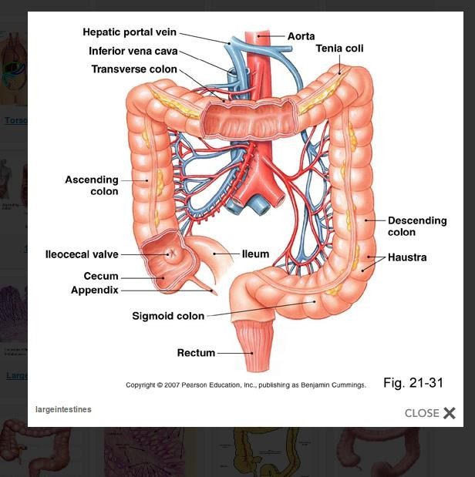

Slide 45
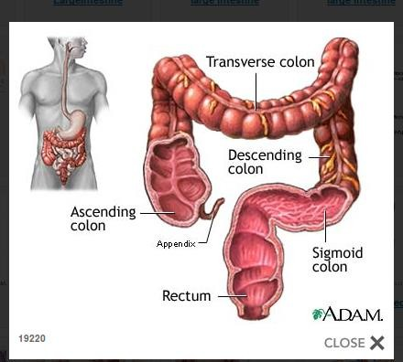

Slide 46
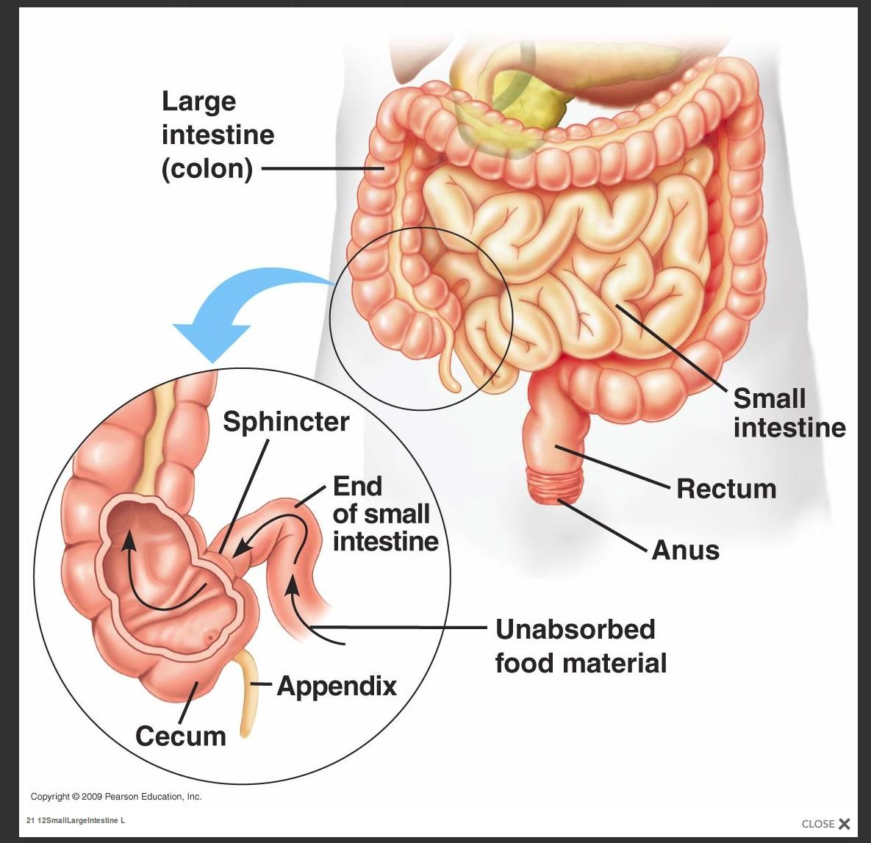

Slide 47
liver
• It is the largest internal organ in the body.
• The nutrient absorbed in the digestive tract are processed (detoxification and metabolism) and stored in the liver for use by other parts of the body. Thus liver is an interface between digestive system and blood.
• All materials absorbed via intestine reach the liver through
the portal vein except the complex lipids which
transport mainly by lymph vessel
• It consists of four lobes
(1. left lobe 2. right lobe 3. Quadrate lobe 4. Caudate lobe)

Slide 48
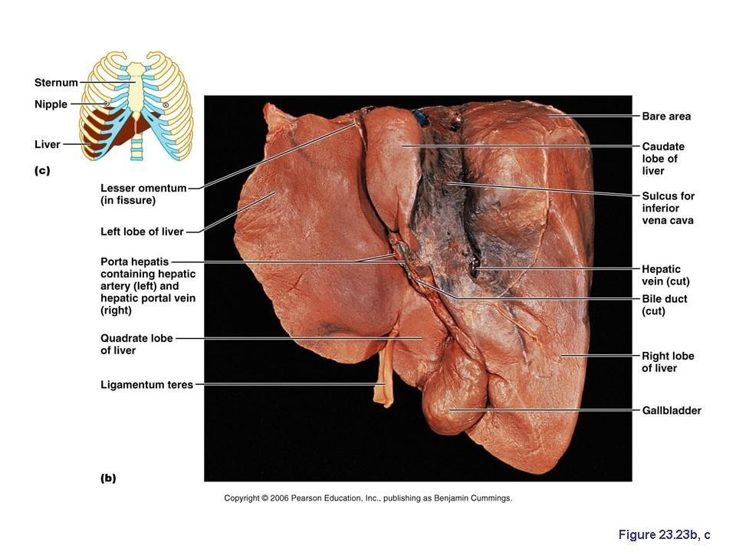

Slide 49
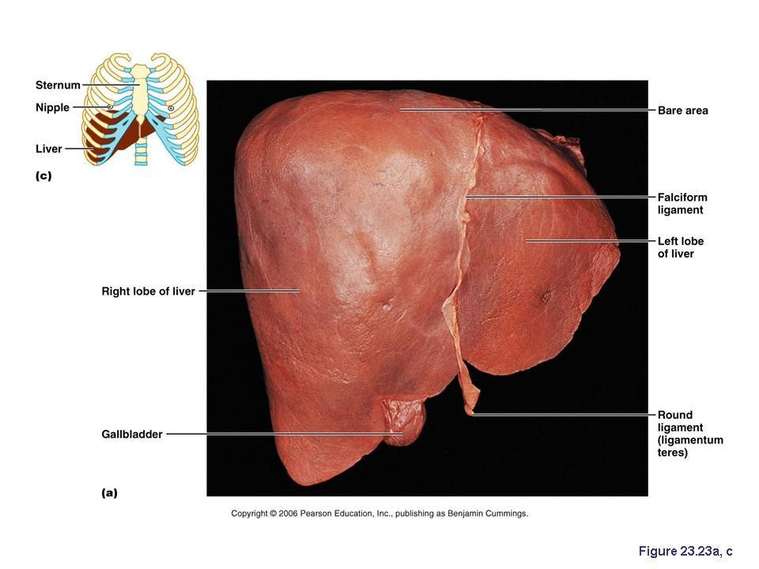

Slide 50
Histology of the liver
• Liver mainly consists from a large number of lobules (hexagonal lobule)
• three adjacent lobules form an area called portal area (this area contains
blood vessels, bile duct and lymph vessel).
• In the center of each lobule there is central vein.
• Hepatocytes arrange as a cord or plate from central vein to the
periphery of lobules.
• Sinusiods carry blood from portal vein and
hepatic artery (in the portal area) to the central vein.
• Kupffer’s cells

Slide 51
Pancreas
• It is an exocrine and endocrine gland.
• Exocrine secretion are amylase, lipase, and proteolytic enzymes.
• Anatomically pancreas consist from:
1. Head
2. Body
3. Tail
  Secretion of pancreas carry by main pancreatic duct.
  • The main pancreatic duct units with common
  bile duct to form ampula of vater

Slide 52
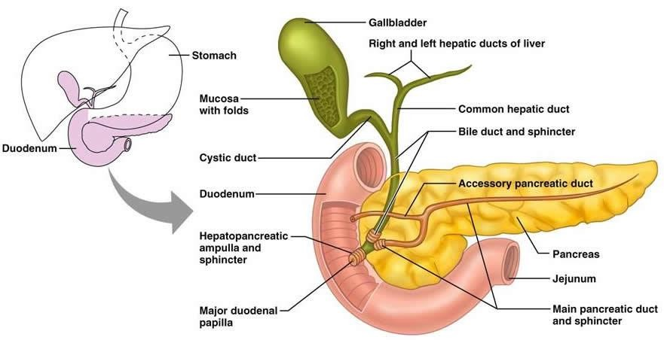

Slide 53
Pancreatic secretion is controlled by
1. Hormones mainly secretin and cholecystokinin are produced by enteroendocrine cells of duodenal mucosa.
2. Parasympathatic stimulation

