Slide 1
By Layth Kareem
Ms.c in MRI applications
Special procedures of GI tract (8)
methods of imaging the hepatobiliary system (CT scan of the liver)

Slide 2
methods of imaging the hepatobiliary system
1. Plain film
2. Ultrasound (US)
3. Computed tomography (CT), including:
(a) Routine ‘staging’ (portal venous phase) CT
(b) Triple phase ‘characterization’ CT
(c) CT cholangiography
4. Magnetic resonance imaging (MRI)
5. Endoscopic retrograde cholangiopancreatography (ERCP)
6. Percutaneous transhepatic cholangiography (PTC)
7. Operative cholangiography
8. Postoperative (T-tube) cholangiography
9. Angiography—diagnostic and interventional
10. Radionuclide imaging:

Slide 3
Computed tomography of the liver and biliary tree
Indications
1. Suspected focal or diffuse liver lesion
2. Staging known primary or secondary malignancy
3. Abnormal liver-funct.
4. Right upper-quadrant pain or mass
5. Hepatomegaly
6. Suspected portal hypertension

Slide 4
indications
7. Characterization of liver lesion
8. Pyrexia of unknown origin
9. To facilitate the placement of needles for biopsy
10. Assessment of portal vein, hepatic artery or hepatic veins
11. Assessment of patients with surgical shunts or transjugular
intrahepatic portosystemic shunt (TIPS) procedures
12. Follow-up after surgical resection or liver transplantion tests

Slide 5
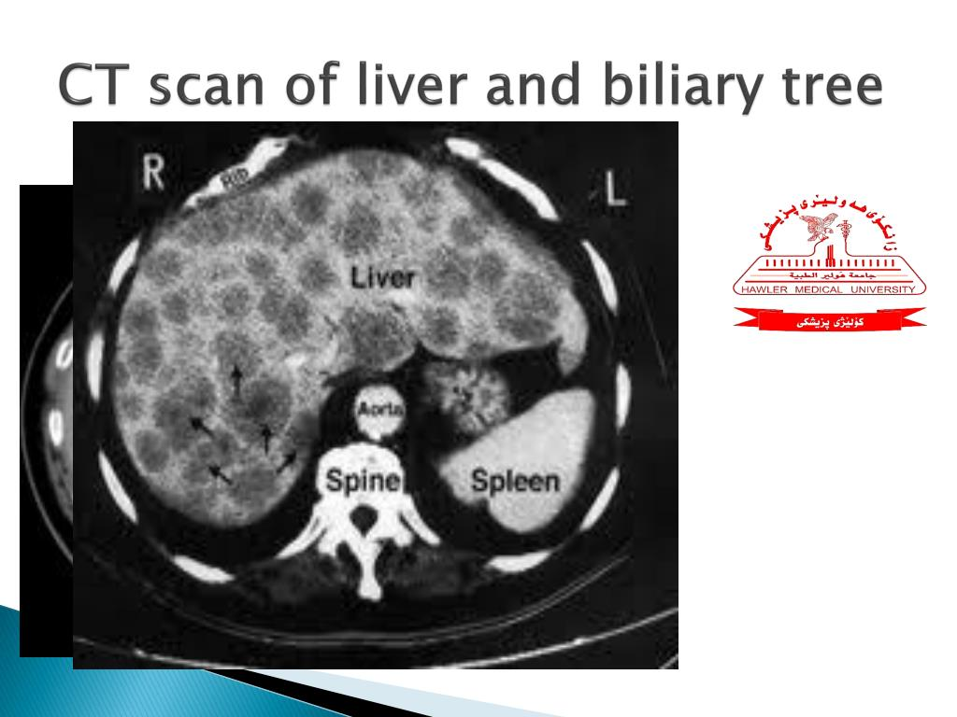
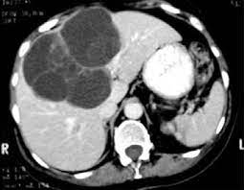
Computed tomography
Contra-indications
1.Pregnancy
2. Allergy to iodinated contrast agents

Slide 6
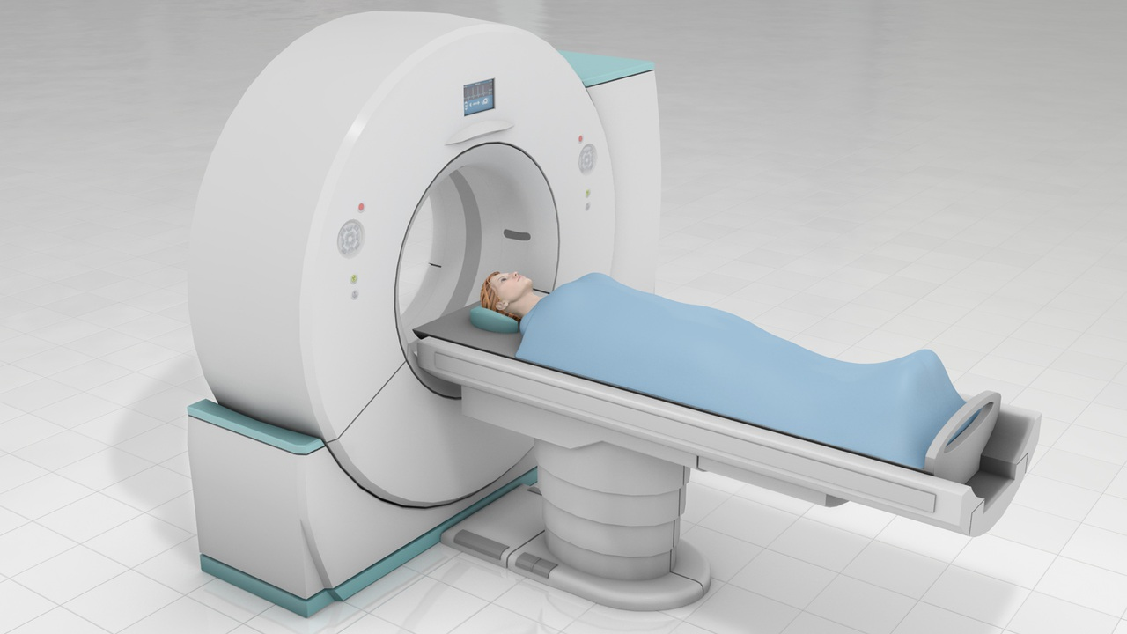
Ct multiphase(very important)

Slide 7
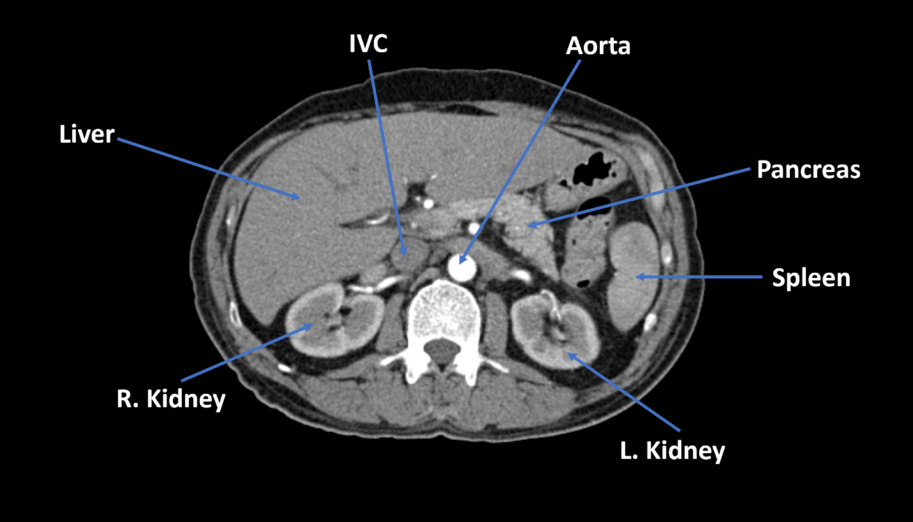
Anatomy of abdomen

Slide 8
Technique
Technique
Single-phase (portal phase) contrast-enhanced computed tomography
This is the technique for the majority of routine liver CT imaging.
The liver is imaged during the peak of parenchymal enhancement—
i.e. when contrast-medium-laden portal venous blood has fully perfused the liver (around 60–70 s after the start of a bolus injection).
Oral contrast may be given but is not necessary if only the liver is
being investigated. Slice thickness will depend upon the CT scanner
specification but should be 5 mm or less.

Slide 9
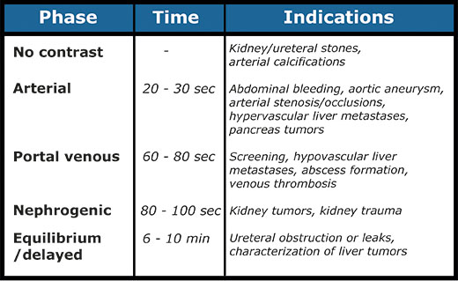
Ct multiphase(very important)

Slide 10
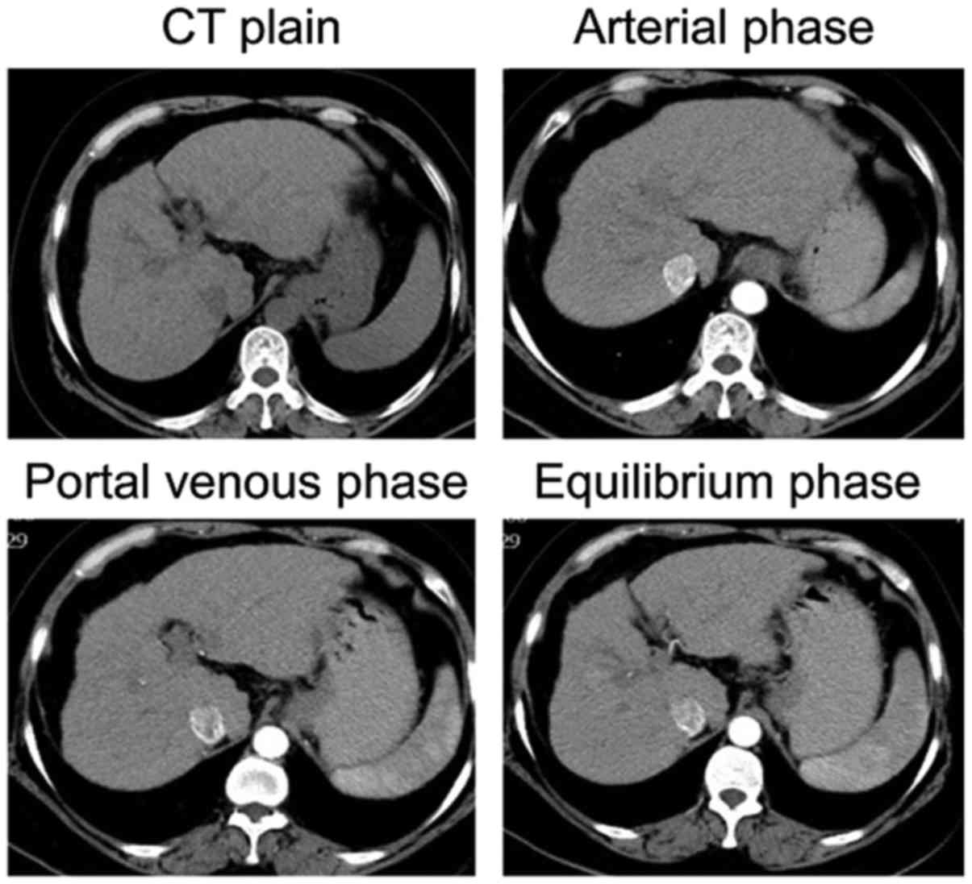
Ct multiphase(very important)

Slide 11
CT SCAN(MULTIPHASE)
Multiphasic contrast-enhanced computed tomography
The fast imaging times of helical/multi slice CT enable the liver
to be scanned multiple times after a single bolus injection of
contrast medium. Most primary liver tumors receive their blood
supply from the hepatic artery, unlike normal hepatic parenchyma,
which receives 80% of its blood supply from the portal
vein. Liver tumors (particularly hyper vascular tumors) will
therefore enhance strongly during the arterial phase (beginning
20–25 s after the start of a bolus injection) but are of similar or
lower density to enhanced normal parenchyma during the portal

Slide 12
CT SCAN(MULTI PHASE)
venous phase (washout). Some tumours are most conspicuous
during early-phase arterial scanning (25 s after the start of a bolus
injection), and others later, during the late arterial phase 35 s after
the start of a bolus injection. Thus a patient who is likely to have
hypervascular primary or secondary liver tumours should have

Slide 13
an arterial phase scan as well as a portal venous phase CT scan
(discussed previously). Early and late arterial phase with portal
venous phase is appropriate for patients with suspected hepatocellular
cancer (triple phase). In general, late arterial and portal
venous scans are appropriate to investigate suspected hypervascular
metastases. Some centres, however, also use a ‘delayed’ o

Slide 14
CT SCAN(MULTI PHASE)
‘equilibrium’ phase scan at 180 s to help identify and characterize
primary liver tumours (quadruple phase). Terminology may be
potentially confusing, as some centers may consider a triple phase
scan to include arterial, portal and delayed scans. Non contrast
examinations have limited usefulness. Haemangiomas often show a characteristic peripheral discontinuous
nodular enhancement and progressive centripetal ‘fill-in’.
After the initial dual- or triple-phase protocol, delayed images at 5 and 10 min are obtained through the lesion.

Slide 15
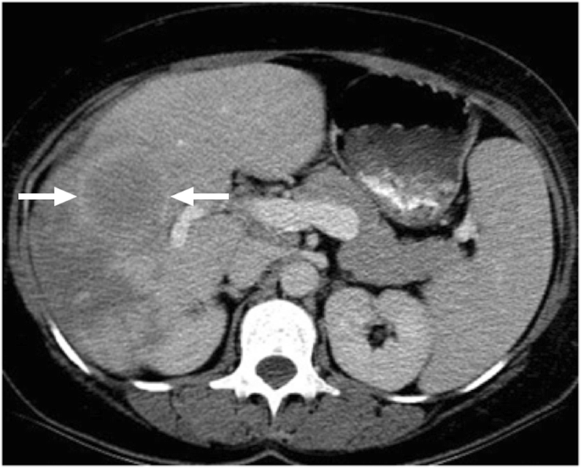
Case of liver lesion ct scan

