Slide 1
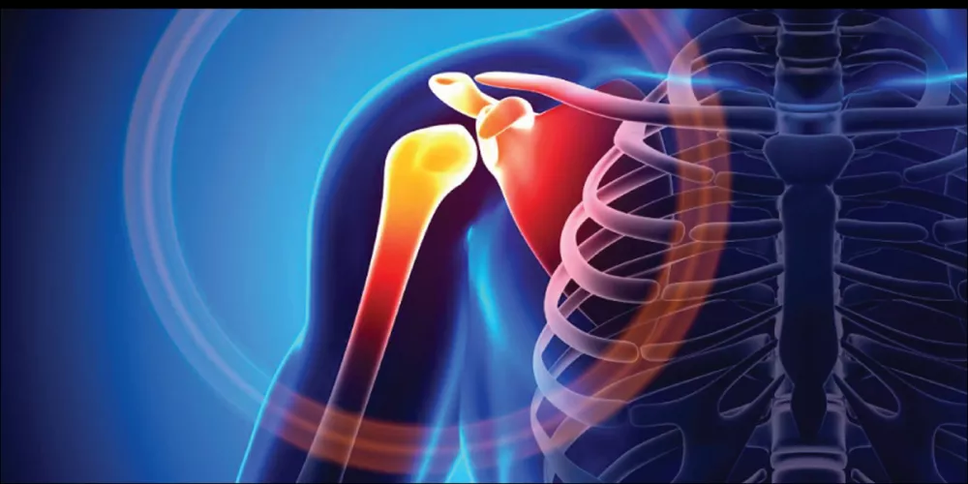
Lec 3 ( Radiographic techniques(X – Ray Department
By
Layth Kareem
Ms.c in MRI applications
radiographic techniques for upper limbs(lec3)

Slide 2
Recommended position
Shoulder – survey ( basic position)
1.Antero-posterior AP (15 degrees neutral rotation) – erect/sitting
2. Lateral ( basic)
3.Supero-inferior (axial)…. Sitting
4. Infero- superior (axial)…supine
5. Stryker notch view

Slide 3
Shoulder joint anatomy
The shoulder joint (or glenohumeral joint from Greek glene, eyeball, + -oid, 'form of', + Latin humerus, shoulder)
The shoulder joint is a ball-and-socket joint between the scapula and the humerus.
It involves an articulation between the glenoid fossa of the scapula (shoulder blade) and the head of the humerus (upper arm bone).
it is the most mobile joint of the human body.

Slide 4
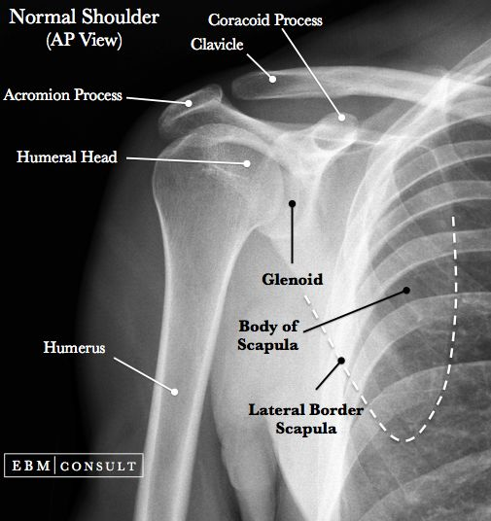
shoulder joint x ray anatomy

Slide 5
1. shoulder AP( neutral rotation)
Position
1.the patient is placed either in supine position or in erect position
2. Adhere shoulder to image receptor (IR)
3. Place coracoid process on the center of (IR) and place the (IR) 5 cm above the shoulder
Direction and centring of the X-ray beam
• project perpendicularly toward coracoid process
Respiration
Suspended

Slide 6
shoulder AP( neutral rotation)
IR size
25*30 cm(10*12)
SID
100 cm
Collimation
Include 2/3 of clavicle and 1/3 of proximal portion of numerus
Kvp=65
mAs=16

Slide 7
Cv shoulder AP( neutral rotation)
Pathology
Fracture of distal humerus and clavicle, dislocation subluxation and calcification of shoulder joint
Region
glenohumeral joint, scapula, proximal humerus, clavicle

Slide 8
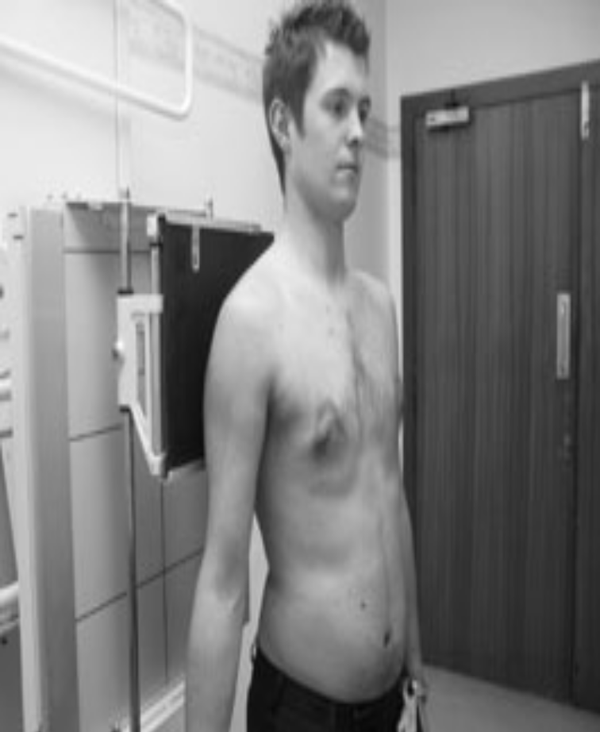
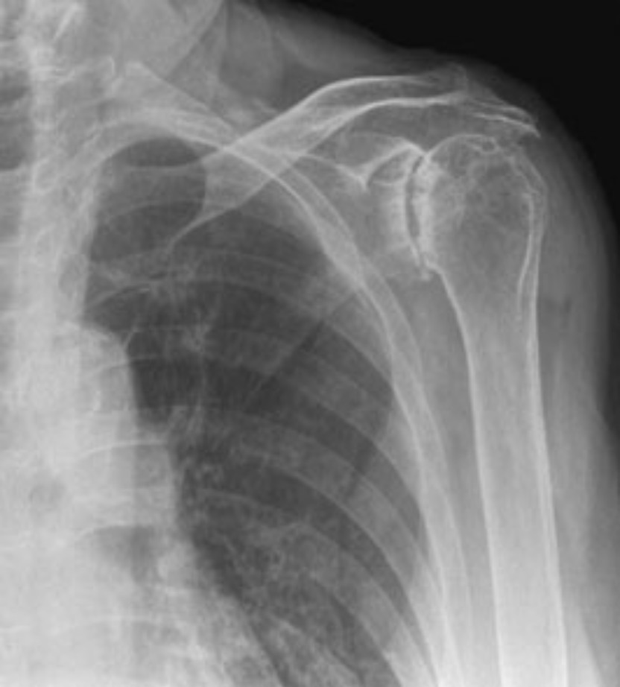
Antero-posterior (15 degrees) erect – survey image

Slide 9
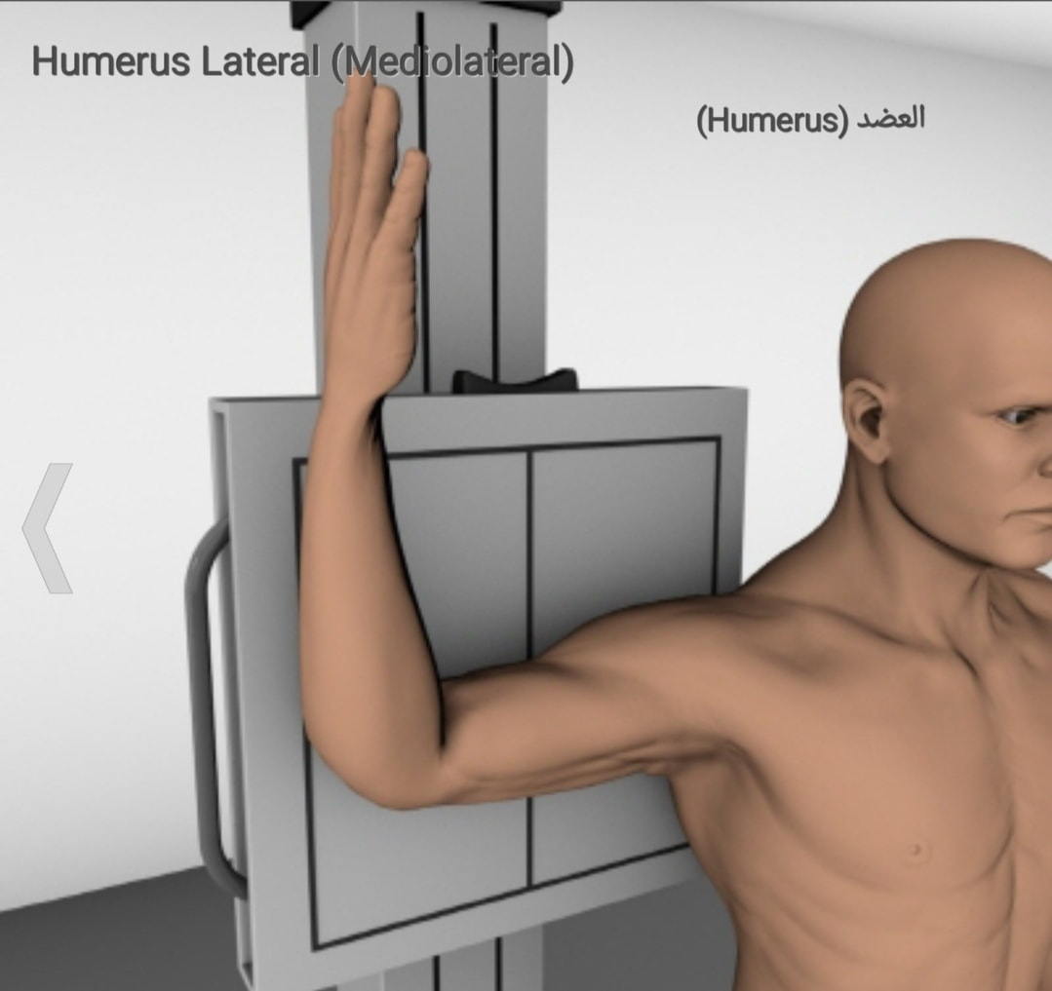
Shoulder lateral (patient position )

Slide 10
Shoulder lateral
position
1.The patient is placed either in supine position or in erect position.
2.Place the the filming shoulder on the image receptor (IR)
3.Abduct humerus 90 while flex forearm90.
IR size
25*30cm(10*12 inch)

Slide 11
Shoulder lateral
Region
Glenohumeral joint,scapula, proximal humerus,clavicle
Pathology
Fracture of distal humerus and clavicle, dislocation,
Subluxation and calcification of shoulder joint
SID
100cm
Centeral ray:project perpendicularly toward the center of scaplula

Slide 12
Shoulder lateral
Collimation
Include half proximal portion of the filming humerus.
Evaluation
1.Check compression or fracture of humeral head
2.check posterior dislocation
Kvp
70
mAs
20

Slide 13
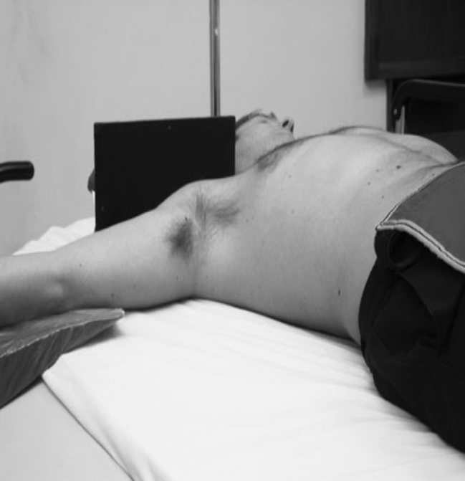
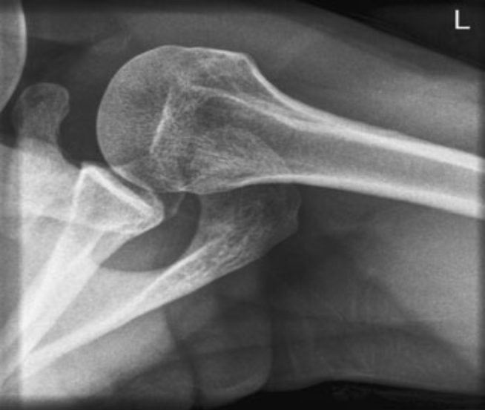
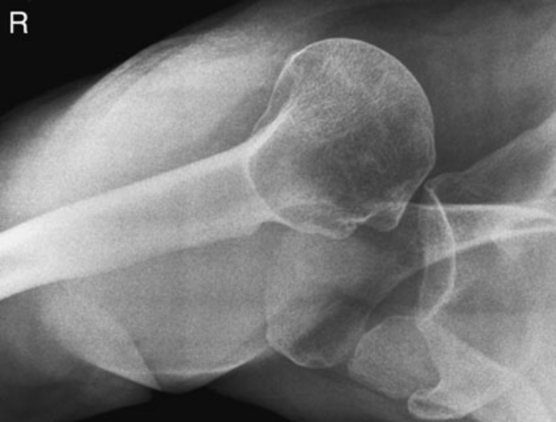
Infero-superior (alternate)
Normal infero-superior radiograph of the shoulder
Note
The most common type of dislocation of the shoulder is an anterior dislocation,

Slide 14
Infero-superior(Lawrence method )
Patient position
The patient is palced in supine position supporting the head with a pillow and the head is in rotation toward the opposite side of filming table.
2.put the arm in complete abduction and face the palm upward.
3.place neck adhere to image receptor (IR) standing erectly.

Slide 15
Infero-superior position
IR size
25*30 (10*12 inch)
SID =100 cm
Central ray
Project perpendicularly at axilla and humeral head
Respiration
-suspended
Collimation ( same)
Evaluation (same)
Kvp and mAs (same)

Slide 16
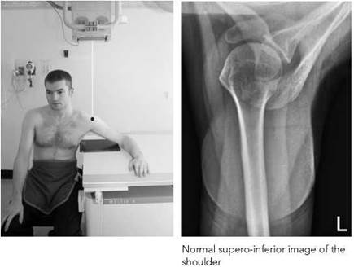
Shoulder supero- inferior

Slide 17
Superio-inferior
Region
pathology
IR size
SID
central ray,Respiration,
evaluation Kvp ,mAs
and position (the same)

Slide 18
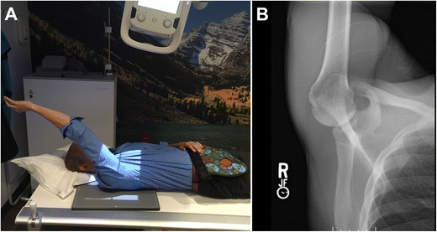
Shoulder stryker notch

Slide 19
Position
1.the patient is placed in supine position
2.place coracoid process of filming shoulder on the center of image receptor(IR)
3. place humeral body in parallel with mid sagittal
Place
The other things ( the same )

Slide 20
thank you listening

