Slide 1
Classification of partial partial denture lec2
Assit lecturer :samah khalel RADHI

Slide 2
Kennedy's classification.
There are many different methods of classification the most universally accepted method used today is called Kennedy's classification.
Kennedy classified all partially edentulous areas into 4 main types according to:
1.Position of edentulous area.
2.Numbers of edentulous area.

Slide 3
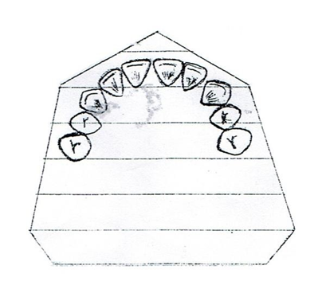
The following are 4 types of Kennedy classification:-
Class I : bilateral edentulous areas located posterior to the natural teeth. (bilateral free – end extension).

Slide 4
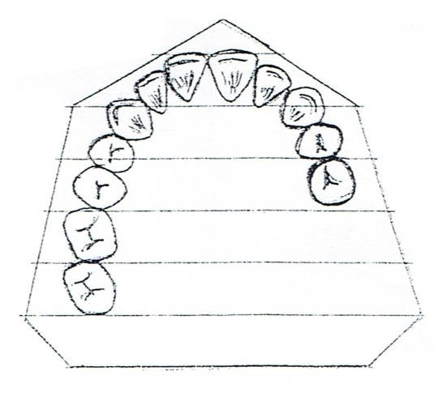
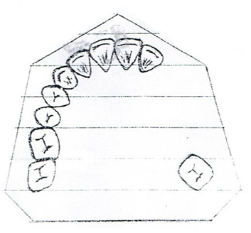
Class II : unilateral edentulous area located posterior to the remaining natural teeth (unilateral free-end extension).
Class III : unilateral edentulous area with natural teeth remaining both anterior and posterior to it (unilateral bounded area)

Slide 5
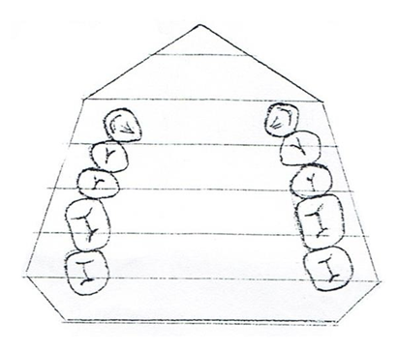
Class IV : A single, but bilateral (crossing the midline) edentulous area located anterior to the remaining natural teeth (bilateral but single bounded edentulous area).
.It is the bounded saddle area loss anterior teeth) no modification area

Slide 6
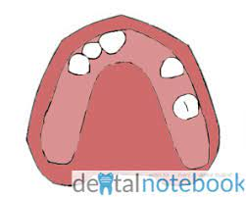
Modification area: is additional bounded edentulous area other than 4 those determining the basic classes of Kennedy classification
and it is determined by the number of these spaces not by the number of the missing teeth in the space.
Modification area can be seen with class I, II, and III only, while in class IV there no modification area.
Modification area can be seen in the anterior region or posterior region.

Slide 7
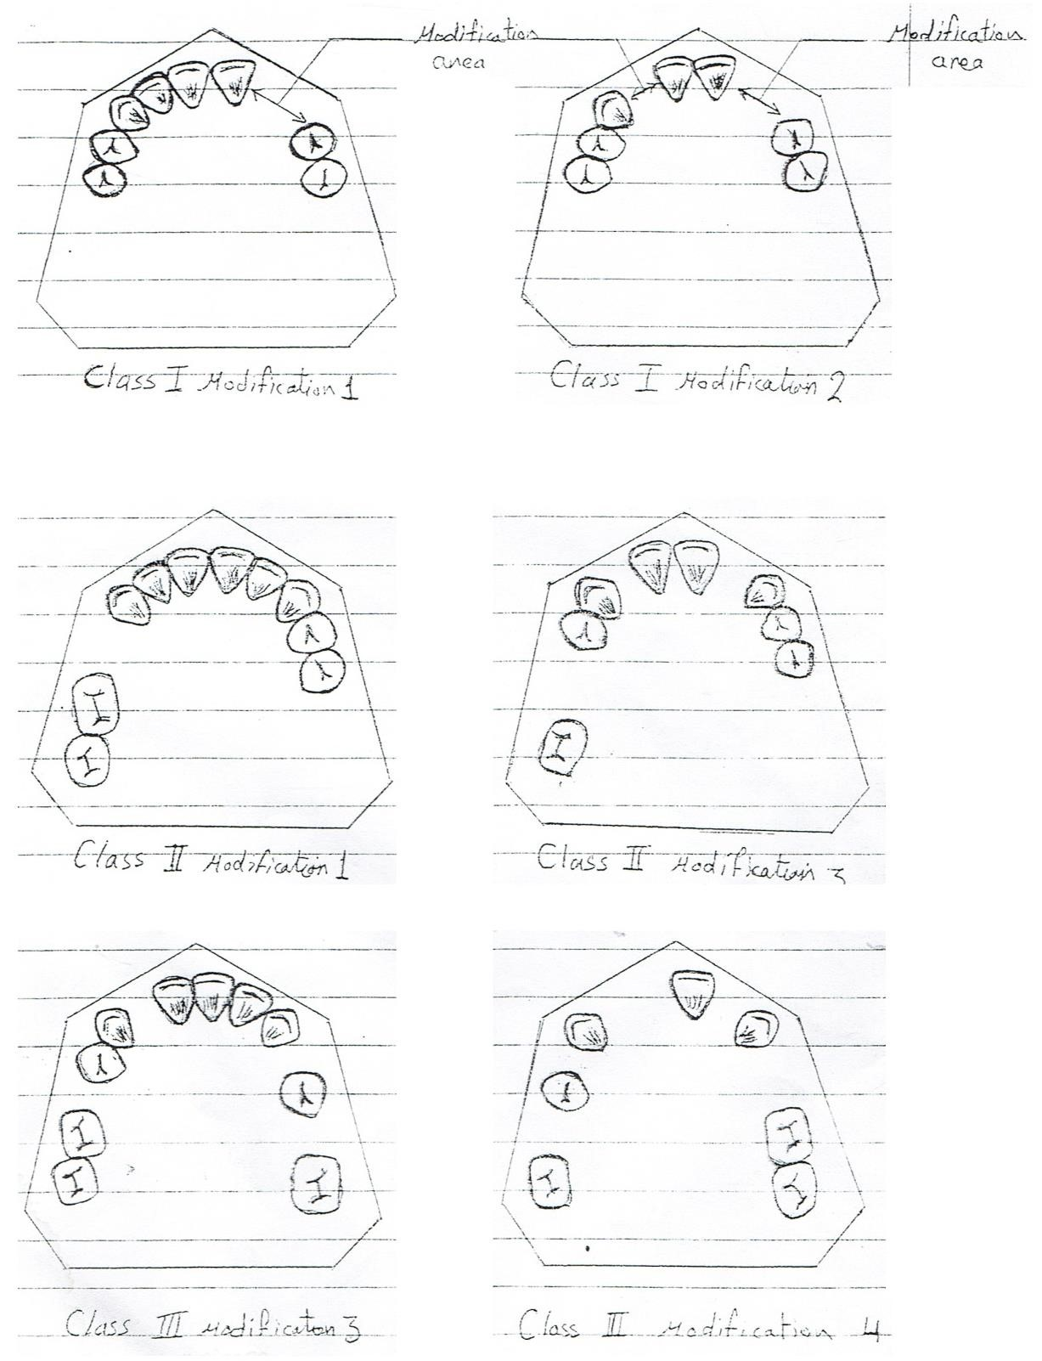

Slide 8
Note :In each classification:- the most posterior edentulous area determine the class type that mean we see first the posterior area if we have edentulous area we determine if it is bounded or free end extension area and then we see if it one side (unilateral) or two sides (Bilateral. Then we see if there is another space considered as modification area).
That mean:
Basic 4 types of Kennedy classification + modification area

Slide 9

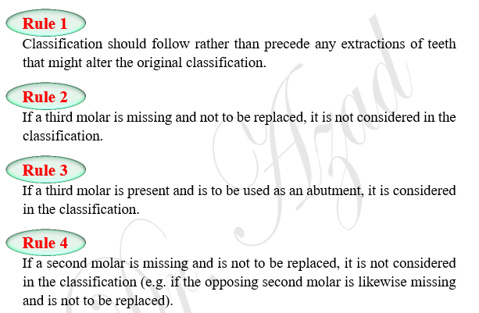

Slide 10
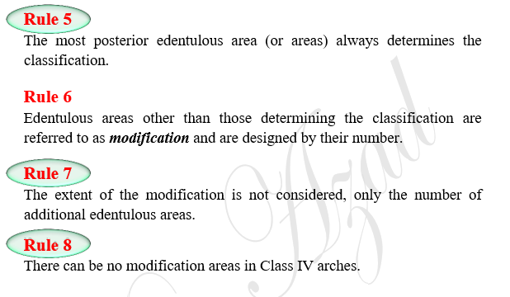

Slide 11
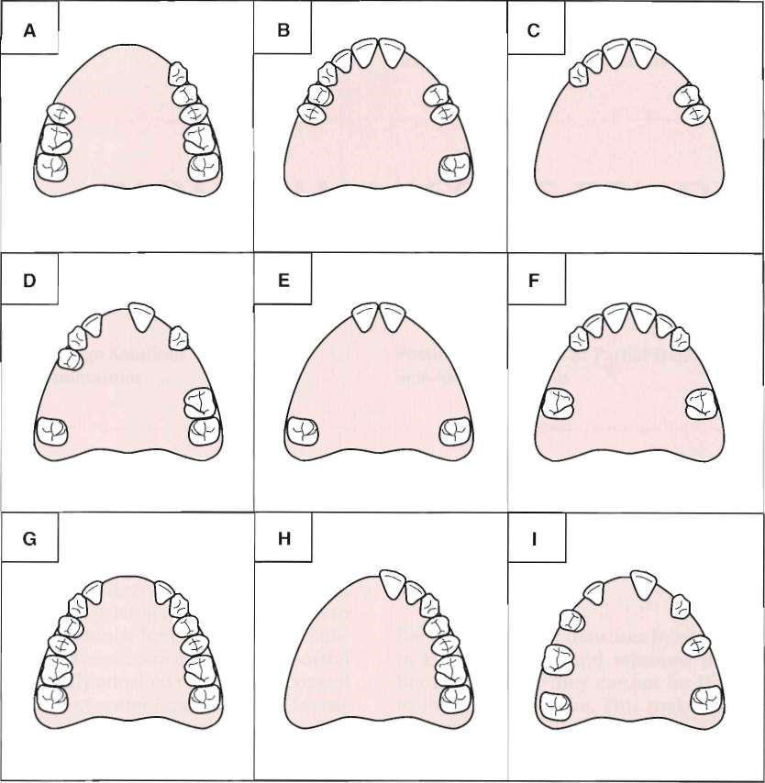

Nine partially edentulous arch configurations.

Slide 12
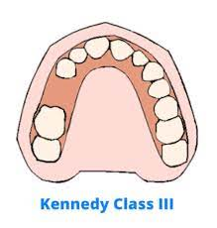
Classification of removable partial denture according to the load distribution (support )
This classification depended on which part bear the masticatory load in function tooth or mucosa. We have 3 types:
1.Tooth borne partial denture: is partial denture which entirely supported by teeth.

Slide 13
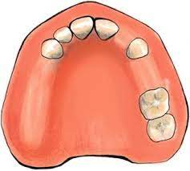
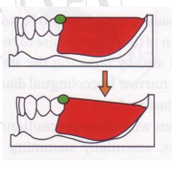
Tooth-tissue borne partial denture: is partial denture which entirely supported by both tooth and mucosa and underlying bone.
Tissue borne partial denture: is partial denture which is entirely supported by mucosa and underlying bone.

Slide 14
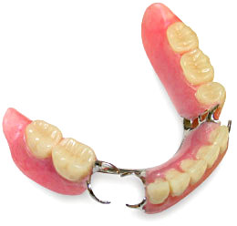
Tissue borne partial denture: is partial denture which is entirely supported by mucosa and underlying bone.

Slide 15


