Slide 1
An articulator and face bow

Slide 2
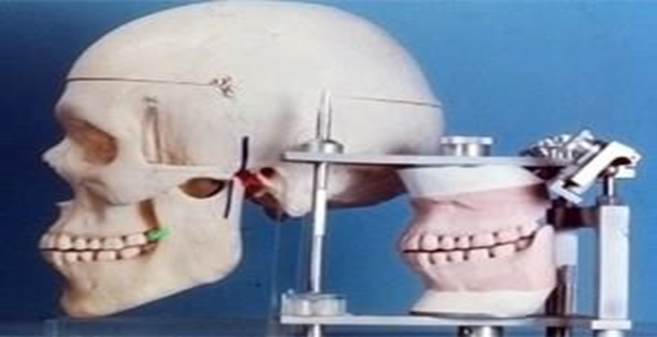
An articulator is a mechanical device to which maxillary and mandibular casts may be attached, representing the tempro-mandibular joints and jaw members, and it is used to hold the casts in one or more position of diagnosis, the arrangement of teeth (artificial teeth) and the development of the occlusal surfaces of fixed restoration.

Slide 3
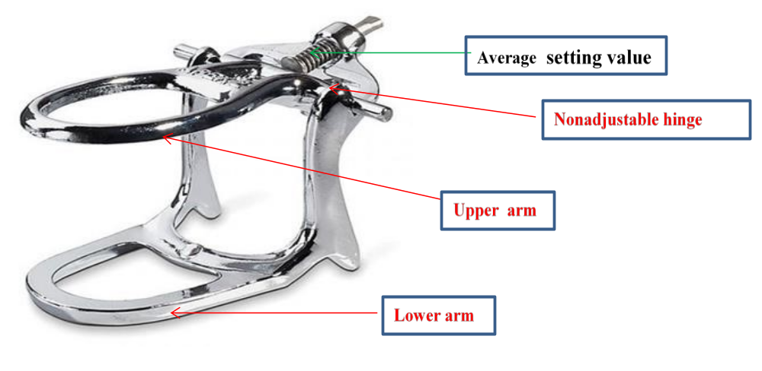
Articulators can be divided into three types:
1. Simple hinge or Small nonadjustable articulators:
It's the simplest type, consist of two members (arm) upper and lower, they are joined by a nonadjustable hinge, it can hold the casts in the centric relation and can be opened & closed only.

Slide 4
Uses of simple articulator : removable partial dentures that doesn’t need balanced occlusion it may be also used in diagnosis
Advantages:
1.Low cost
2.Easy to use
3.Average setting value
Disadvantages :- they do not represent the tempro- mandibular joint and mandibular movements ( protrusive, and lateral)

Slide 5
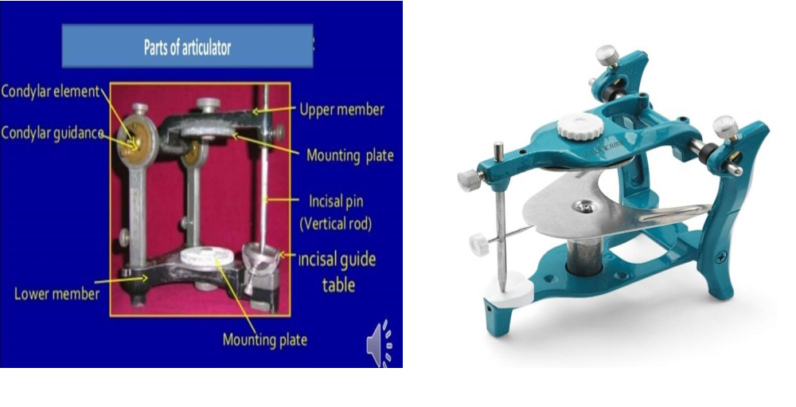
Semi –adjustable articulator :- lt consists of two members (upper & lower), these articulators have “adjustable horizontal condylar guides and incisal pin and accept both centric relation and protrusive maxilla mandibular relation records, for example, Hanau articulator .

Slide 6
Disadvantages:
1.Moderate cost
2.Not all its type represents the Bennett shaft.
3.Required more time and procedure.

Slide 7
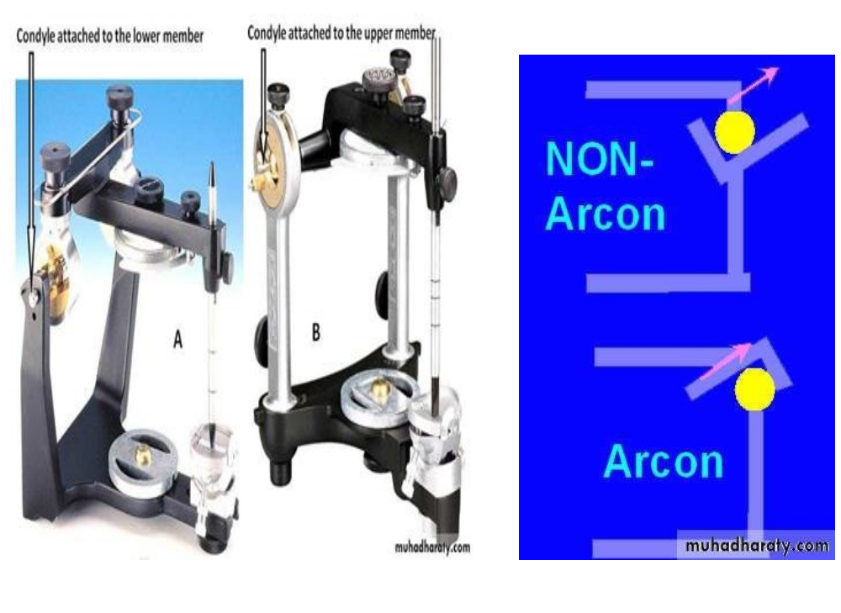
Types of Semi-adjustable articulators
They are generally. divided into 2 types:
1.ARCON: condylar elements are on the lower member of the articulator and mechanical fossa attached to the upper member
2. NON-ARCON condylar elements are placed on the upper portion of the articulator

Slide 8
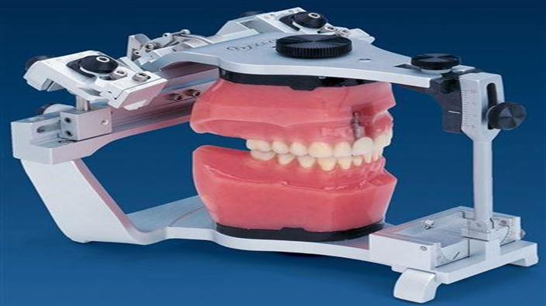
Fully adjustable articulators:
These accept not only centric relation maxilla-mandibular relation records, but also protrusive and right & left lateral maxilla-mandibular relation.
Fully adjustable articulators horizontal and lateral condylar path inclination can be obtained from the patient mouth in addition to face bow transfer. It facilitates the mounting of the cast on the articulator

Slide 9
Advantages:
Allow view close representation of the T.M.J. ( tempro -mandibular joint ) with a more accurate reproduction of condylar path and Bennet shaft
Disadvantages
1.Time-consuming to use and adjustable.
2.Require a high level of skill and understanding from both dentists and technicians
3.Expensive instrument .

Slide 10
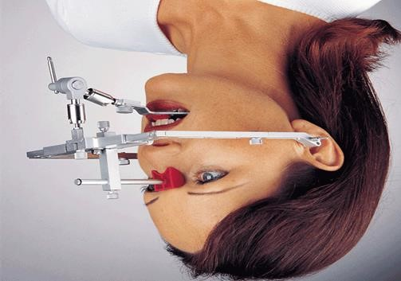
FACE-Bow :
lt is a caliper like device used to record the relationship of the maxilla to T.M.J or it's an instrument used to record the relationship of the maxillary arch and then transfer this relationship to an articulator.

Slide 11
Uses of the face-bow
1)To register the relationship of the patient's maxillary arch in three planes of space and transfer this information into an articulator that can be adjusted to simulate the patient's jaw movements .
2) Facilitate the mounting of the cast on the articulator

Slide 12
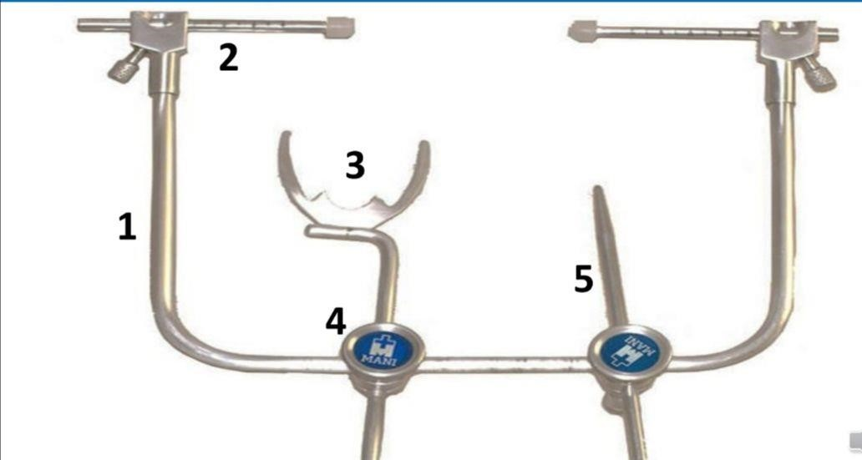
Parts of Face - bow:-
1.U- shaped frame.
2.The part that contacts the skin over the T.M.J. is the condyle rods.
3.bite fork.
4.Locking device
5.the orbital point

Slide 13


