Slide 1
partial denture lec6+7
Assit lecturer :samah khalel RADHI

Slide 2
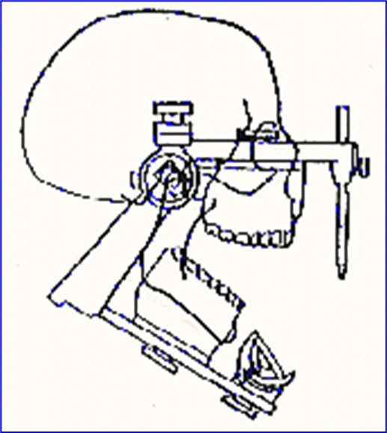
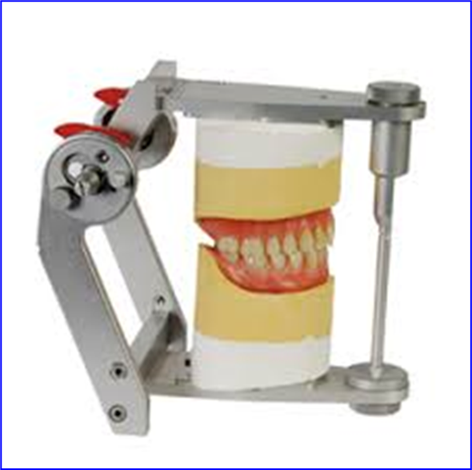
An articulator:
An articulator:
It is a hinge-like device which can be used to position the upper and lower casts in a chosen relationship to each other. There are many different designs of articulators several of which reproduce some of the movements of which the mandible is capable.

Slide 3
An articulator:
Requirement of articulator:
1.should allow protrusive and lateral motion.
2.Should hold casts in the correct horizontal, and vertical relationships
3.It should provide an appositive anterior vertical stop.
Uses of articulators: -
  1.Correct and modify the completed restoration
  2.Aid in the fabrication of dental restoration.
  3.Diagnosis of dental occlusion of both natural and artificial dentition
  4.Plan dental procedure that involves position contours and relationships of both natural and artificial as they relate to each other.
.

Slide 4
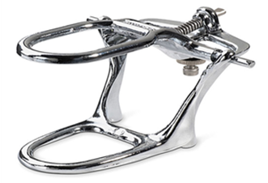
Types of articulators:
Hinge articulator:
Simple hinge articulator: this type of articulator consists of upper and lower members joined by a hinge; it accepts only opening and closing movements.
Advantages: -
Simple instrument
Cheep
Rigid
Disadvantages: -
A simple articulator is designed to accept only interocclusal that is inaccurate.
Cannot accept face bow.

Slide 5
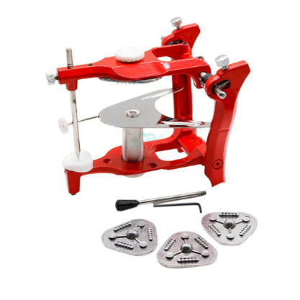
An articulator:
Semi- adjustable articulators:
This type of articulator is the most widely used articulator in dental prosthesis it consists of two members upper and lower these articulators have adjustable horizontal condylar guides and incisal pin and accept both centric relation and protrusive maxillary mandibular relation records
Advantages: -
Accept face bow record
Have adjustable condylar guidance for better dentures.
Have adjustable incisal guidance.
Disadvantages: -
require more time and procedure.
moderate cost.

Slide 6
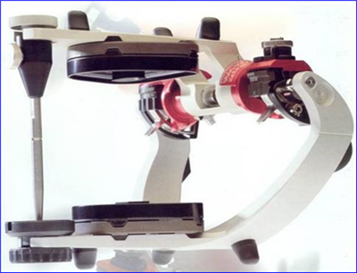
Mounting
Fully adjustable articulators:
This type of articulator is more complex than a semi-adjustable articulator and more expensive. This produces all movement (opening, closing, protrusive, lateral movement).
Advantages:
Allow very closed representation of TMJ with more accurate reproduction of condylar path bennet shift.
Disadvantages:
1.Time-consuming to use and adjustable.
2.Require a high level of skill and understanding
from both the dentist and technician.
3.Expensive instrument.

Slide 7
An articulator:
Definition of mounting
Laboratory procedure by which the upper and lower base plate and rims with there casts are attached to the articulator and then the teeth are set up in centric occlusion.
Requirements of Mounting:
The articulator should be clean and incisal pins should be given zero reading.
The mounting table should be fixed to the articulator.

Slide 8
Mounting of the upper cast
Mounting of the upper cast:
The midline of the upper cast should define and drown on the cast.
The midline is determined as the midline of the incisive papilla.
V-shaped notches are cut on the base of the cast to help in laboratory remounting.
Separating medium should be applied to the base of the cast for easy separation (light coat from cold mold seal)
The occlusal rim and record base should be well seat to the cast and then sealed by wax to the cast.
The midline of the upper bite rim should be lined to the centric of the cross on the mounting table and posterior the cast should be properly centralized on the table.
Enough space should be present between the articulator to accommodate the mounting plaster.
The plaster should be mixed according to the correct water powder ratio and applied over the cast and the upper jaw member closed, the incisal pin should touch the incisal table.

Slide 9
Mounting of the lower cast
Mounting of lower cast according to centric relation record.
The lower occlusal rim is properly related to the upper according to the record taken from the patient mouth.
Care should be taken that there is no interference posteriorly between the upper and lower casts.
Seal the lower cast to the lower occlusion rim.

Slide 10
Errors of mounting:
Errors of mounting:
Record bases are not properly seated and secured to the casts during the mounting procedure.
Occluding rims not keyed for correct orientation.
Wrong transference of midline to the articulator which means shifting of midline.
Movement of the cast during mounting.
Incisal pin not properly screwed.
Interference of the cast posteriorly

Slide 11
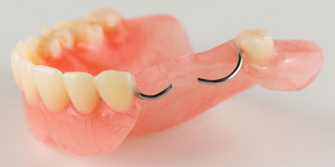
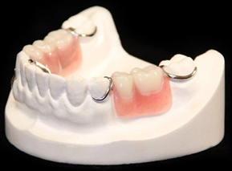
Clasp assembly
The clasp is part of a removable partial denture that acts as a direct retainer and or stabilizer for a prosthesis by partially contacting an abutment tooth.

Slide 12
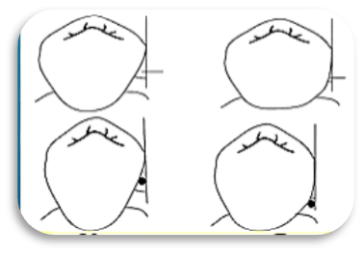
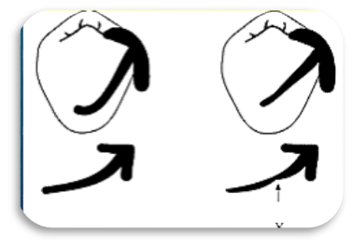
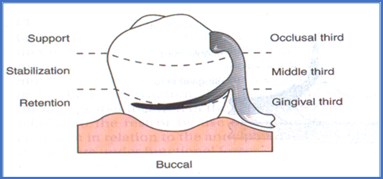
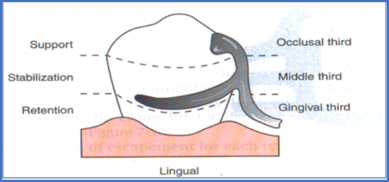
1.The size of the undercut or the angle of cervical convergence will determine How far into that angle a given clasp arm will be placed.
2.The position of the survey line; reciprocal arm should be placed occlusal to the high of contour because rigid elements are placed in desirable undercut area it will become an area of interference during placement and removal

Slide 13
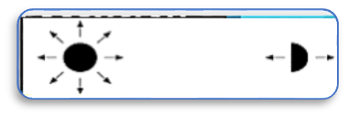
The flexibility of the clasp arm depends on:
It’s the length measured from its point of origin to its tip as long as the clasp it will be more flexible.
It’s the diameter of the clasp arm.
It’s cross-section which is whether round or half-round.
4.The type of material in which the clasp is made of a cast gold alloy, cast chromium-cobalt alloy, wrought wire or titanium.

Slide 14
The function of the clasp arm:
1.Stabilization:
From the arm located the apical portion of the mid-third of the crown.
2.Reciprocation:
The arm is located from the apical portion of the middle third of the crown.
3.Retention:
From the arm located in the gingival third of the crown in measured undercut (retentive arm or flexible arm)

Slide 15


