Slide 1
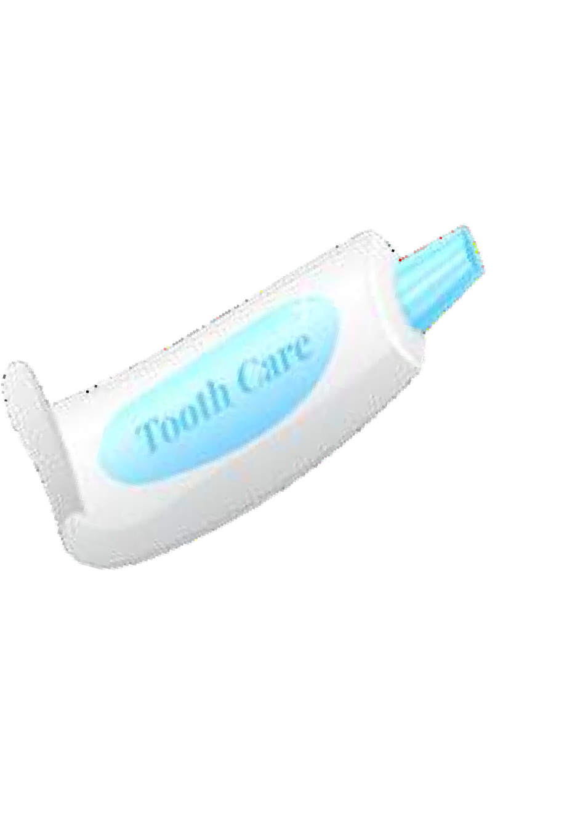

Selection and setting of the teeth , flasking

Slide 2
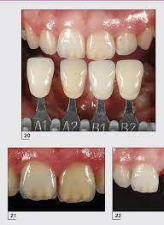
Selection of Anterior teeth:
In routine case a shade of teeth taken by watching the natural teeth to a shade guide- (it’s very important in anterior teeth)
The mold (shape/Anatomy) can be selected by the laboratory technician from standing teeth on the cast.
If all six anterior teeth have been lost, selection of teeth will be depend on following factors:-
Width of teeth will be determined by the length of saddle area.
Length of teeth determine by lip length and facial movement.
Shape of teeth is determine by shape of face
(square, taper, oval) according to it)
The texture (kind of patients skin determine the surface texture of the tooth

Slide 3
The mold (shape/Anatomy) can be selected by the laboratory technician from standing teeth on the cast.
If all six anterior teeth have been lost, selection of teeth will be depend on following factors:-
1.Width of teeth will be determined by the length of saddle area.
2.Length of teeth determine by lip length and facial movement.
3.Shape of teeth is determine by shape of face
(square, taper, oval) according to it)
4.The texture (kind of patients skin determine the surface texture of the tooth

Slide 4
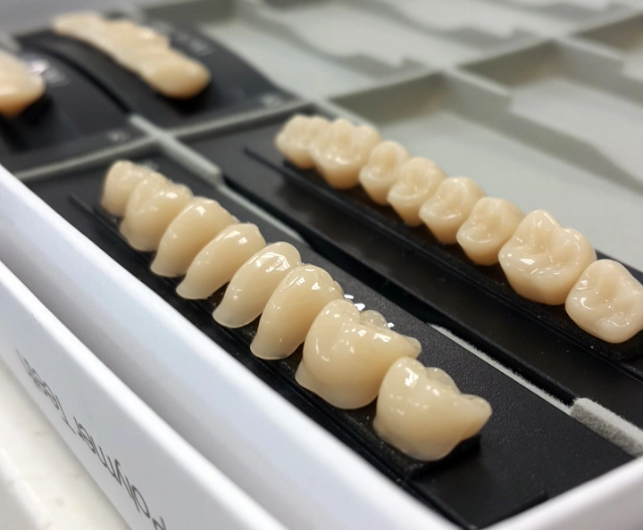
Selection of Posterior teeth
Posterior teeth usually selected by laboratory staff according to the length of saddle and occlusion.

Slide 5
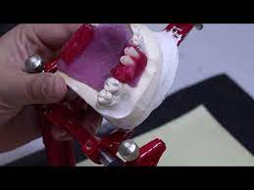
Setting of teeth
Before setting we should mount the upper cast to articulator by a mean of face bow, than use partial denture.
To mount the lower cast in centric occlusion which must be coincide with centric relation of the Jaw. Setting of teeth is difficult in partial denture and it need some experience in selecting type and number of teeth to place in the saddle.

Slide 6
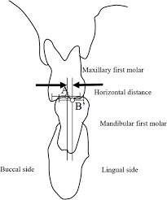
Factor which should consider in Arrangement of teeth
1.Balanced articulation
It means teeth will be in contact in all closed jaw relation, this is done in order to distribute the masticatory load over as wide area as possible.
2.Buccolingual position:- artificial teeth should be position in the saddle area in a similar manner like a stable position of natural teeth because it will be subjected to the same pressure form the toung on one side and form other side.

Slide 7

3.Antro-Posterior relation:- Its very important to provide an adequate occlusion antro Posteriorly so in most case we need to a grinding of teeth during arrangement

Slide 8
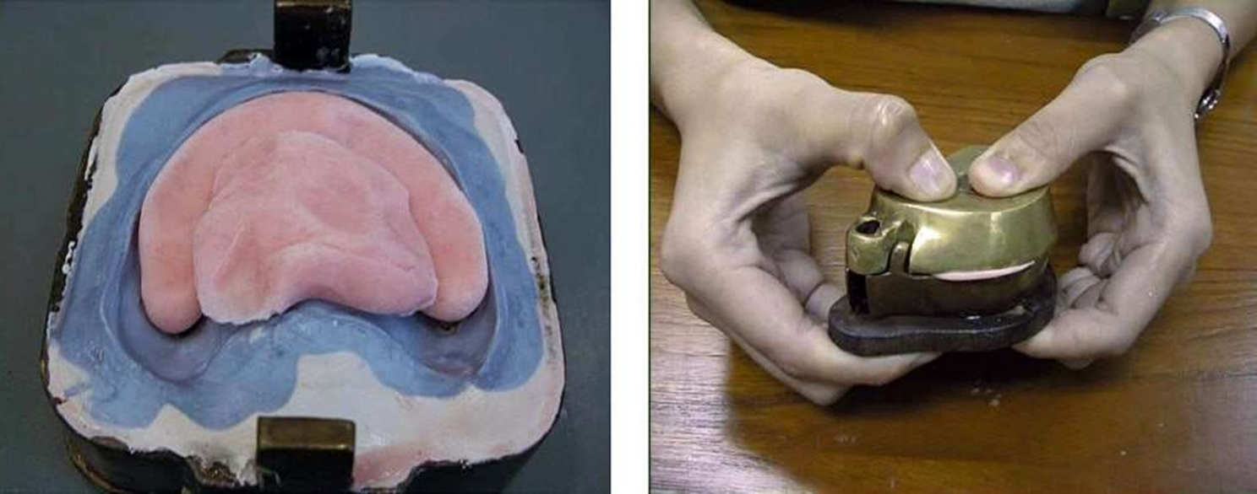
Flasking :Is the process of investing the cast with the waxed denture in a flask to make a sectional mold that is used to form the acrylic resin denture base.

Slide 9
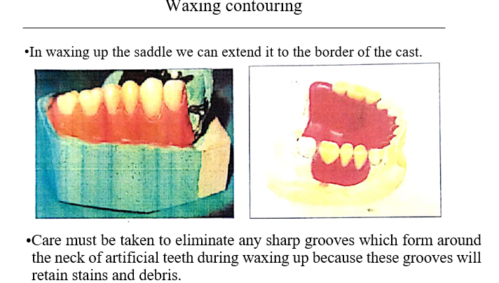

Slide 10
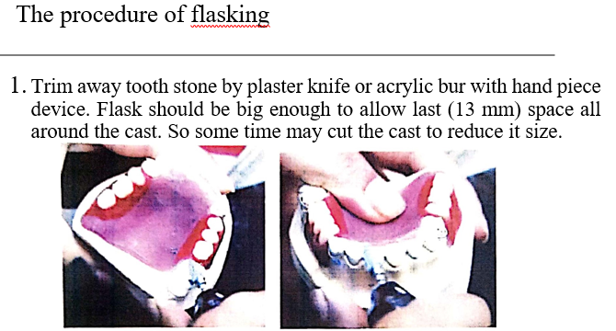

Slide 11
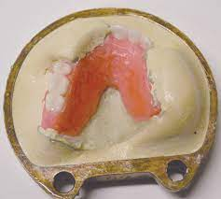
2.The cast is embedded in the shallow section of the flask then mixed plaster, the cast being with the level of the metal flange of the shallow section of flask the all the cast (tooth stone, clasp wire and other stone surface of the cast) should be covered by mixing of plaster.

Slide 12
3.Plaster must be smoothed after the initial set also a metal surface of the flask completely cleaned.
4.Separating solution or Vaseline is painted over the plaster if desired tinfoil can be applied over the wax surface of the denture.

Slide 13
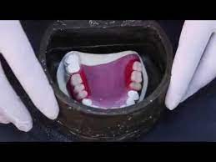
5.The tops of the teeth are covered with a mixture of stone to a depth of (6 mm) this should be carefully painted to prevent bubbles by using vibrator device.
6.The top (deep section) (upper part) of the flask is added and then filled with either plaster or a mixture (1 : 1) stone and plaster which is preferable to eliminate

Slide 14
7.Close the flask with its cover. Then put the flask in the bench press about 1 hour to ensure that the cover will be parallel with the base also bench intimate contact to prevent plaster going throughout press wake as sure the two sections of the flask become in intimate contact to prevent plaster going throughout which lead to changes in occlusion of the finished denture

Slide 15


